Slide 1
Prospectus
Invest in UK University R&D
Zero carbon energy in the Midlands

Slide 2
Forge the future of zero carbon energy with universities in the Midlands

Slide 3
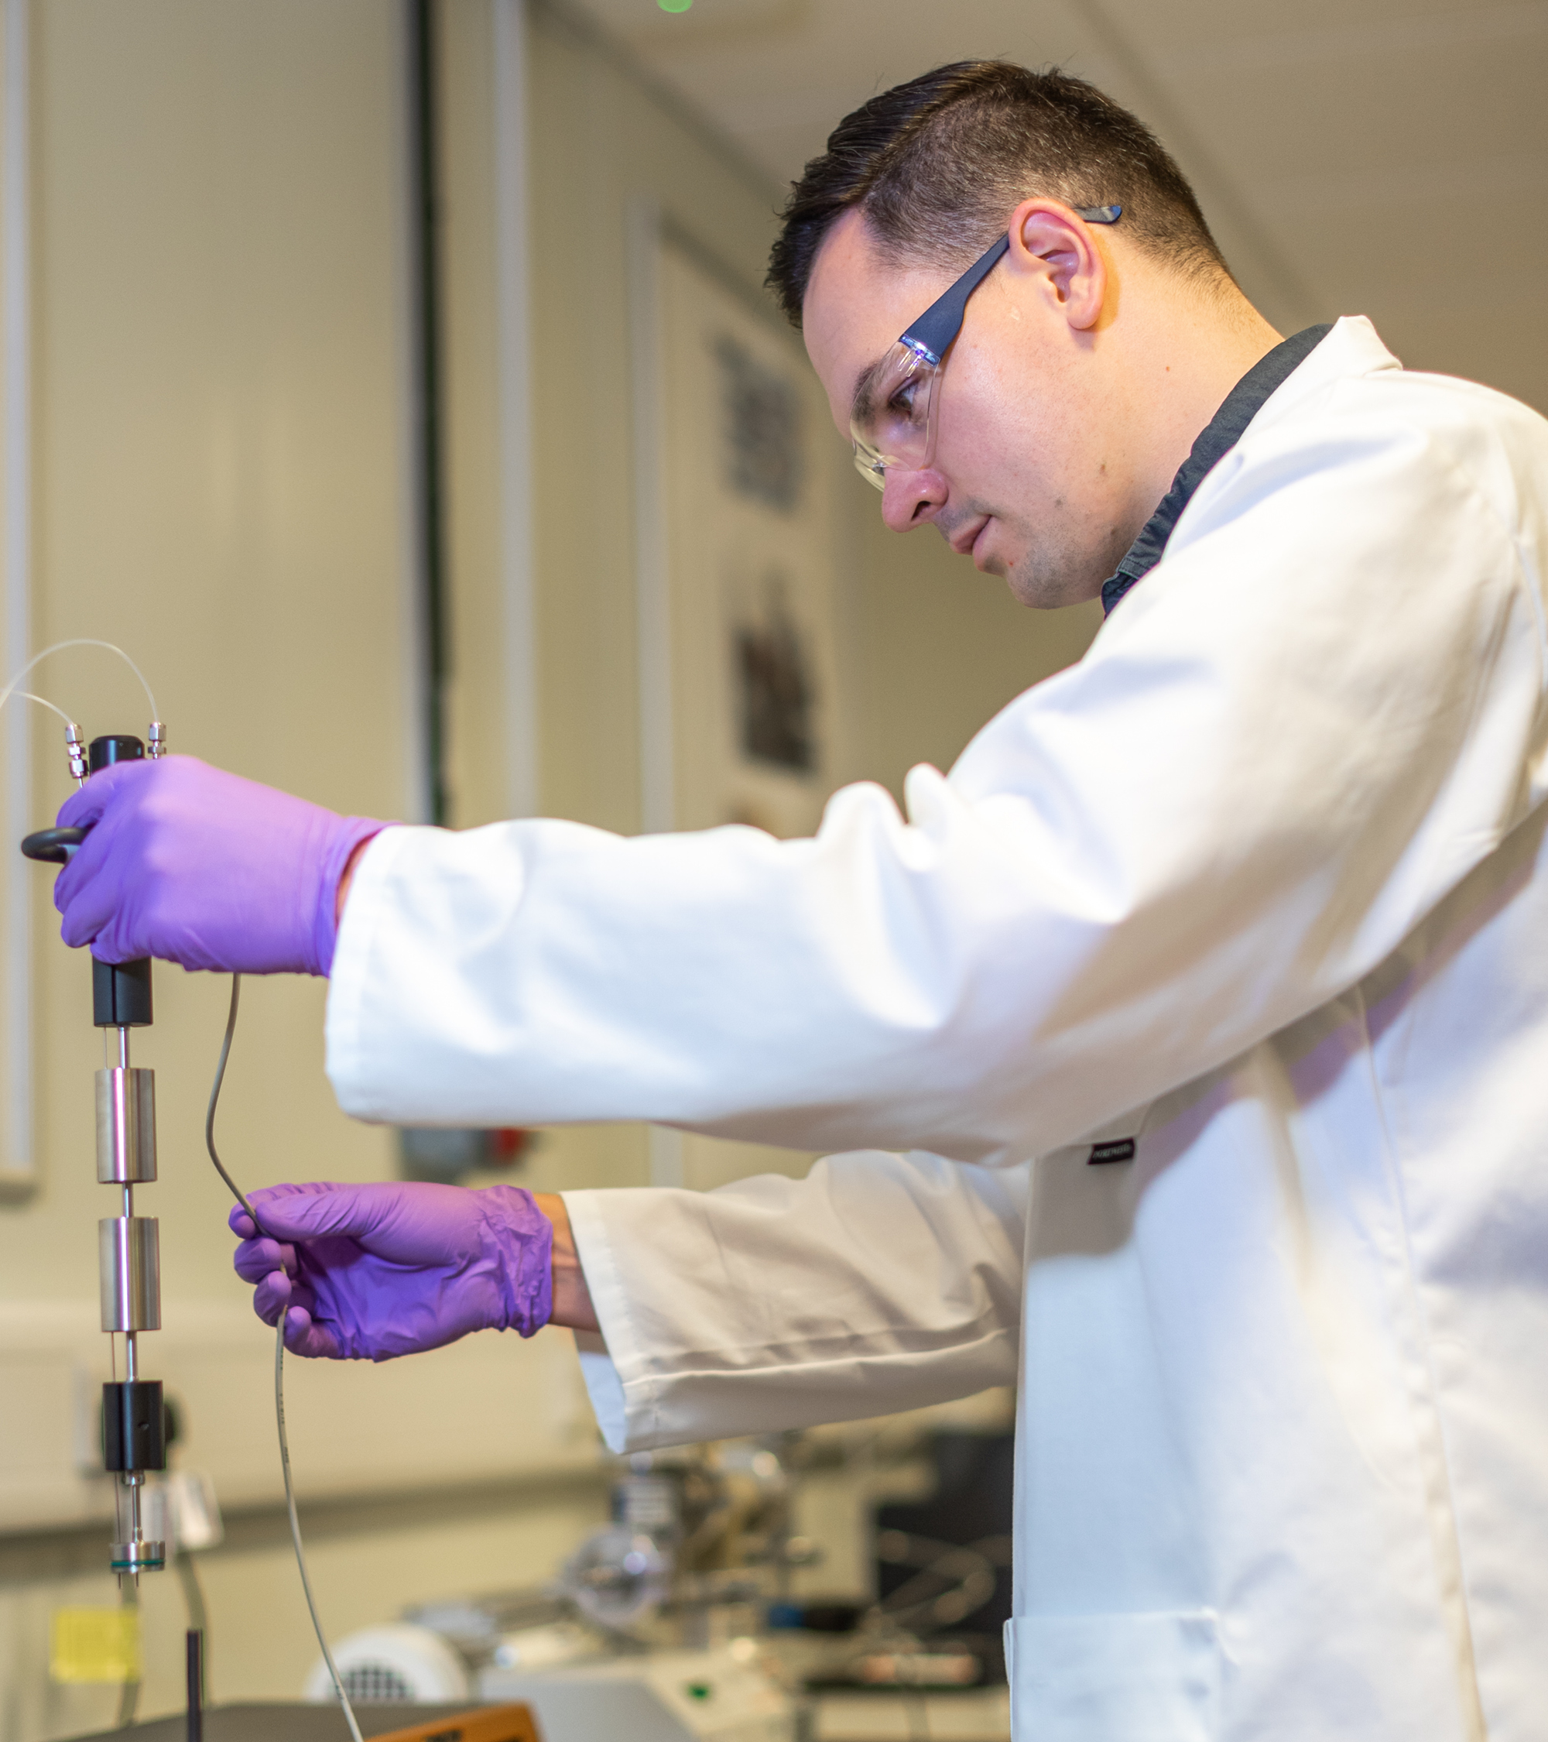
The Midlands is home to a great zero carbon energy cluster. For over a century, the Midlands has developed technologies, and pioneered new ways of generating energy for homes, businesses, schools and hospitals. One in four of all energy and low carbon jobs, in England, are in the Midlands.

Slide 4
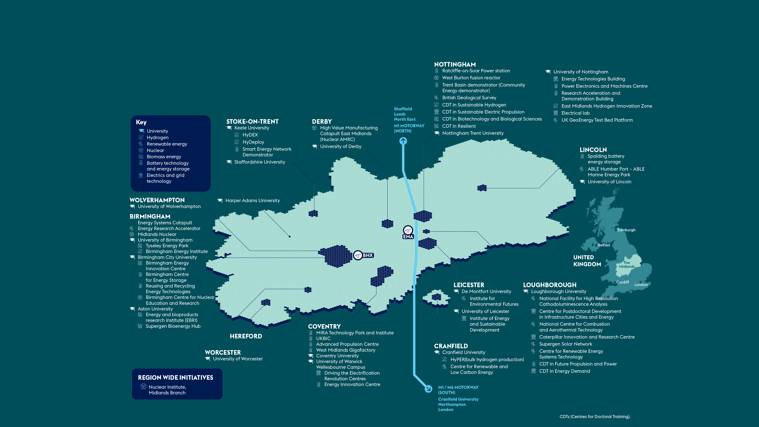
Universities and Zero Carbon technologies in the Midlands – major R&D assets

Slide 5
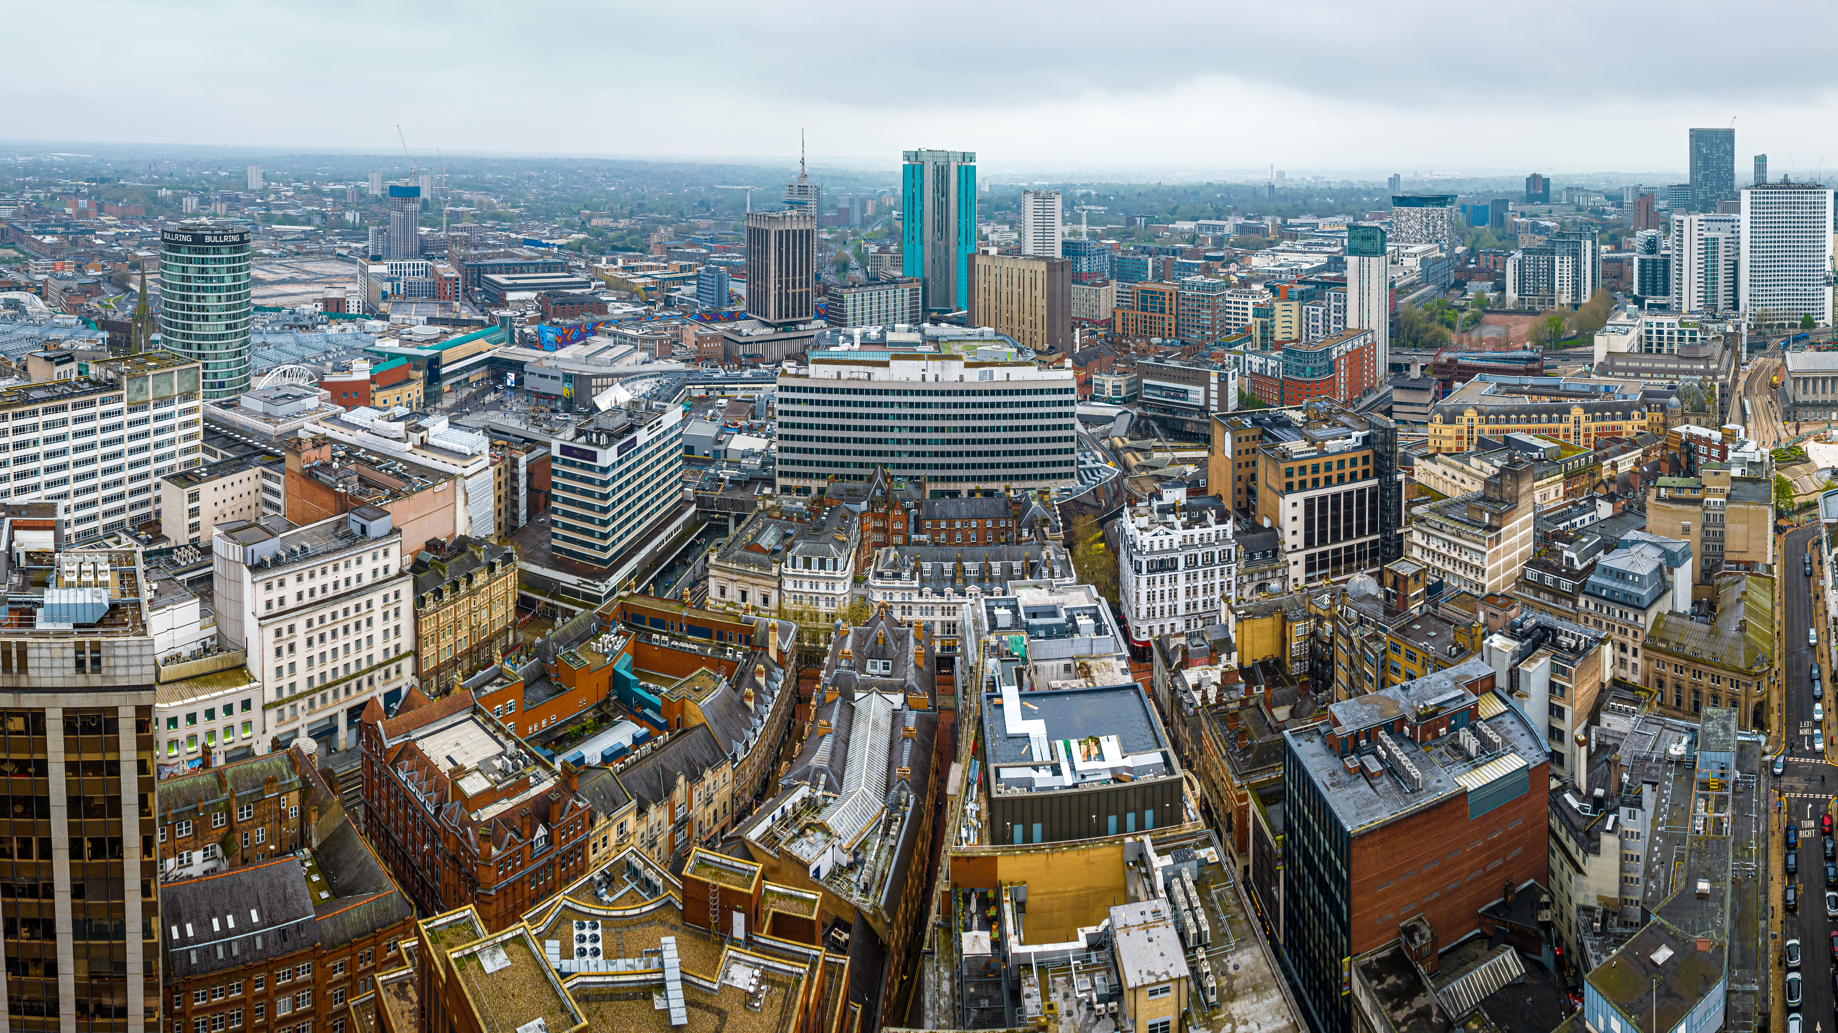
Science and innovation pedigree
At the heart of the Midlands’ science and innovation landscape are its world-class universities. Midlands Innovation (MI) is a partnership of eight research-intensive universities in the Midlands region of England: Aston University, University of Birmingham, Cranfield University, Keele University, University of Leicester, Loughborough University, University of Nottingham, and University of Warwick. The collective of universities has £4bn revenue, 15,000 academics, 50,000 postgraduates and are one of the most efficient producers of world class research in the UK with 40% more world class science than Oxford or Cambridge.

Slide 6
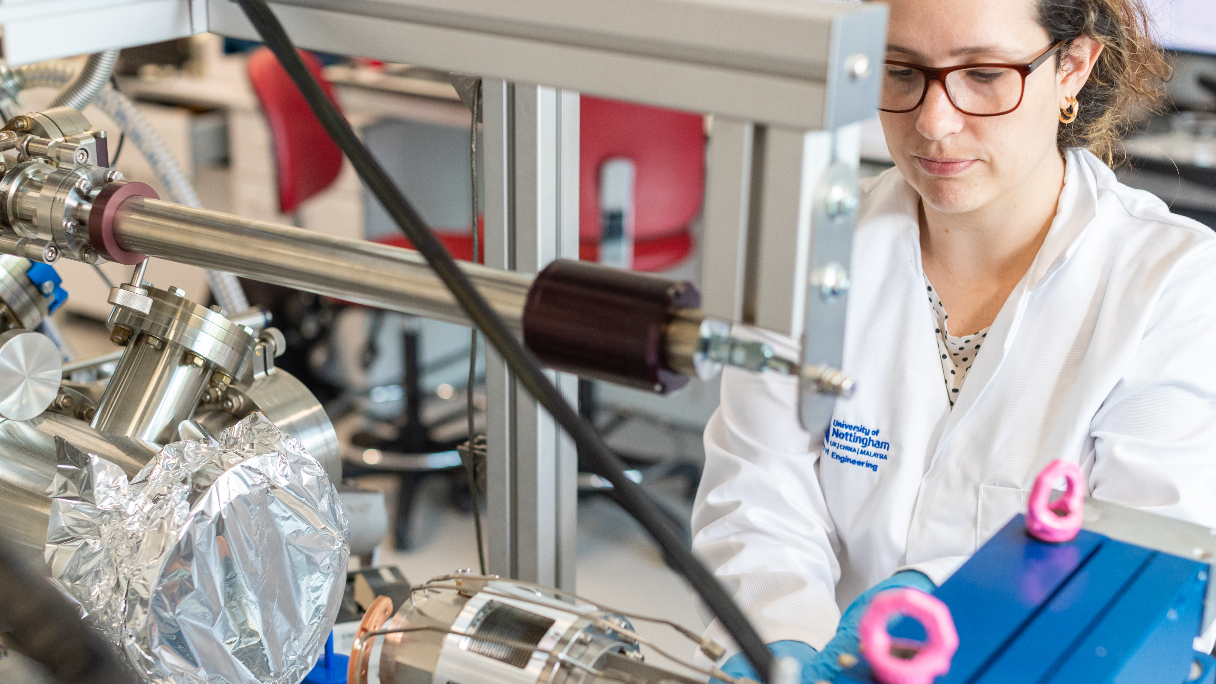
World-leading zero carbon energy strengths in the Midlands

Slide 7
Biomass
Bioenergy, or biomass, is currently the second largest source of renewable energy in the UK, generating 12.9% of UK electricity supply in 2021 – roughly the equivalent of four Sizewell B nuclear plants. When combined with carbon capture and storage, biomass has the potential to deliver negative emissions; the Midlands can be pivotal in the UK’s goal to reach net zero carbon emissions by 2050.
Biomass generates the same amount of electricity each year as four Sizewell B nuclear powerplants – over 12% of UK generating capacity
Biomass generating capacity at the Tyseley Energy Park generates sustainable power equivalent to the needs of 17,000 local homes.
The Supergen Bioenergy Hub recently received £5m to further its pioneering research into sustainable bioenergy systems that support the UK’s transition to an affordable, resilient, low-carbon energy future.

Slide 8
Hydrogen
Hydrogen is essential to delivering a carbon free energy sector. As the manufacturing heartland of the UK, the Midlands has the experience and capacity to address the necessary inputs for hydrogen production and delivering net zero.
The Midlands Engine Hydrogen Technologies Strategy could deliver: 167,000 new or safeguarded jobs
£10bn of additional Gross Value Added (GVA) and a 29% reduction in CO₂ (17m tonnes).
Transport for West Midlands aims to have over 120 hydrogen fuelled buses on the road by 2024.

Slide 9
Nuclear
Nuclear energy, and new nuclear technology will be a core part of the future zero carbon energy sector. In 2020, 16% of the UK’s electricity came from nuclear power plants in 2020, second only to gas. The government’s Energy Security Strategy plans to significantly accelerate nuclear generating capacity to 24GW by 2050. This represents 25% of projected electricity demand.
The world’s first nuclear fusion plant could be built in the East Midlands;
Almost 5,000 people work in the civil nuclear sector in the Midlands.
Rolls Royce are developing the world’s first Small Modular Reactor, supported by £210m from the Advanced Nuclear Fund.

Slide 10
Renewables
Currently only 37% of the electricity generated in the UK comes from renewable sources. Electricity demand is projected to double by 2050 and this, combined with carbon reduction targets, means a four-fold increase in clean electricity generation is needed. The Midlands consumes 16% of Great Britain’s electricity and has 19% of England’s total installed renewables capacity, with wind, solar and bio-energy being the most significant sources.
The UK’s offshore wind fleet is due to more than treble in size by 2030. Based on existing deployment, this could mean that over 3 million homes in the Midlands are powered by offshore wind by 2030, reducing emissions by 4.2 megatonnes of CO₂.
Lincolnshire hosts the world’s biggest offshore windfarm, generating 18% of England’s renewable generating capacity.
Solar power on rooftops in the Midlands alone could reduce greenhouse gas emissions by 187 kilo-tonnes of CO₂.

Slide 11
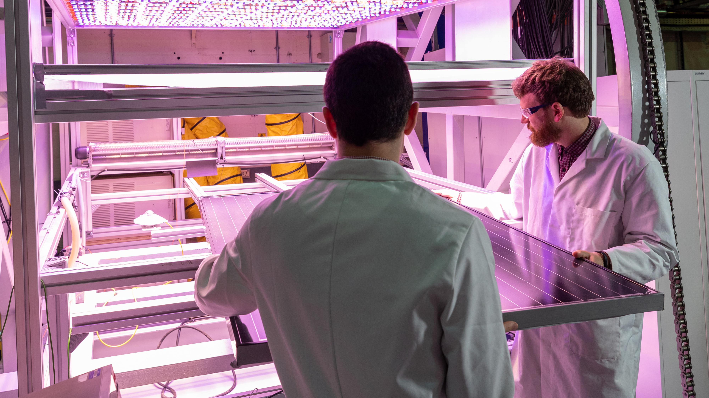
Enablers of research and development in zero carbon energy

Slide 12
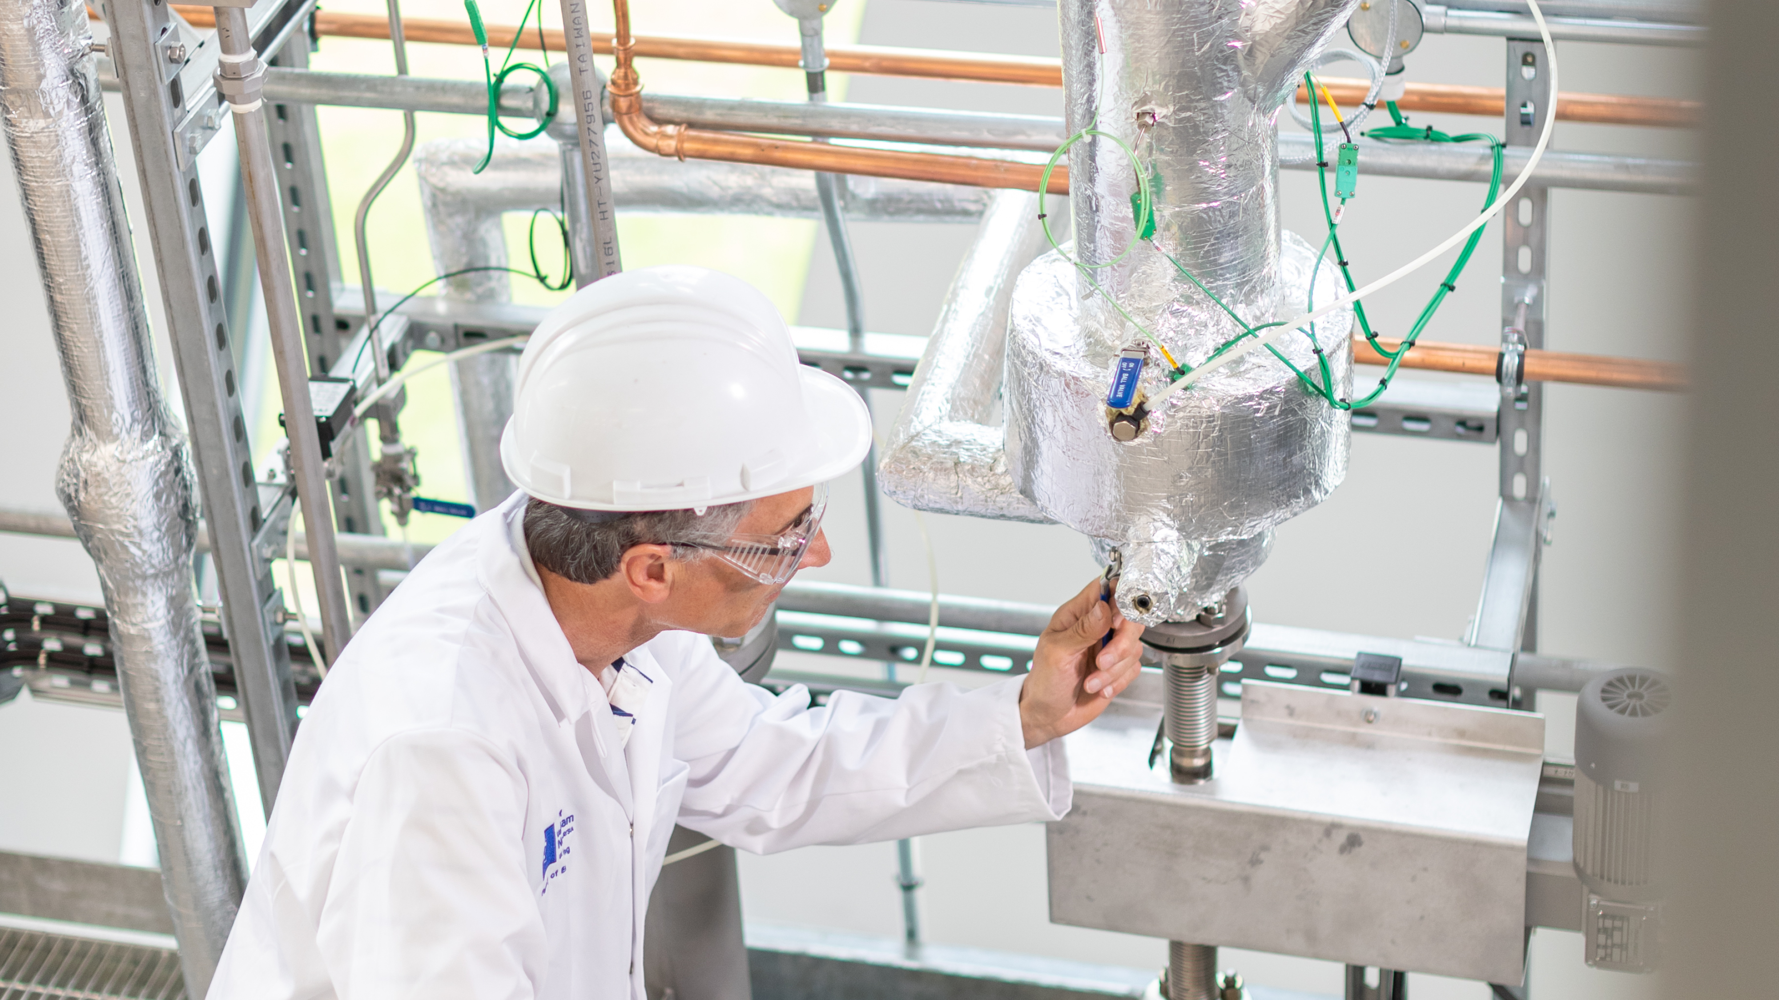
Battery technology and energy storage
The Midlands’ low carbon economy is worth £12 billion and growing. The Midlands hosts a number of research centres dedicated to driving the transition to net zero.
30% of renewable electricity generated in the Midlands
comes from wind, and 25% from solar.
The UK Battery Industrialisation Centre is a £130m, 20,000m² facility supporting battery manufacturing in the UK.

Slide 13
Smart grid technology
The UK’s energy system is changing at an unprecedented pace to meet its economy-wide net zero target by 2050.
With a steady deployment of smart grids by 2050, the Midlands could see:
A reduction of approximately 80% of CO₂ emissions compared to 1990 levels.
Up to £9bn in cost savings.
Additional GVA of £1.5bn.
1,400 new jobs.

Slide 14
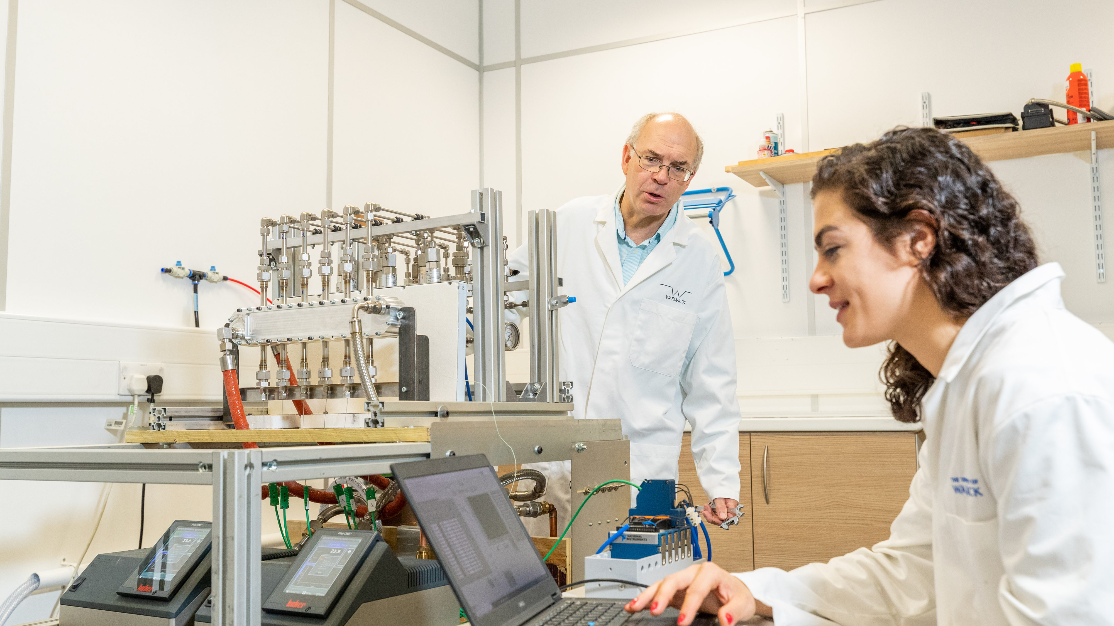
Invest in a partnership with Midlands universities

Slide 15
Research translation
Universities in the Midlands have an exceptional track-record of working with the world’s largest companies, helping translate fundamental research into industry-leading innovations in the transition to net zero.
The University of Warwick
and the University of Nottingham are both in the Top 5 recipients of the £885m of Innovate UK Funding allocated across the UK in the last 10 years.

Slide 16
Innovation
Midlands universities have been supporting the innovation eco-system of their local and regional economies for decades. If your business is looking to access innovation support chains, our dedicated support programmes, funding and networks can help you do this. Through co-funded Government schemes like Knowledge Transfer Partnerships (KTPs), which is one of the most successful, long-running innovation schemes anywhere in the world, we help businesses of all sizes to innovate using the knowledge and expertise of UK universities.
Case study
The Energy Systems Catapult, based in Birmingham was set up to accelerate the transformation of the UK’s energy system and ensure UK businesses and consumers capture the opportunities of clean growth on the way to Net Zero. The Catapult is an independent, not-for-profit centre of excellence, funded by Innovate UK, that bridges the gap between industry, government, academia and research.

Slide 17
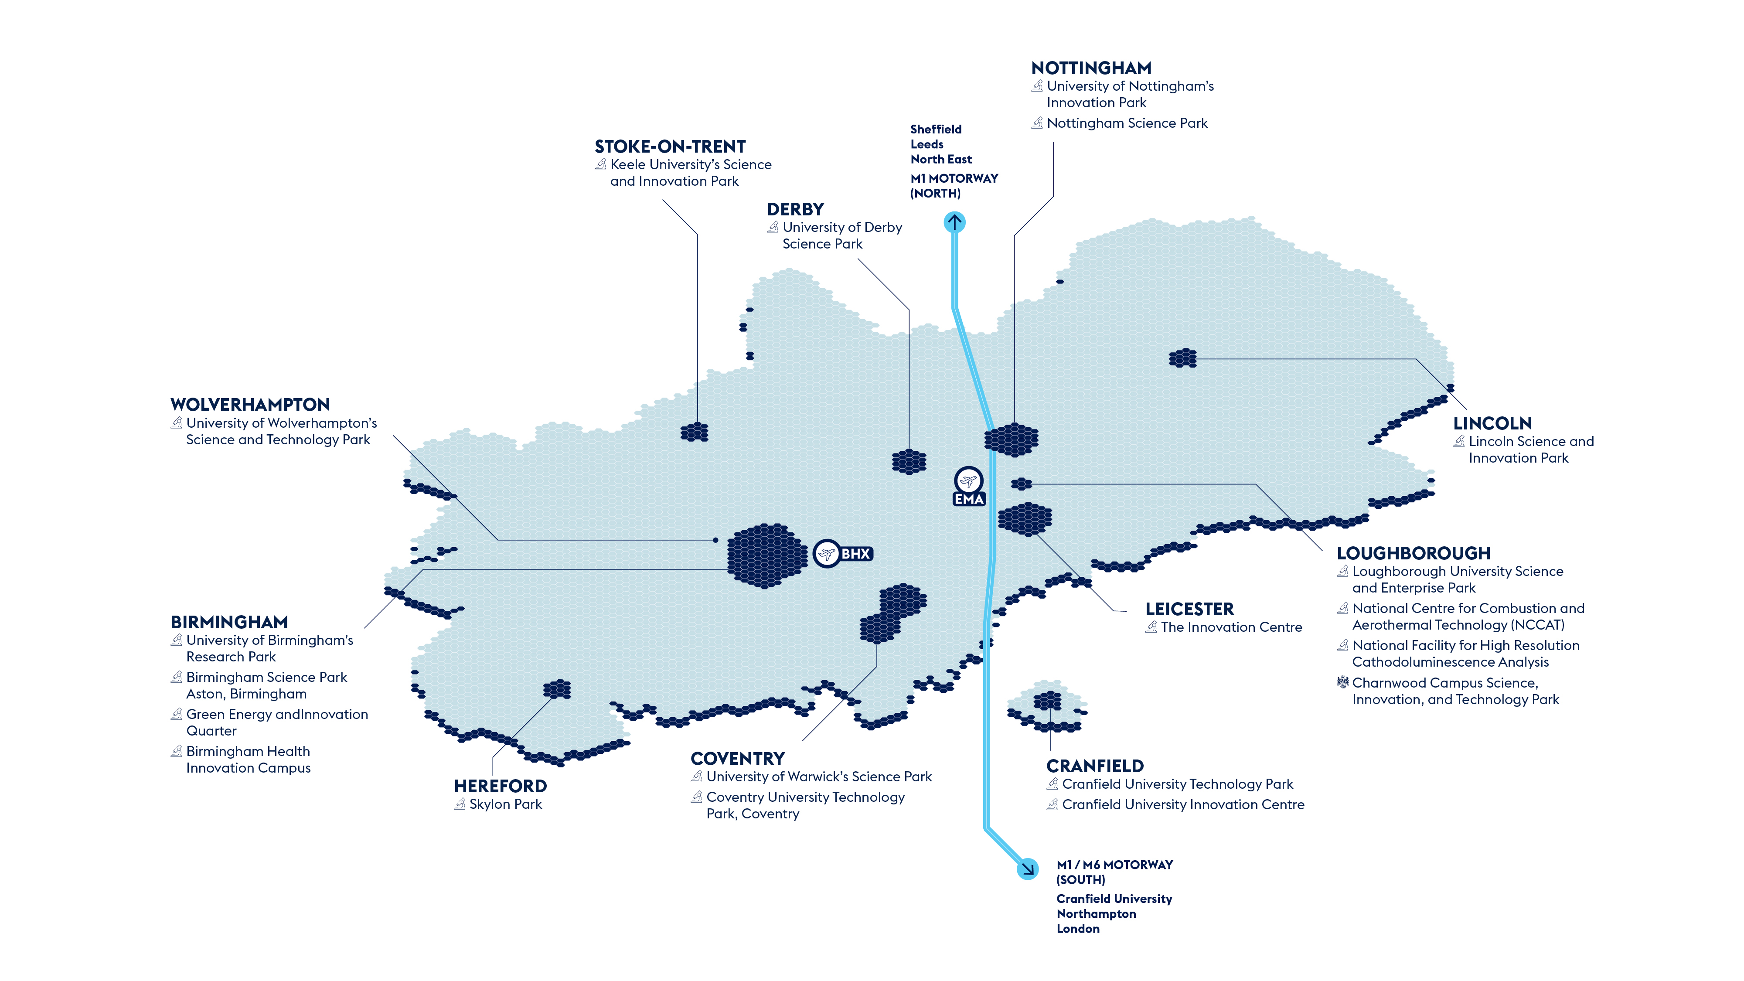
Co-location

Slide 18
Regeneration and integration
Universities across the Midlands work in partnership with the UK and Local Government to help drive economic growth through innovation and inward investment. Through a range of public-private partnerships, universities are involved in over 20 major economic development opportunities identified by the Midlands Investment Portfolio, worth over £10bn in Gross Development Value. In the West Midlands, universities work with the Combined Authority and Growth Company to work on a range of projects as a part of one of only three UK Innovation Accelerators.

Slide 19
Talent
Home to 20 universities, the Midlands hosts over 350,000 students and 100,000 graduates a year. Our universities will work in partnership with local economic growth organisations to develop tailored skills and training package – from degree apprenticeships, to dedicated training and skills programme, to industry-funded PhDs – to support the growth of future industries and your business.

Slide 21
Midlands Mindforge - £250m patient capital fund combining the spinout portfoliosof eight leading UK universities
Midlands Mindforge is an ambitious, patient capital investment company aiming to transform ground-breaking science and technology into successful businesses with the potential to positively impact our world and accelerate the commercialisation of research from our partner universities - Aston, Birmingham, Cranfield, Keele, Leicester, Loughborough, Nottingham, and Warwick.
By providing capital and company-building skills to university spinouts and early-stage IP rich businesses in the Midlands, we will build the foundations of a new technology eco-system in the region and create companies that can drive economic growth whilst delivering real-world impact.
enquiries@midlandsmindforg

Slide 22
Midlands Mindforge - £250m patient capital fund combining the spinout portfoliosof eight leading UK universities
Midlands Mindforge is an independent company that aims to raise up to £250m from strategic corporate partners, institutional investors and qualifying individuals.
Mindforge will “invest with impact” to found and scale transformational science backed companies in sectors such as Clean Technologies, AI and Computational Science, Life Sciences and Health Tech, to create highly skilled jobs and support the UK’s ambition to become a science and technology superpower.
enquiries@midlandsmindforg

Slide 23
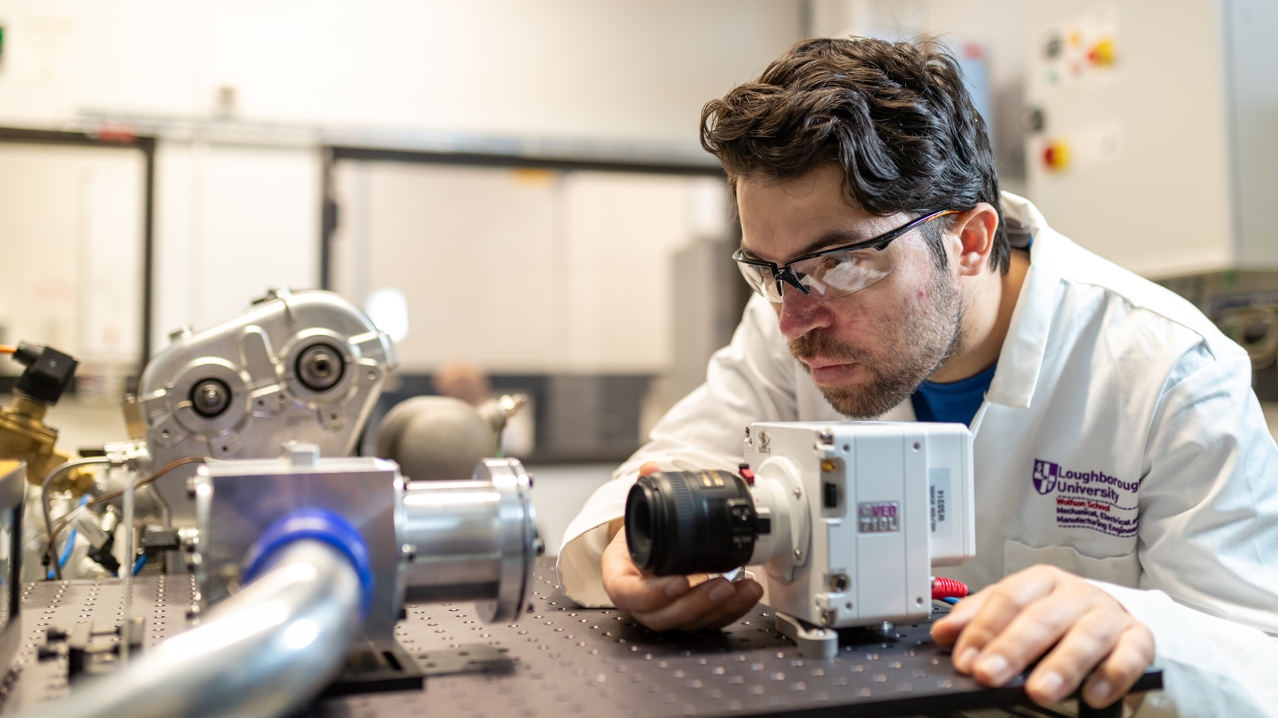
Directory of key zero carbon energy R&D assets across the Midlands

Slide 24
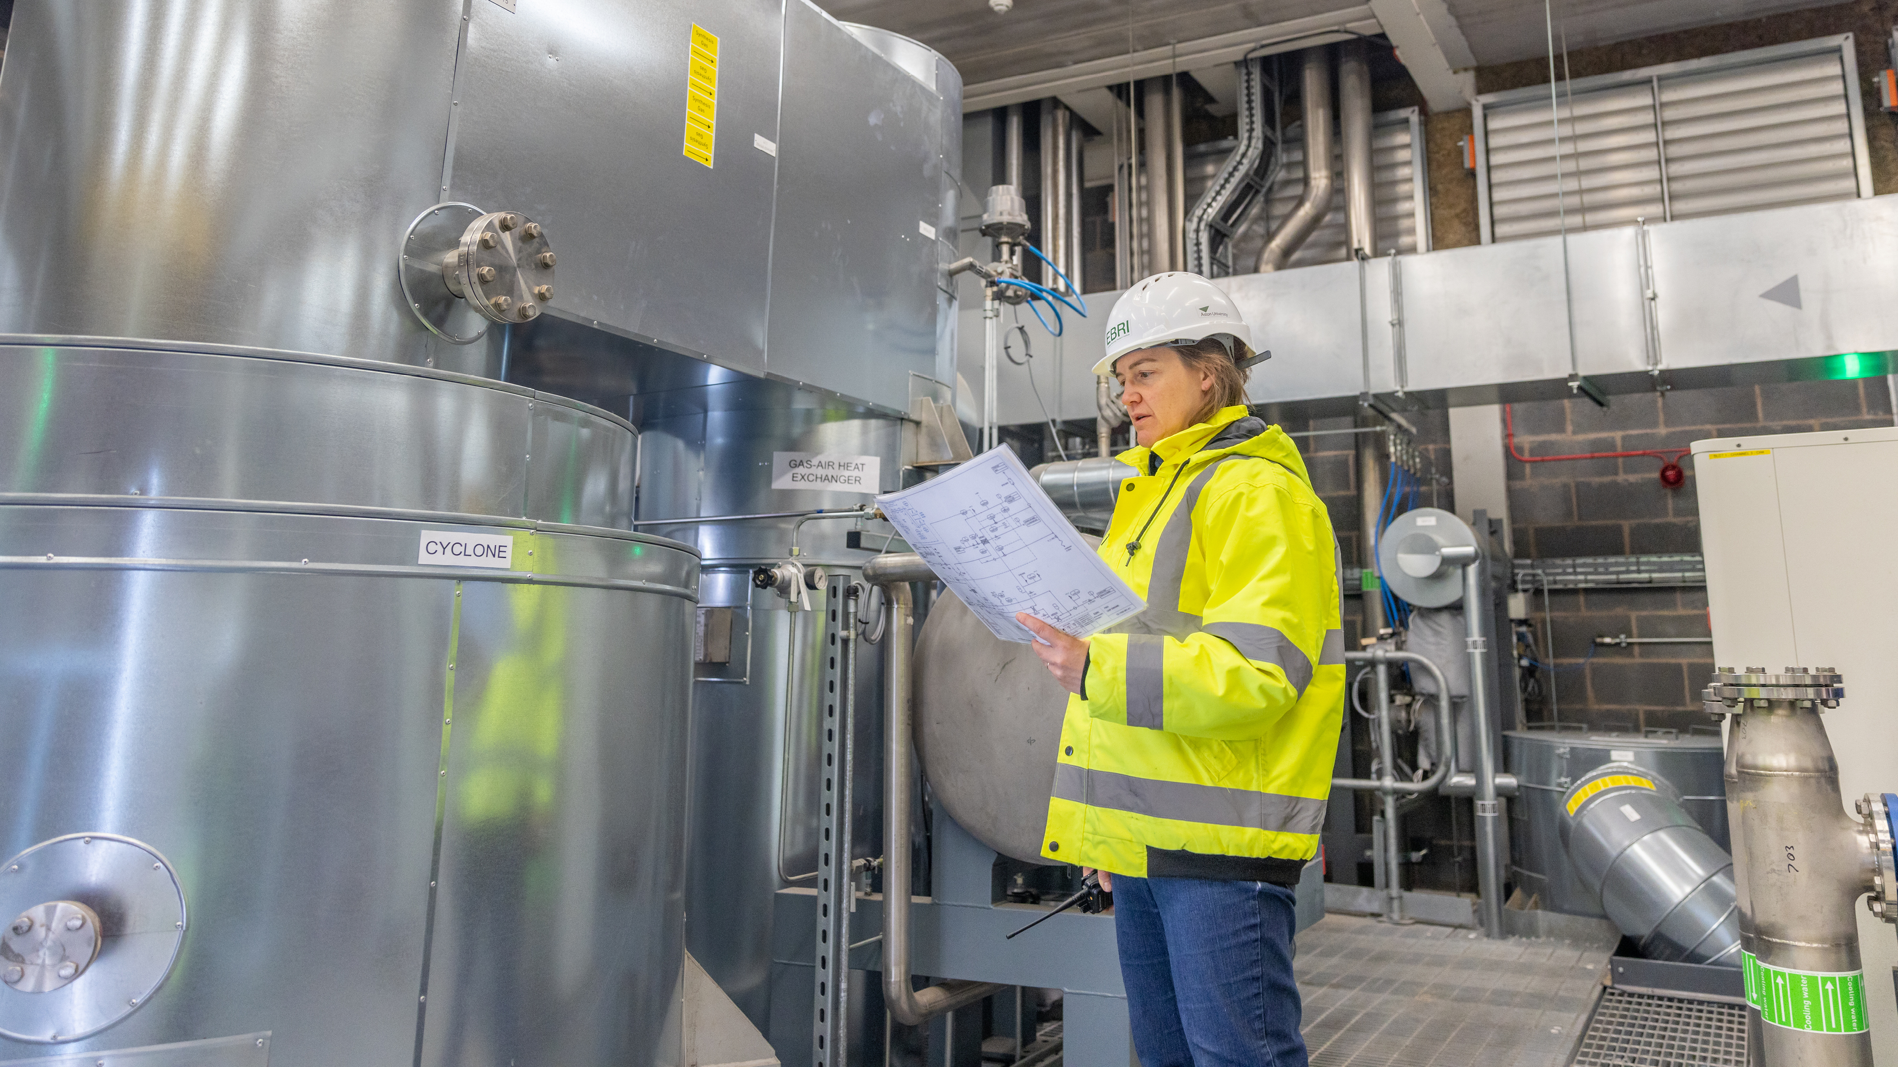
Sectors
Biomass
Businesses can work with a range of research and development facilities, which can help them translate their research, innovate their product, or co-locate to access research facilities and a skilled community of experts.
Aston University – Energy and Bioproducts Research Institute
The EBRI is the result of a £20 million investment to support the development of a regional bioenergy supply chain. The EBRI has four core objectives in supply chain development: characterise feedstocks and products; measure conversion/technology performance; model process energetic, economic, and environmental performance; and integrate expertise in supply chains, markets, policy and regulation.
Investor support
Research assets
University based
Training

Slide 25
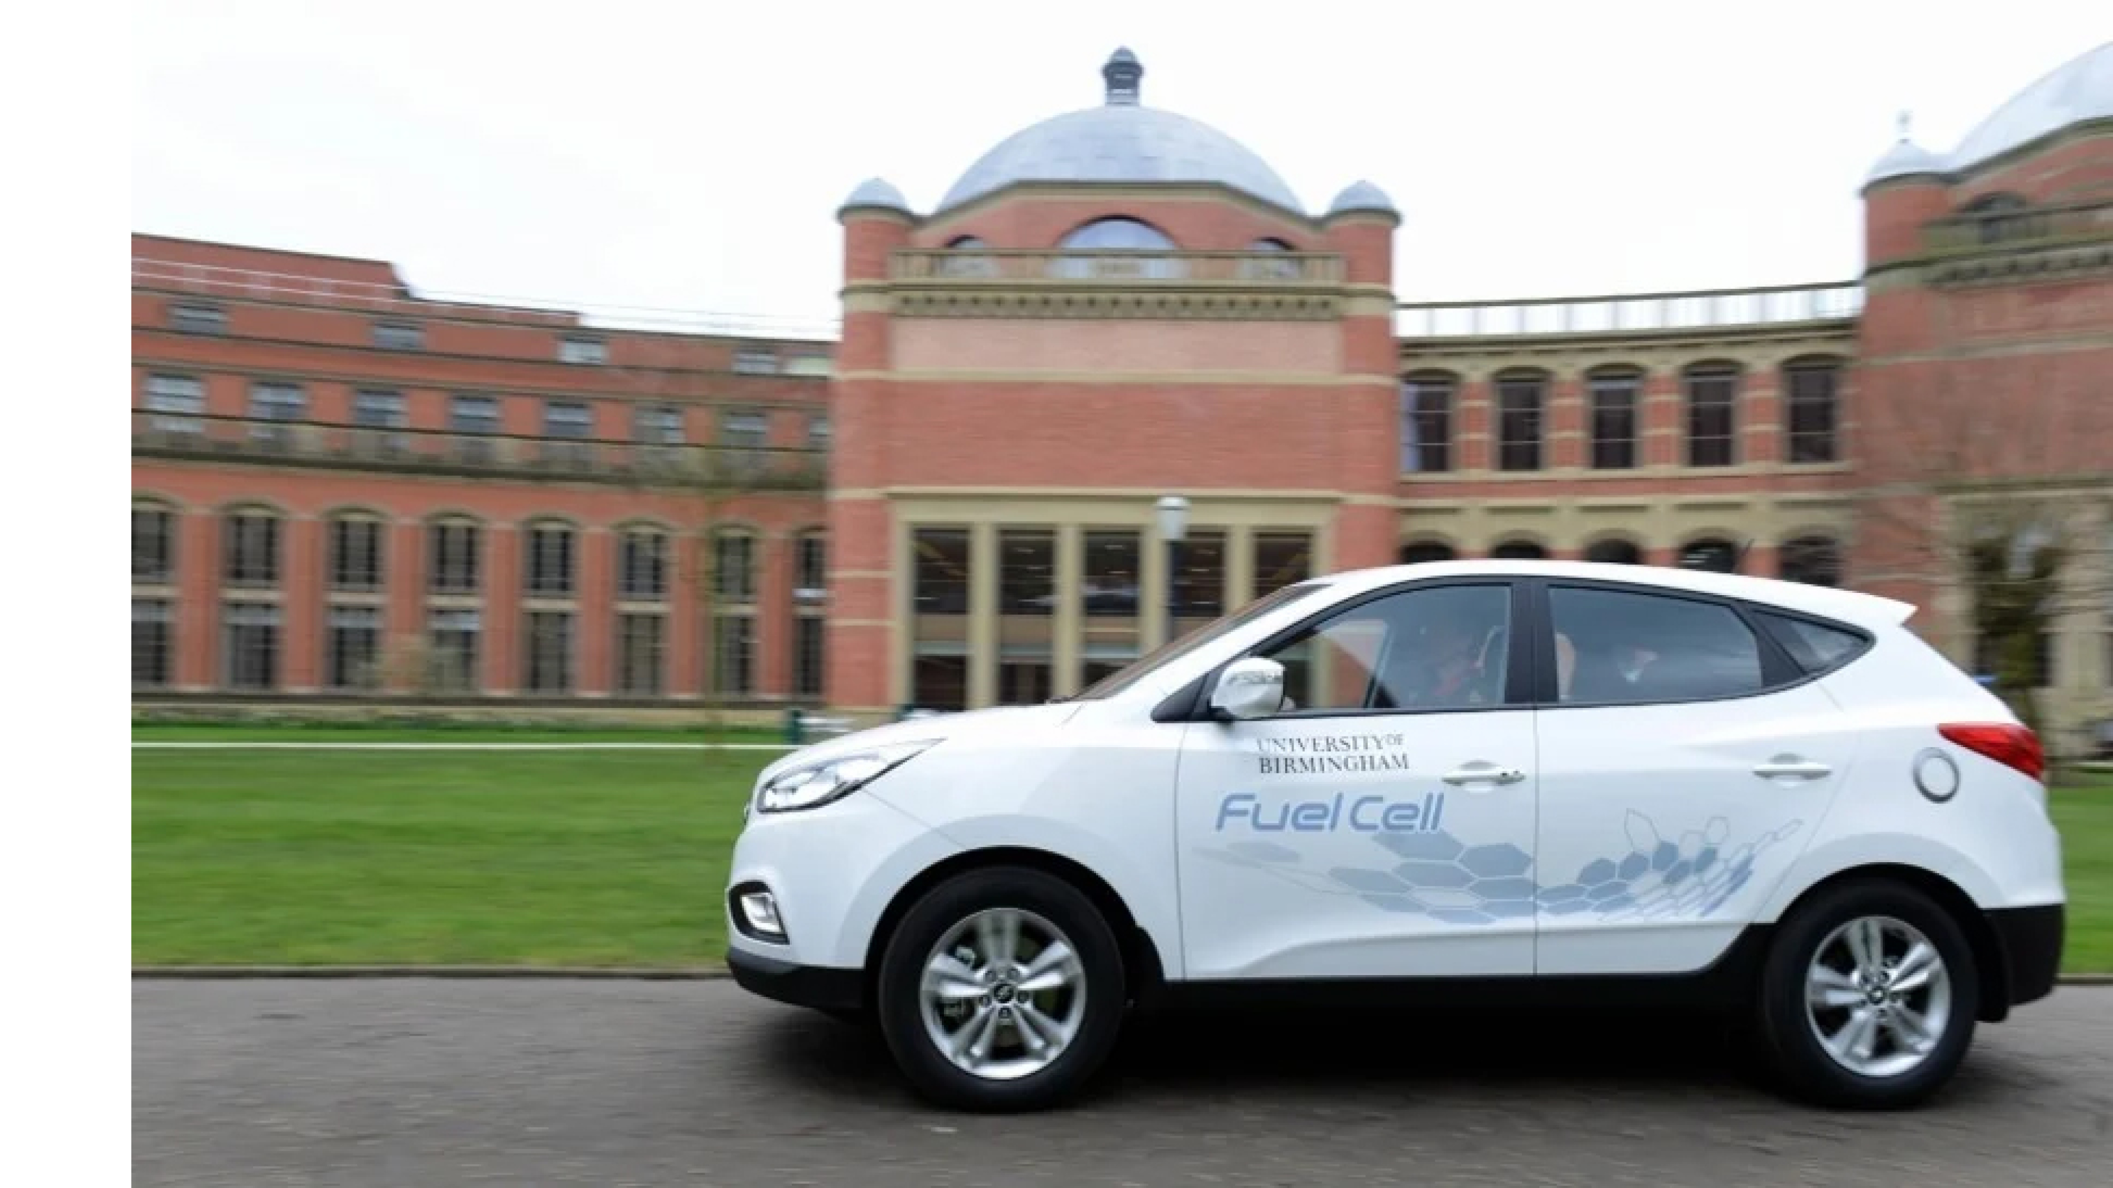
Sectors
Hydrogen
University of Birmingham – Centre for Fuel Cell and Hydrogen Research, BEI
As a part of the Birmingham Energy Institute, the Centre for Fuel Cell and Hydrogen Research focuses on research and development, applications and demonstrations of fuel cell and hydrogen systems and technologies.
Home to a number of global businesses innovating in hydrogen, the sector offers a range of opportunities for investors to grow their business.
Investor support
Research assets
University based
Training

Slide 26
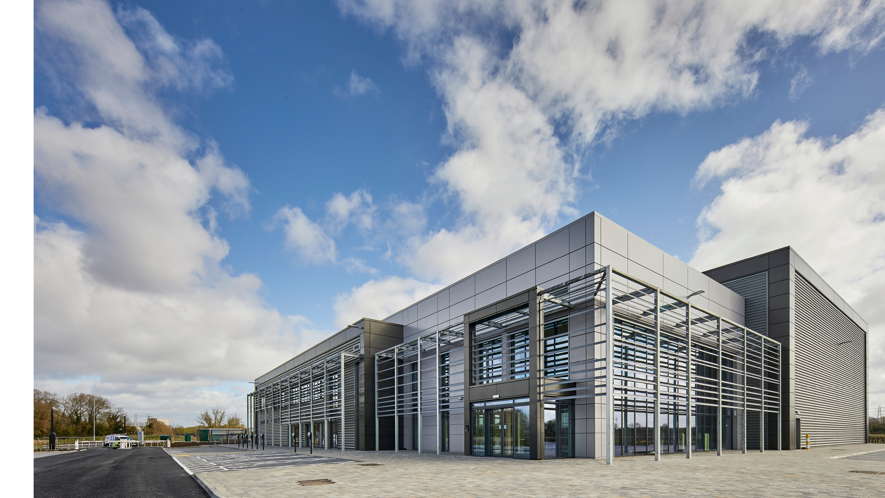
Sectors
Nuclear
University of Derby – High Value Manufacturing Catapult, Nuclear AMRC
The University of Derby is a member of the Nuclear AMRC, part of the High Value Manufacturing Catapult, a hub designed to transform manufacturing for the modern era by bringing together business, research, and government. In 2020/2021, £486 million of research and development took place, with almost 6,000 partners and over 2,000 commercial projects.
With a skilled workforce of 5,000 people across the civil nuclear industry in the Midlands, the sector is focused around the Rolls Royce nuclear cluster in the East Midlands, with a further grouping located in the West Midlands.
Investor support
Research assets
University based
Catapults and other research collaboration opportunities
Cluster organisations

Slide 27
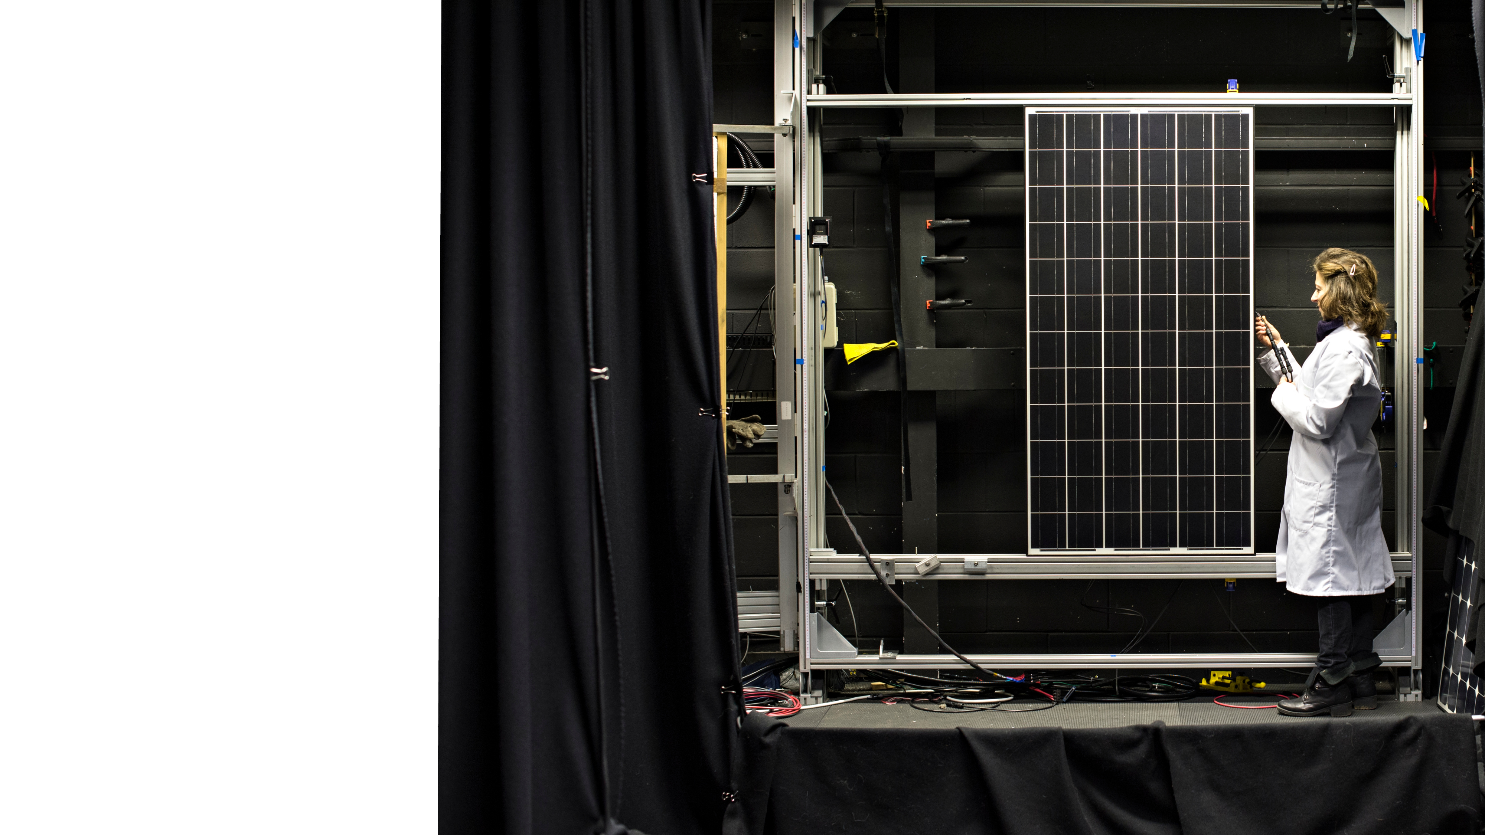
Sectors
Renewables
The Midlands is leading the way in renewable energy production and is home to the world’s biggest offshore windfarm in Lincolnshire, providing 18% of England’s renewables capacity.
Loughborough University – SuperGen SuperSolar Hub
Loughborough University’s National Facility for High Resolution Cathodoluminescence Analysis is a multi-million resource to advance knowledge of how solar cells work at the atomic level. Its researchers lead work modelling the atomic structure of thin film PV; develop new functional coatings; explore PV device degradation; monitor system performance; and investigate cost effective, efficient manufacturing processes.
Investor support
Research assets
University based
Catapults and other research collaboration opportunities
Cluster organisations

Slide 28
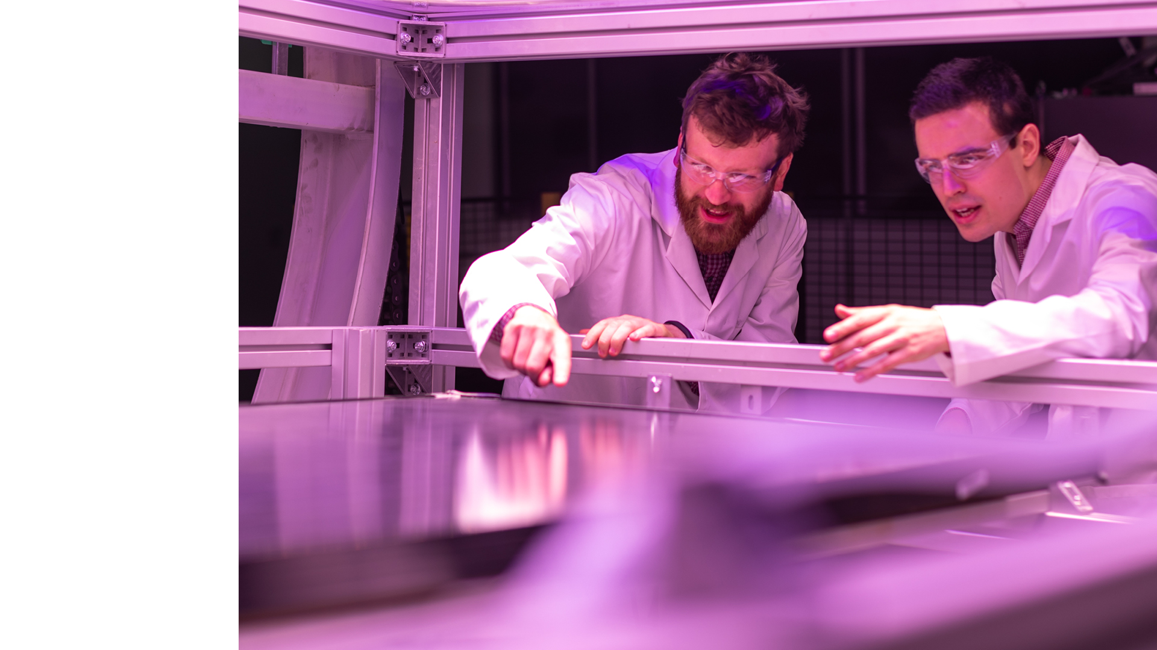
Enablers
Battery technology and energy storage
Research assets
University based
Catapults and other research collaboration opportunities
Cluster organisations
University of Warwick – Energy Innovation Centre
The Energy Innovation Centre supports research and development into the entire battery life cycle. Initially built with a £50 million award from the Government, it has since received an additional £20 million of funding to expand its facilities. Facilities include cutting edge laboratories; a dry room for cell assembly; equipment for characterisation work at cell, module and pack levels; innovative charging infrastructure and second-life evaluation facilities; a material scale-up line; and the UK’s first openly accessible 1MW pack test facility to support larger testing projects for motorsport and aerospace companies. There are now 20 different laboratories working side-by-side.
Investible opportunities

Slide 29
Enablers
Electrics and grid technology
University of Nottingham – Power Electronics Machine Centre
The PEMC is a purpose built centre for the Power Electronics, Machines, and Control research group from a total £23.5 million of investment from various sources. There are three purpose-built labs: High Power, Power Electronics, and Drives. The research group is internationally renowned and one of the largest in its field with 19 academic staff, 60 research fellows, and around 70 PhD students. Research themes include power electronic systems, electrical machines, electric motor drives and systems, and power electronic integration. The Centre delivers high-impact teaching, research and industrial collaborations.
Research assets
Training

Slide 30
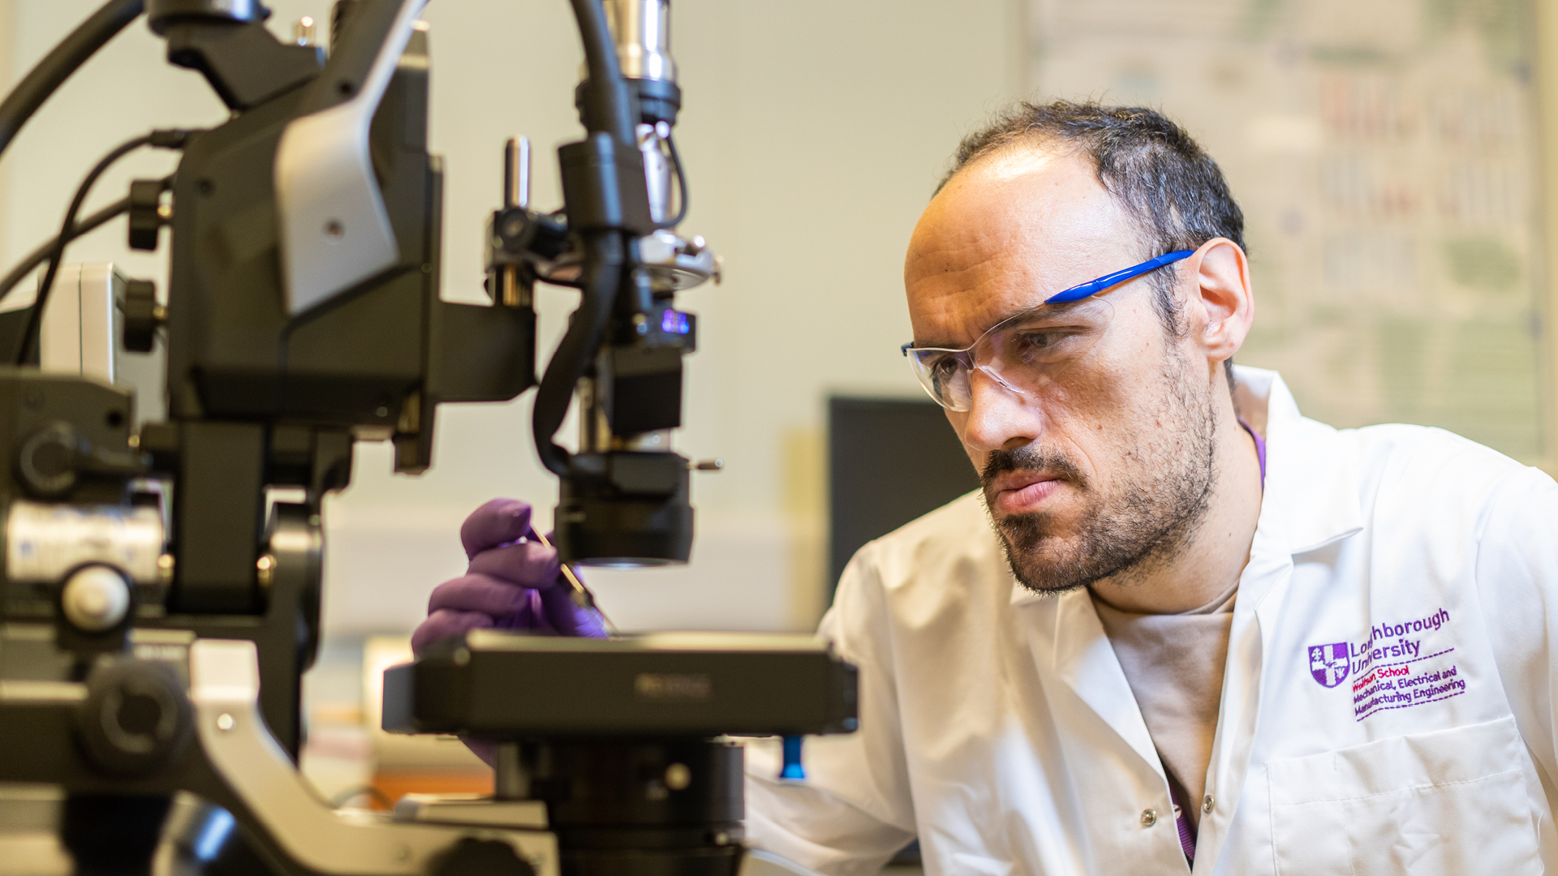
Work with us

Slide 31
Our universities
From the Midlands, 90% of the UK’s population and businesses are less than a four-hour drive away; 45% of heavy rail freight and 33% of heavy road freight comes from, goes to, or passes through the Midlands and, with the advent of HS2, London will be less than an hour away. By air, the Midlands is home to two international airports – Paris is just a 90 minute flight away – with access to the seaports of the Humber. The Midlands are home to 11 million people, 15% of the UK’s GVA, and the only inland freeport. This is critical to dispersing the output of the Midlands and accessing the potential markets of not only the wider UK, but Europe and international buyers. The region is constantly growing with new development sites and spaces for bespoke builds, including labs, test spaces, and offices.

Slide 32
Directory of contacts across the Midlands
University | Business engagement and Technology Transfer | Careers service
Aston University | rke@aston.ac.uk | employerteam@aston.ac.uk
University of Birmingham | info@enterprise.bham.ac.uk | recruiters@contacts.bham.ac.uk
Coventry University | ei@coventry.ac.uk | talentteam@coventry.ac.uk
Cranfield University | business@cranfield.ac.uk | cranfieldcareers@cranfield.ac.uk
De Montfort University | businessservices@dmu.ac.uk | employerliaison@dmu.ac.uk
University of Derby | businessgateway@derby.ac.uk | employerteam@derby.ac.uk
Harper Adams University | reception@harper-adams.ac.uk | careers@harper-adams.ac.uk
Keele University | gateway@keele.ac.uk | gateway@keele.ac.uk
University of Leicester | redenterprise@le.ac.uk | employer.services@le.ac.uk
University of Lincoln | enterprise@lincoln.ac.uk | careers@lincoln.ac.uk
Loughborough University | innovation@mailbox.lboro.ac.uk | employer.services@lboro.ac.uk
University of Nottingham | workwithus@nottingham.ac.uk | recruiterservices@nottingham.ac.uk
Nottingham Trent University | workingwithyou@ntu.ac.uk | talent@ntu.ac.uk
University of Warwick | ventures@warwick.ac.uk | employerconnect@warwick.ac.uk
University of Wolverhampton | engage@wlv.ac.uk | theworkplace@wlv.ac.uk
University of Worcester | researchforbusiness@wor.ac.uk | careers@worc.ac.uk

Slide 33
Energy Research Accelerator – at the forefront of energy innovation
ERA’s research priorities are focused on:
Energy and the built environment
Energy generation and systems
Transport and mobility
Sustainability and people
Decarbonisation of industry
For more information about the Energy Research Accelerator and to find out how it can support you with energy innovation, visit www.era.ac.uk or email enquiries@era.ac.uk
The pioneering Energy Research Accelerator (ERA) brings together 1,400 researchers in eight internationally-recognised research universities from the Midlands region (Aston, Birmingham, Cranfield, Keele, Leicester, Loughborough, Nottingham and Warwick) and the British Geological Survey.

Slide 34
Developing the Hydrogen Economy through HyDEX
Supporting the Midlands’ Nuclear industry
The Energy Research Accelerator is also working to develop a hydrogen economy in the Midlands through its HyDEX programme.
The Energy Research Accelerator has also established Midlands Nuclear. Midlands Nuclear is bringing together the supply chain with developers, generators, researchers and skills providers to maximise nuclear opportunities in the Midlands region.

Slide 35
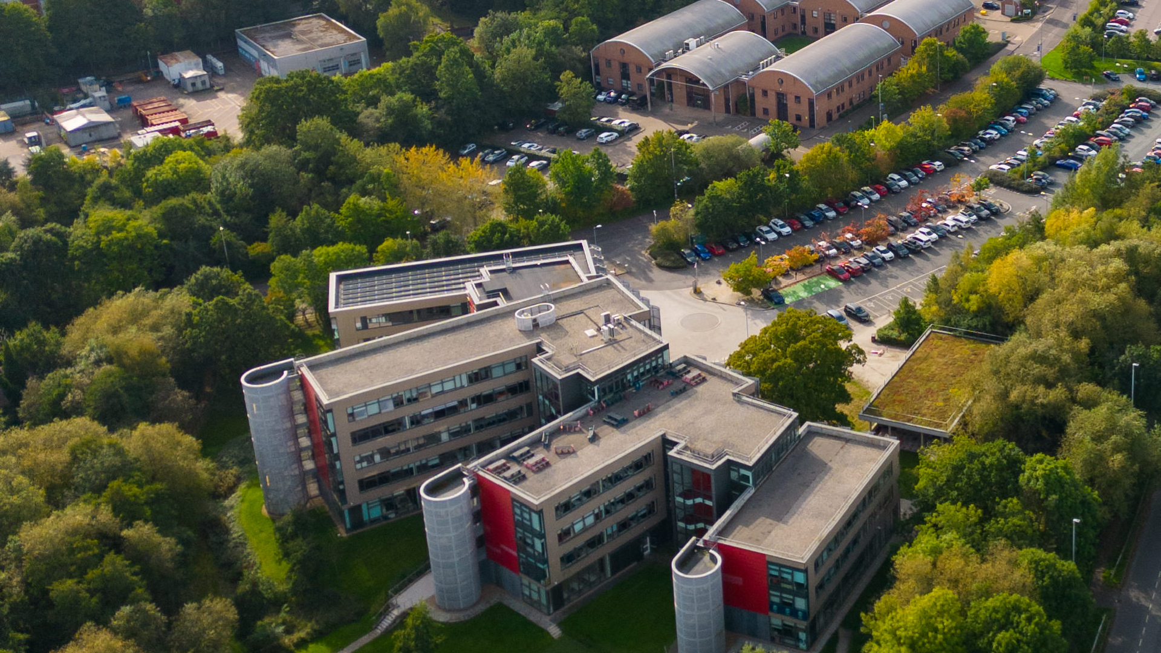
Science Park Contacts
University | Science or Technology Park
Birmingham Science Park Aston, Birmingham | info@astonsciencepark.co.uk
Birmingham Research Park, Birmingham | brpl@bham.ac.uk
Coventry University Technology Park, Coventry | +44 (0) 2476236000
Cranfield University Technology Park, Bedfordshire | joshua.parello@kirkbydiamond.co.uk
The Innovation Centre, Leicester | innovationcentre@dmu.ac.uk
University of Derby Science Park | +44 (0) 1332 742 800
INFINITY Park, Derby | ssalloway@salloway.com
Keele University Science and Innovation Park, Staffordshire | gateway@keele.ac.uk
Space Park, Leicester | enquiries@space-park.co.uk
Lincoln Science and Innovation Park | enquiry@lincolnsciencepark.co.uk
Loughborough University Science and Enterprise Park | lusep@lboro.ac.uk
University of Nottingham Innovation Park, Nottingham | reception@unip.nottingham.ac.uk
Nottingham Science Park | regeneration@nottinghamcity.gov.uk
University of Warwick Science Park, Coventry | more-info@uwsp.co.uk
University of Wolverhampton Science Park, Wolverhampton | joinus@wolverhamptonsp.co.uk
Birmingham Innovation Quarter, Birmingham | hello.scitech@bruntwood.co.uk
Skylon Park, Herefordshire | info@skylonpark.co.uk

Slide 36
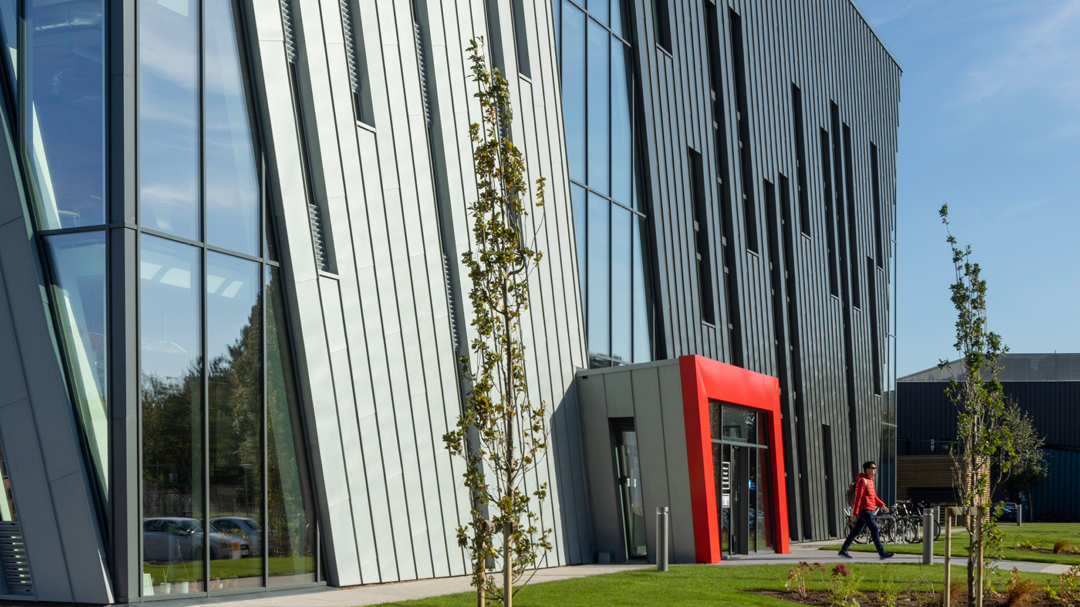
Investment support across the Midlands
Place focused inward investment support
Inward investment is supported by dedicated organisations in other parts of the Midlands, as detailed below.
Destination Chesterfield +44 (0) 1246 207207
Invest Coventry and Warwickshire contact@investcw.co.uk
Marketing Derby invest@marketingderby.co.uk
Invest in Leicester enquiries@investinleicester.com
Invest in Nottingham enquiries@investinnottingham.co.uk
Invest Telford Invest@telford.gov.uk
Invest Shropshire invest@shropshire.gov.uk
Invest Stoke-on-Trent enquiries@investstoke.co.uk
Invest Staffordshire hello@wearestaffordshire.co.uk
Invest in West Midlands invest@wmgrowth.com
Invest Wolverhampton invest@wolverhampton.gov.uk
Invest in Worcestershire +44 (0) 1905 677888
Team Lincolnshire investment@lincolnshire.gov.uk
The West Midlands Growth Company offers investors support to find the right networks, receive advice on locations, secure sector specific market research, identify funding support, and generate publicity.

Slide 37
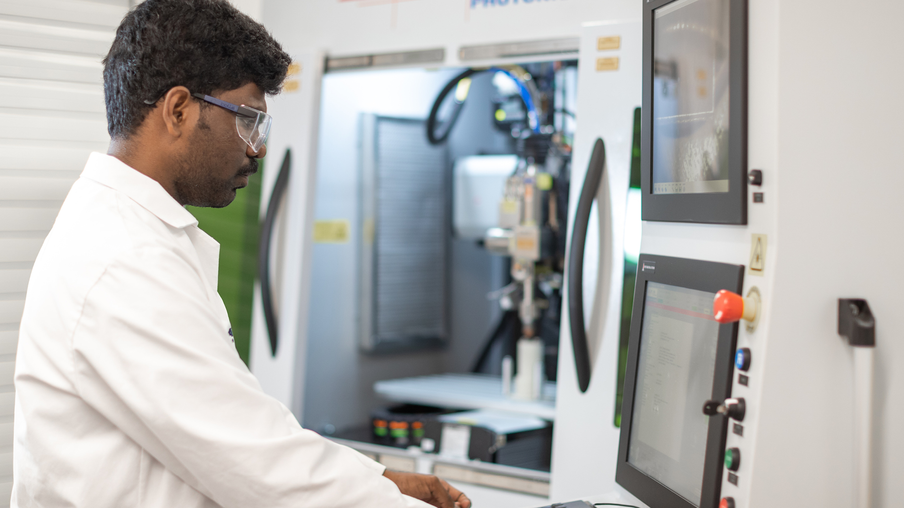
UK Investment Support
The UK’s ability to develop new ideas is one of our great strengths, from the jet engine and the bagless vacuum cleaner to MRI scanners and the world wide web. The UK’s talent pool, funding and incentives and business infrastructure all help create an environment of business innovation. Our commitment to world-leading research and development will help your business reach its full potential. We are one of the most innovative countries in the world - ranked in the top 5 countries in the Global Innovation Index 2019. For companies such as Ford, Pfizer, Eli Lilly, Nokia and Eisai, the UK’s business environment is the natural choice for investment in innovation.

Slide 38
Department for Business and Trade We support growth by backing businesses in the UK and globally, promoting investment and championing free trade.
Disclaimer Whereas every effort has been made to ensure that the information in this document is accurate, the Department for Business and Trade and the Contributors do not accept liability for any errors, omissions or misleading statements, and no warranty is given or responsibility accepted as to the standing of any individual, firm, company or other organisation mentioned.
© Crown copyright 2023 This publication is licensed under the terms of the Open Government Licence v3.0 except where otherwise stated. To view this licence, visit https://www.nationalarchives.gov.uk/doc/open-government-licence/version/3/
Where we have identified any third party copyright information you will need to obtain permission from the copyright holders concerned.
Published by Department for Business and Trade October 2023

