Slide 1
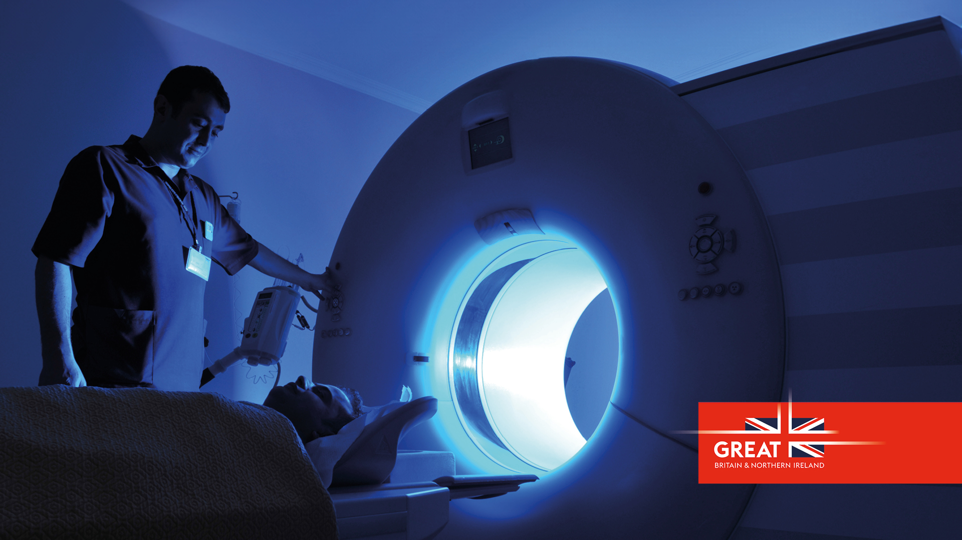
Prospectus
Invest in UK University R&D
Health and life sciences in the Midlands

Slide 2
Forge the future of transport technology with universities in the Midlands

Slide 3
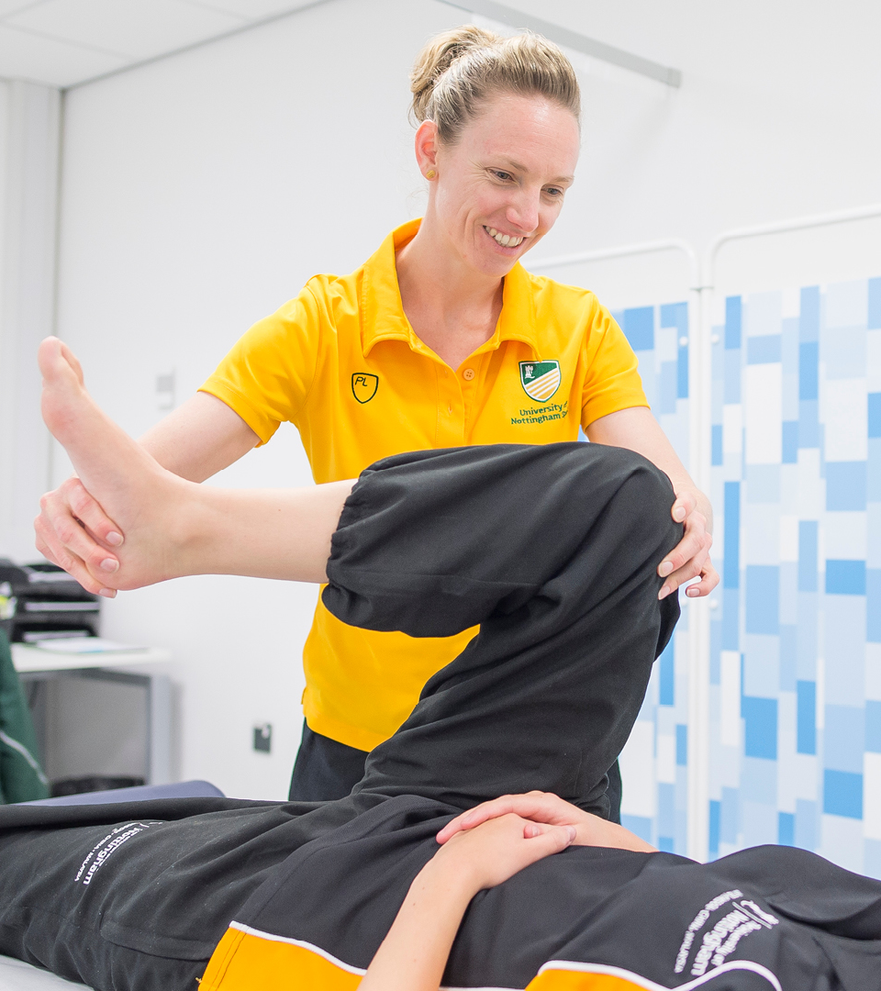
The Midlands is home to an excellent health and life science cluster. For over a century, the Midlands has housed world-leading capabilities in health, medical technologies and life sciences.

Slide 4
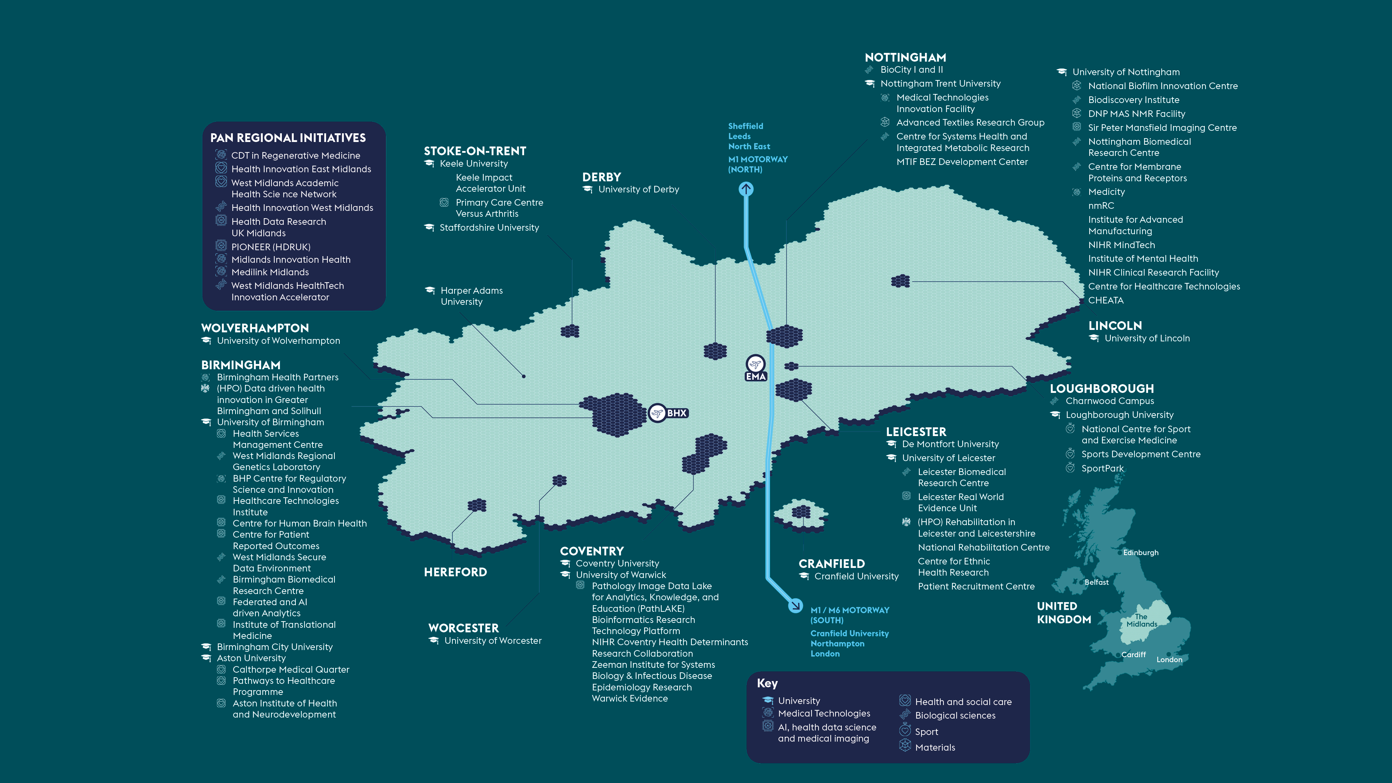
Universities and life sciences technologies in the Midlands – major R&D assets

Slide 5
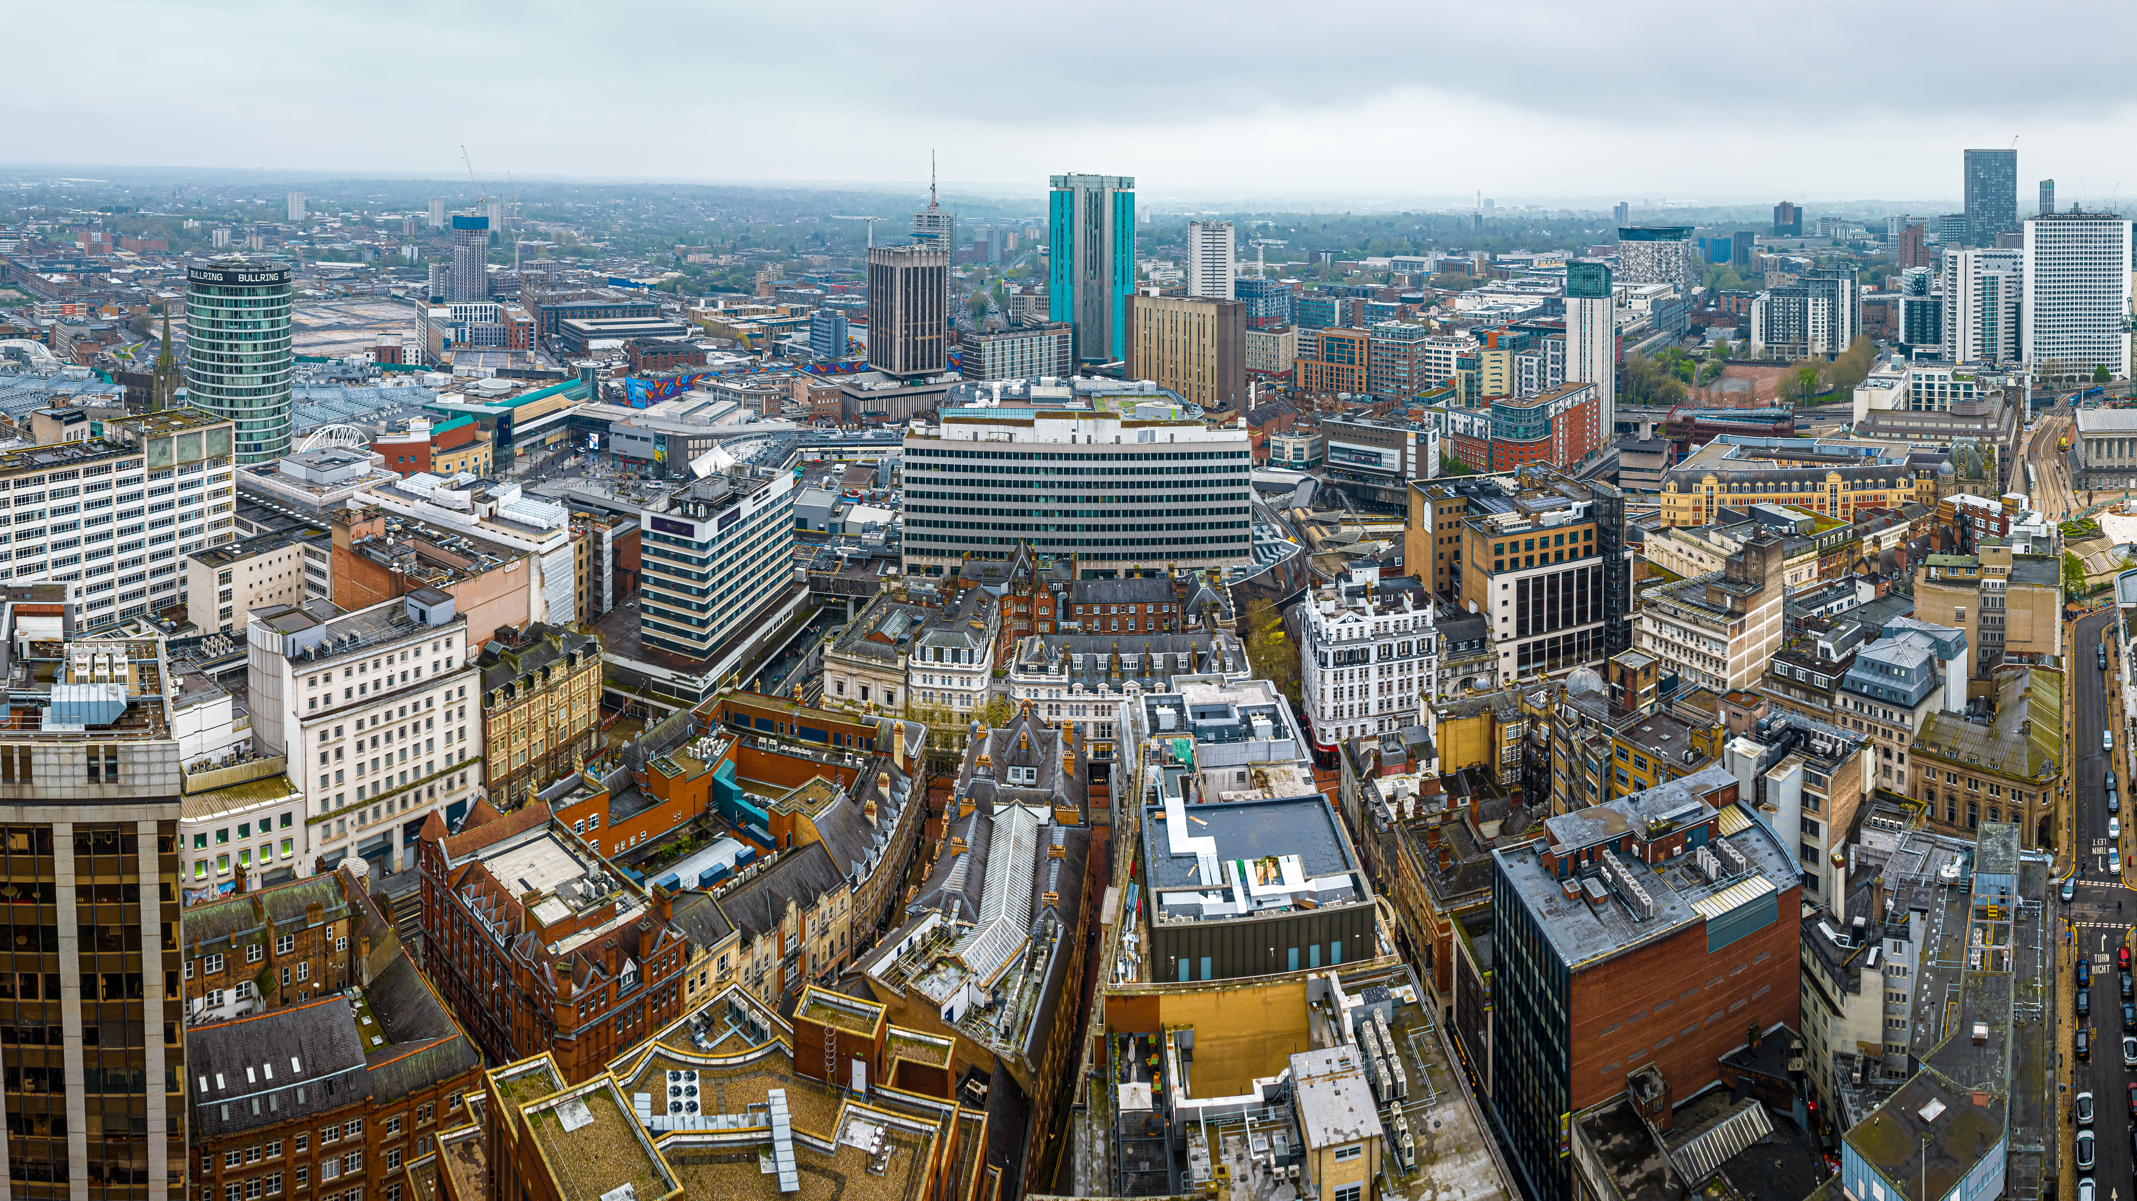
Science and innovation pedigree
At the heart of the Midlands' science and innovation landscape are its world-class universities. Midlands Innovation (MI) is a partnership of eight research-intensive universities in the Midlands: Aston University, University of Birmingham, Cranfield University, Keele University, University of Leicester, Loughborough University, University of Nottingham, and University of Warwick. 48% of the spinouts from these universities are in the health and life sciences sector, from university data. The collective of universities has £4bn revenue, 15,000 academics, 50,000 postgraduates and are one of the most efficient producers of world class research in the UK with 40% more world class science than Oxford or Cambridge.

Slide 6
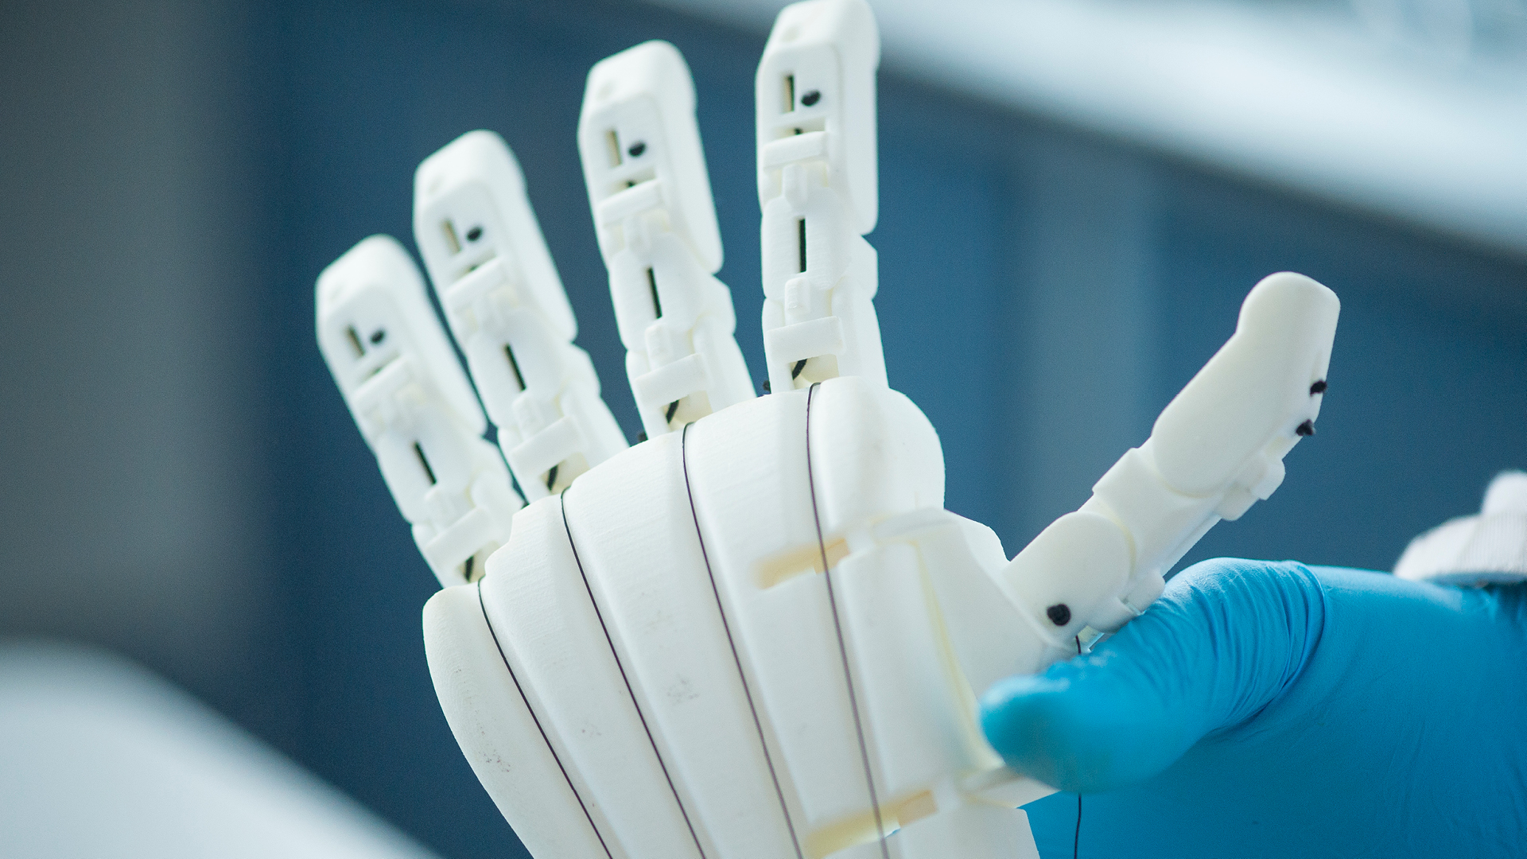
World-leading health and life science sectors in the Midlands

Slide 7
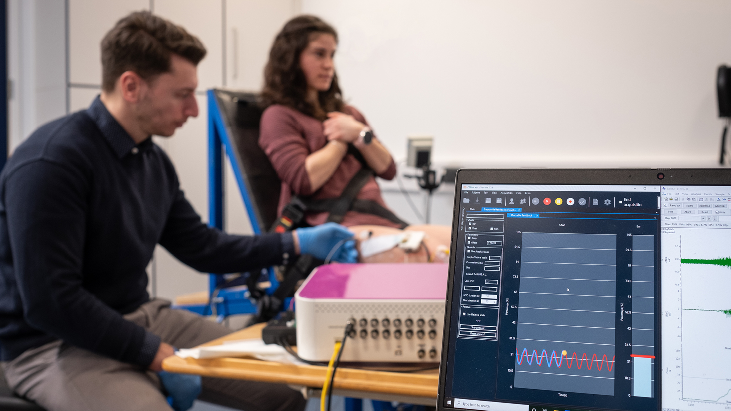
AI, health data science and medical imaging
The Midlands hosts one of the world’s largest Arm-based supercomputer deployments and the UK’s largest IBM Power9 AI cluster.
A critical emerging sector for the Midlands is data-driven and digital healthcare, with the region hosting a rapidly-growing cluster of digital health companies and more digital start-ups than any UK area outside of London. The Midlands also attracts global companies to relocate here through our distinctive NHS-partnering ecosystem, cutting-edge facilities and world-leading expertise, as well as critical focal points including two internationally acclaimed life science hubs - Charnwood Campus and Birmingham Health Innovation Campus. The Midlands is a health data and Al powerhouse.

Slide 8
Biological sciences
The Midlands benefits from some enviable assets that underpins the biological and life sciences sector. The region is home to 2 of the 3 largest UK NHS Trusts, the 2nd largest Clinical Trials cluster in Europe, and 7 Medical Schools (producing over 20% of the UK’s medical students).
The Midlands is home to: 2 of the 3 largest UK NHS Trusts, the 2nd largest Clinical Trials cluster in Europe, and 8 Medical Schools (producing over 20% of the UK’s medical students).

Slide 9
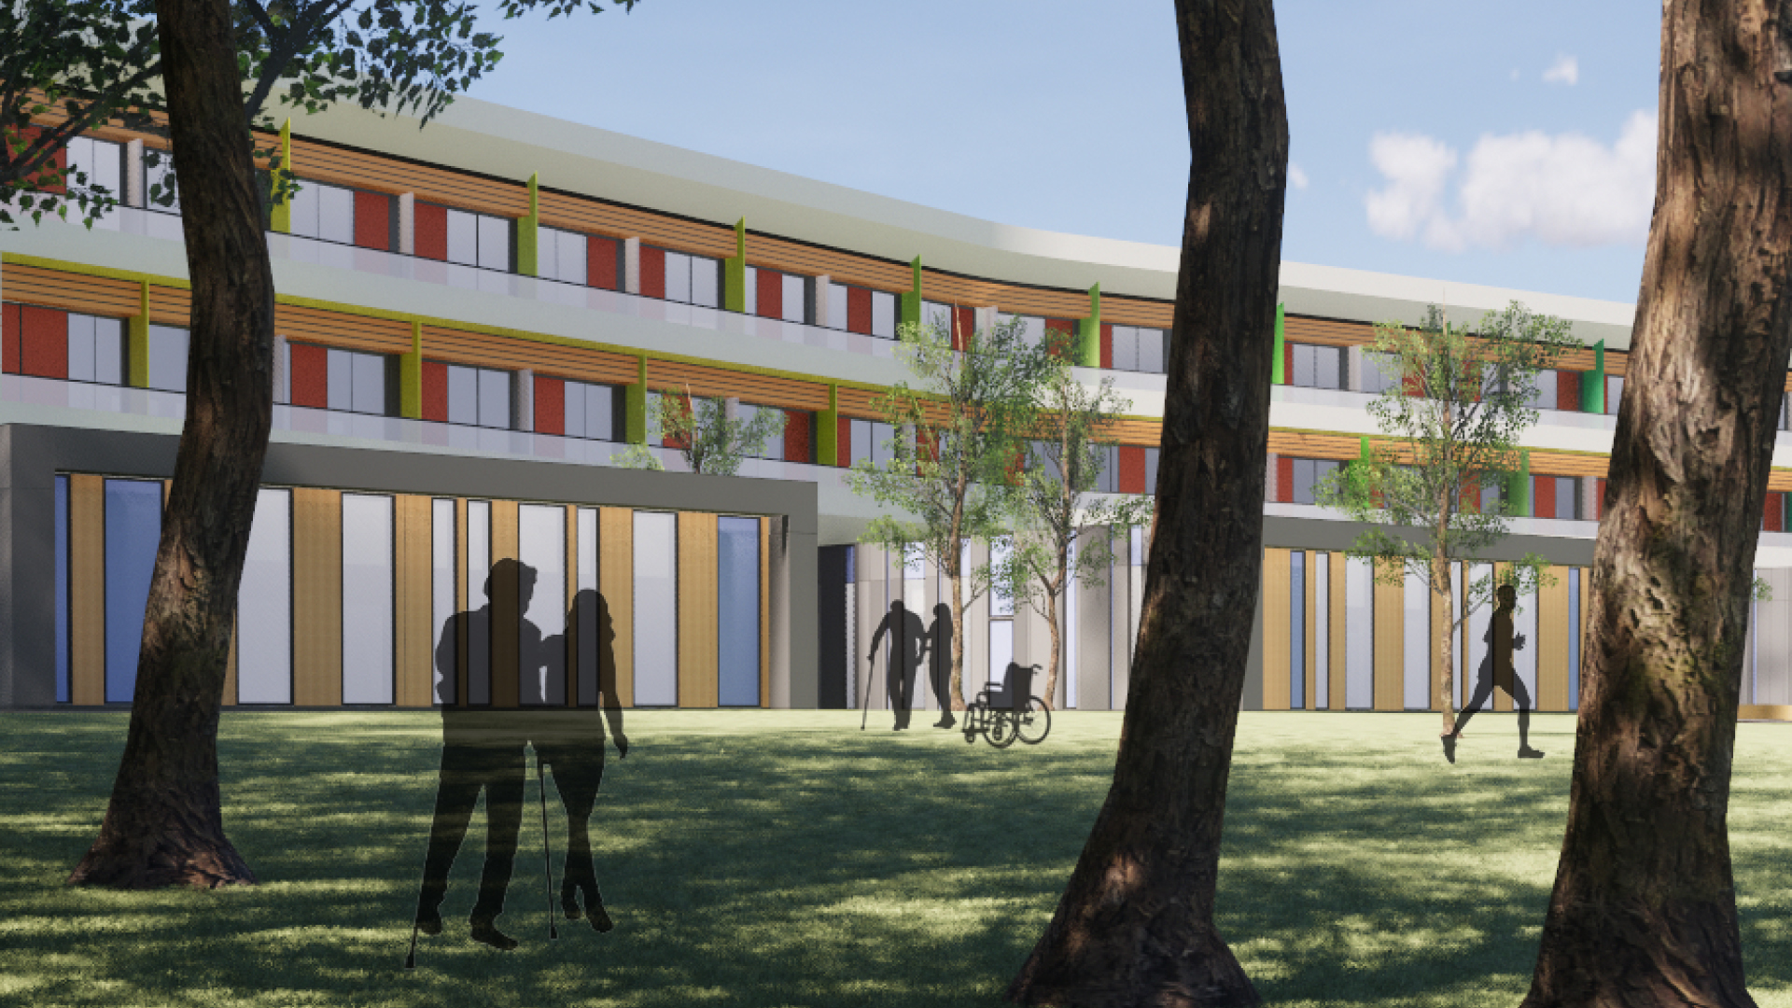
Health and social care
Across the region, hospital trusts, universities and companies work in collaboration to develop new treatments, techniques and methods to enhance health and social care for people in the Midlands.
11,200 life sciences students graduate each year from the Midlands universities
The Midlands has a stable, ethnically diverse population of over 10.7 million – an ideal test bed for global health and interventions to address multi-morbidity.
Life sciences supports 634,000 jobs in the region

Slide 10
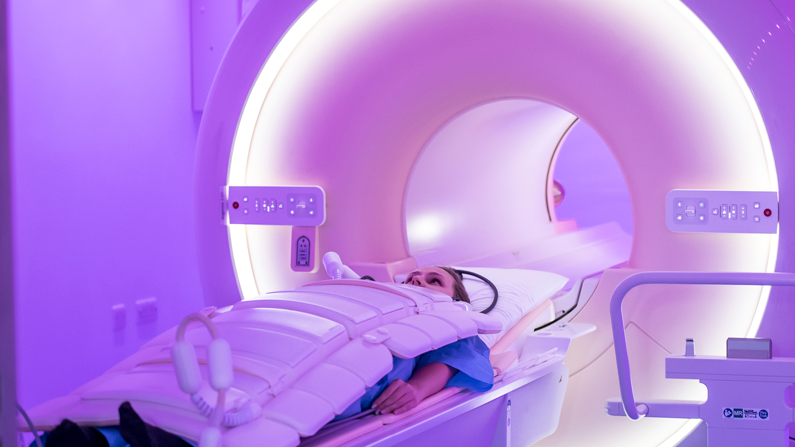
Medical technology
The Midlands is ideally placed to lead the development of new MedTech products and services from bench to bedside, create start-ups, drive regional growth and capture the growing national and global MedTech market.
MedTech in the Midlands supports over 23,000 jobs, in 1,000 companies, creating £1.6bn GVA annually

Slide 11
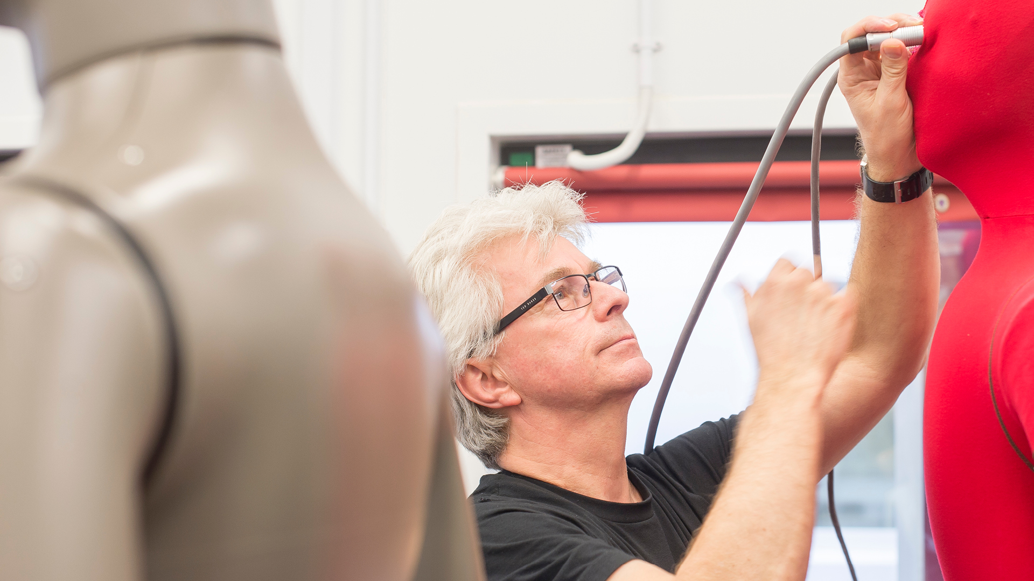
Enablers of research and development in life sciences

Slide 12
Materials
Researching, developing and manufacturing new materials is a critical enabler of new medical technologies, devices and techniques to support rehabilitation and recovery. This is a natural strength of the Midlands – building on existing world class capabilities in engineering, material and advanced manufacturing, and life sciences.

Slide 13
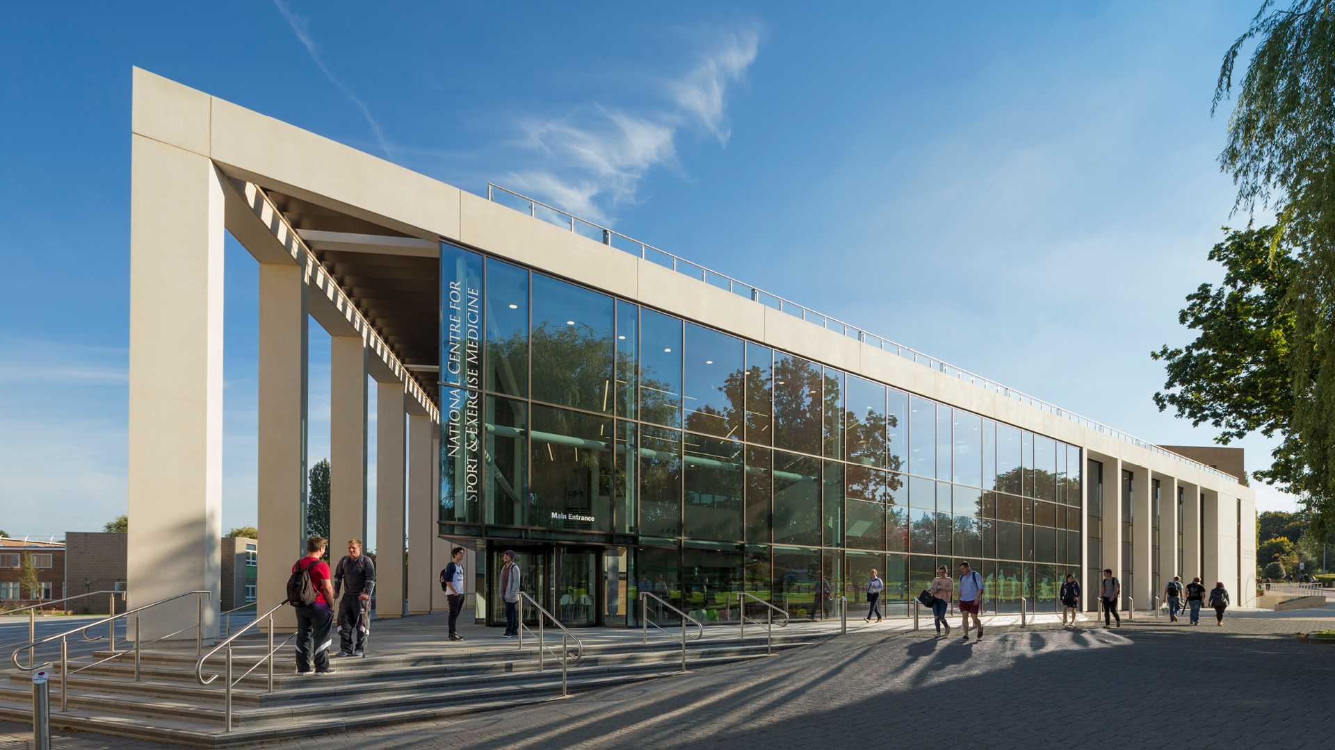
Sport
Understanding how to promote healthy living is critical to tackling some of the biggest health challenges of today. In the Midlands, 1 in 13 adults has received a diagnosis of diabetes – the highest of any region in England. 26% of adults in England are considered obese.

Slide 14
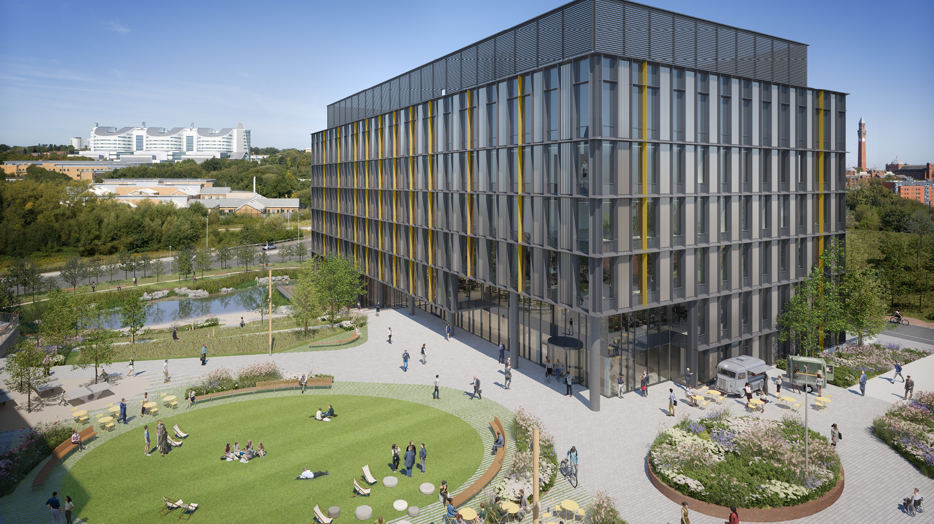
Invest in a partnership with Midlands universities

Slide 15
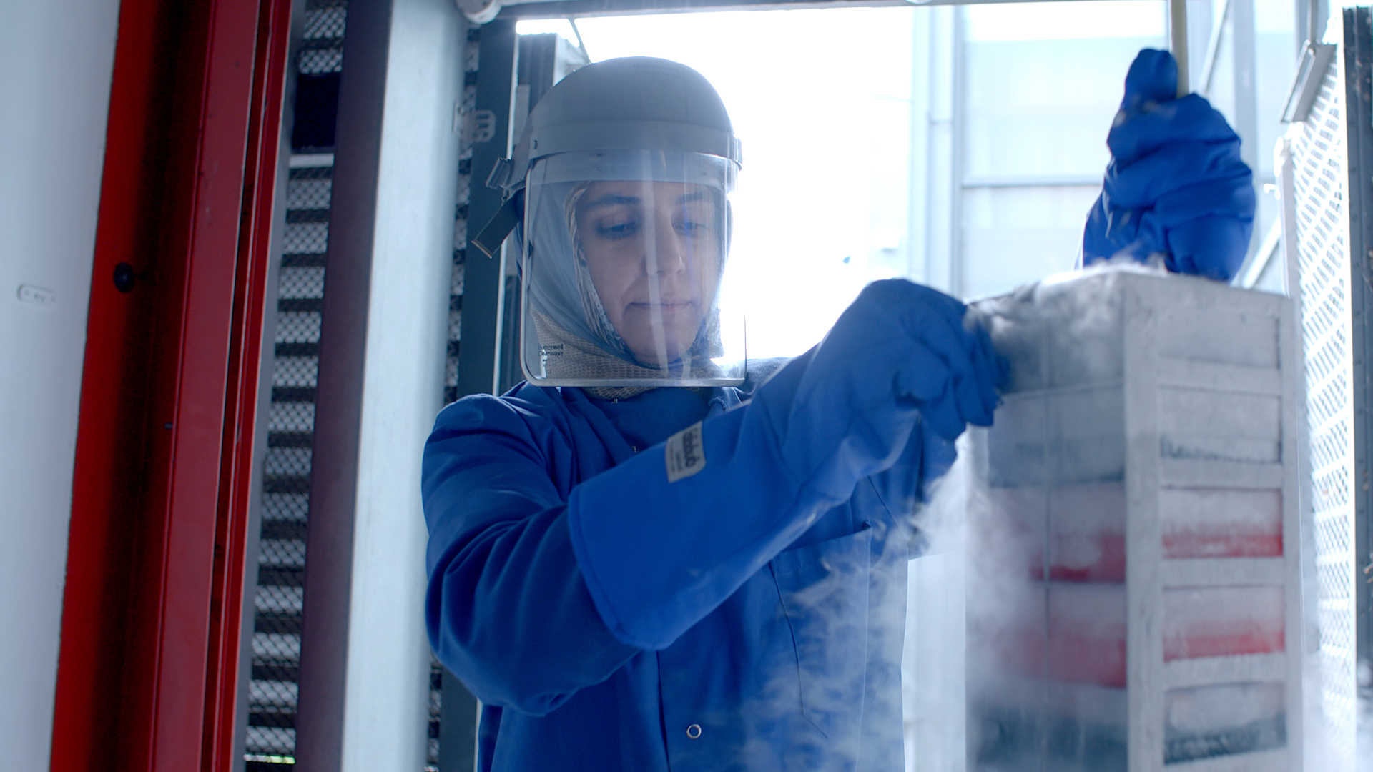
Research translation
Innovation
Midlands universities have been supporting the innovation eco-system of their local and regional economies for decades. If your business is looking to access innovation support chains, our dedicated support programmes, funding and networks can help you do this. Through co-funded Government schemes like Knowledge Transfer Partnerships (KTPs), which is one of the most successful, long-running innovation schemes anywhere in the world, we help business of all sizes to innovate using the knowledge and expertise of UK universities.
Universities in the Midlands have an exceptional track-record of working with the world’s largest companies, helping translate fundamental research into industry-leading innovations.
The University of Warwick and the University of Nottingham are both in the Top 5 recipients of the £885m of Innovate UK Funding allocated across the UK in the last 10 years.

Slide 16
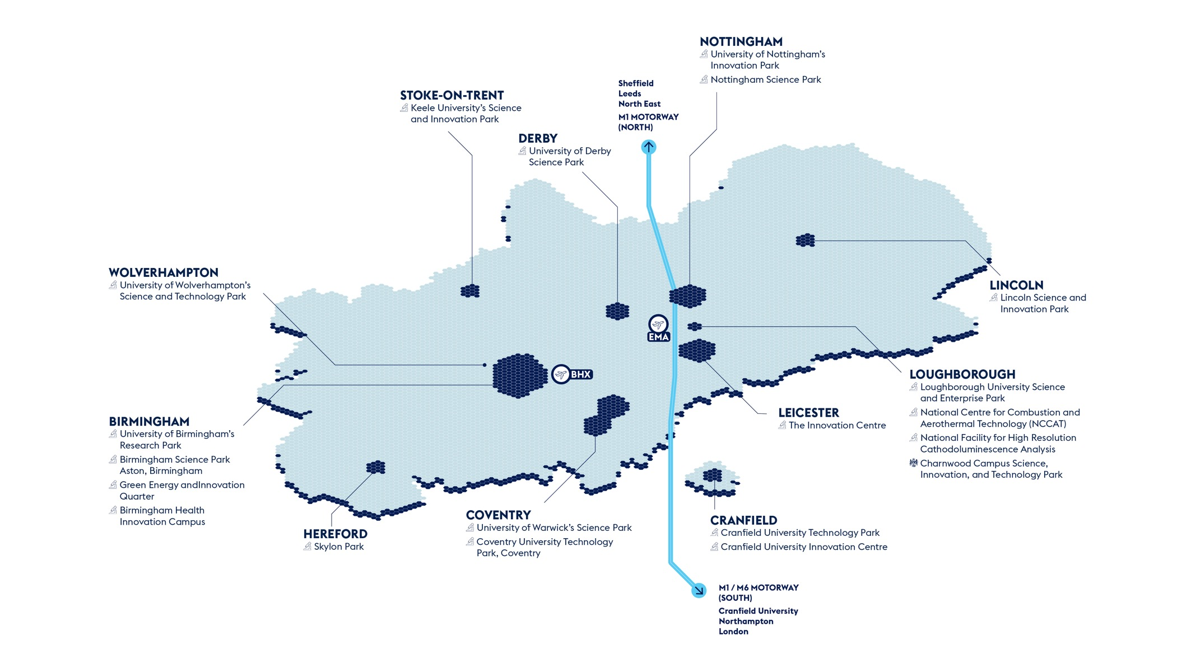
Co-location

Slide 17
Regeneration and integration
Universities across the Midlands work in partnership with the UK and Local Government to help drive economic growth through innovation and inward investment. Through a range of public-private partnerships, universities are involved in over 20 major economic development opportunities identified by the Midlands Investment Portfolio, worth over £10bn in Gross Development Value. In the West Midlands, universities work with the Combined Authority and Growth Company to work on a range of projects as a part of one of only three UK Innovation Accelerators.

Slide 18
Talent
Home to 20 universities, the Midlands hosts over 350,000 students and 100,000 graduates a year, including 20% of the UK's medical students. Our universities will work in partnership with local economic growth organisations to develop tailored skills and training package – from degree apprenticeships, to dedicated training and skills programme, to industry-funded PhDs – to support the growth of future industries and your business.

Slide 20
Midlands Mindforge - £250m patient capital fund combining the spinout portfolios of eight leading UK universities
Midlands Mindforge is an ambitious, patient capital investment company aiming to transform ground-breaking science and technology into successful businesses with the potential to positively impact our world and accelerate the commercialisation of research from our partner universities - Aston, Birmingham, Cranfield, Keele, Leicester, Loughborough, Nottingham, and Warwick.
By providing capital and company-building skills to university spinouts and early-stage IP rich businesses in the Midlands, we will build the foundations of a new technology eco-system in the region and create companies that can drive economic growth whilst delivering real-world impact.
enquiries@midlandsmindforg

Slide 21
Midlands Mindforge - £250m patient capital fund combining the spinout portfoliosof eight leading UK universities
Midlands Mindforge is an independent company that aims to raise up to £250m from strategic corporate partners, institutional investors and qualifying individuals.
Mindforge will “invest with impact” to found and scale transformational science backed companies in sectors such as Clean Technologies, AI and Computational Science, Life Sciences and Health Tech, to create highly skilled jobs and support the UK’s ambition to become a science and technology superpower.
enquiries@midlandsmindforg

Slide 22
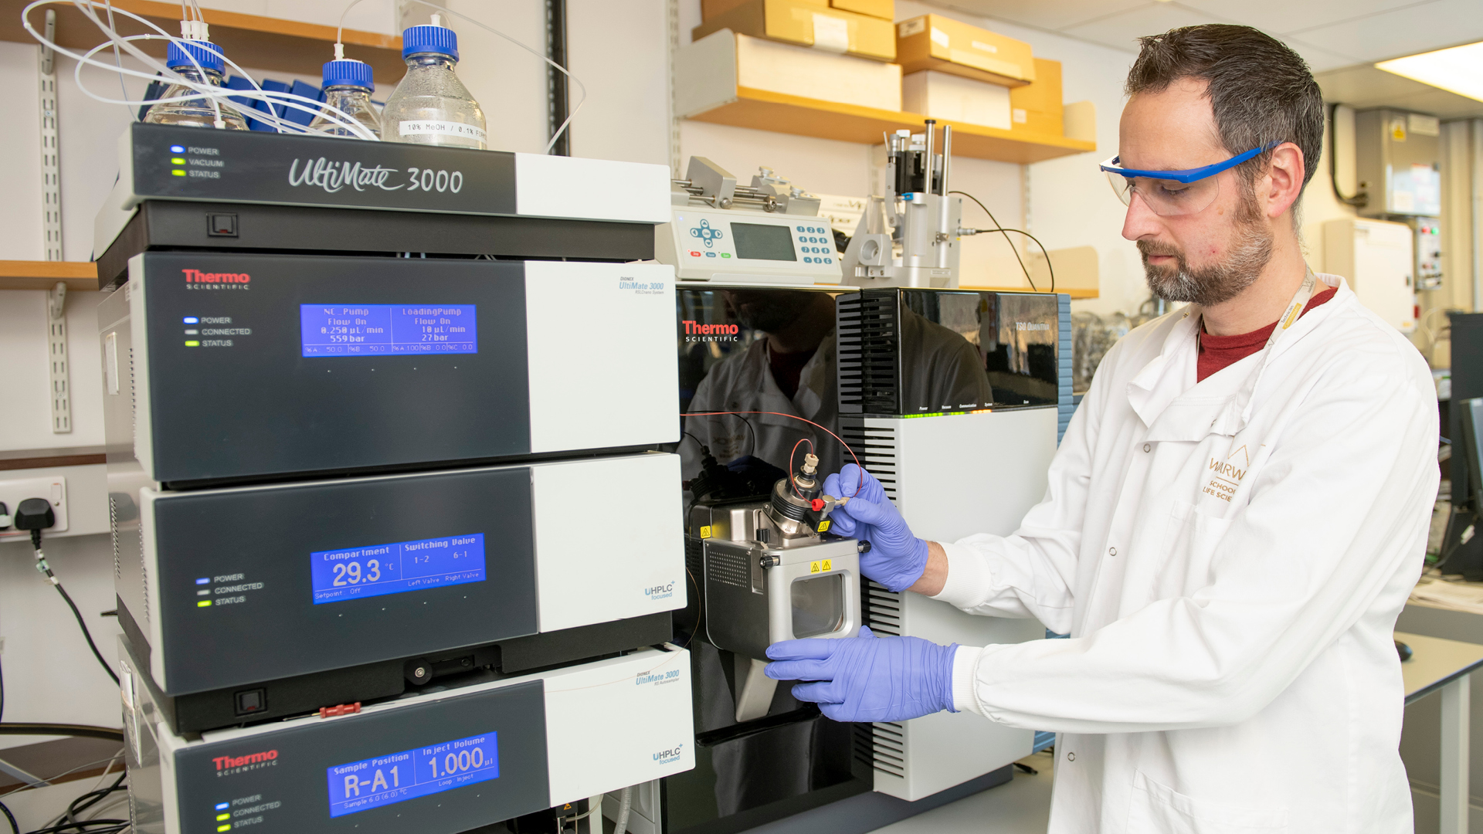
Directory of significant health and life sciences R&D assets across the Midlands and its universities

Slide 23
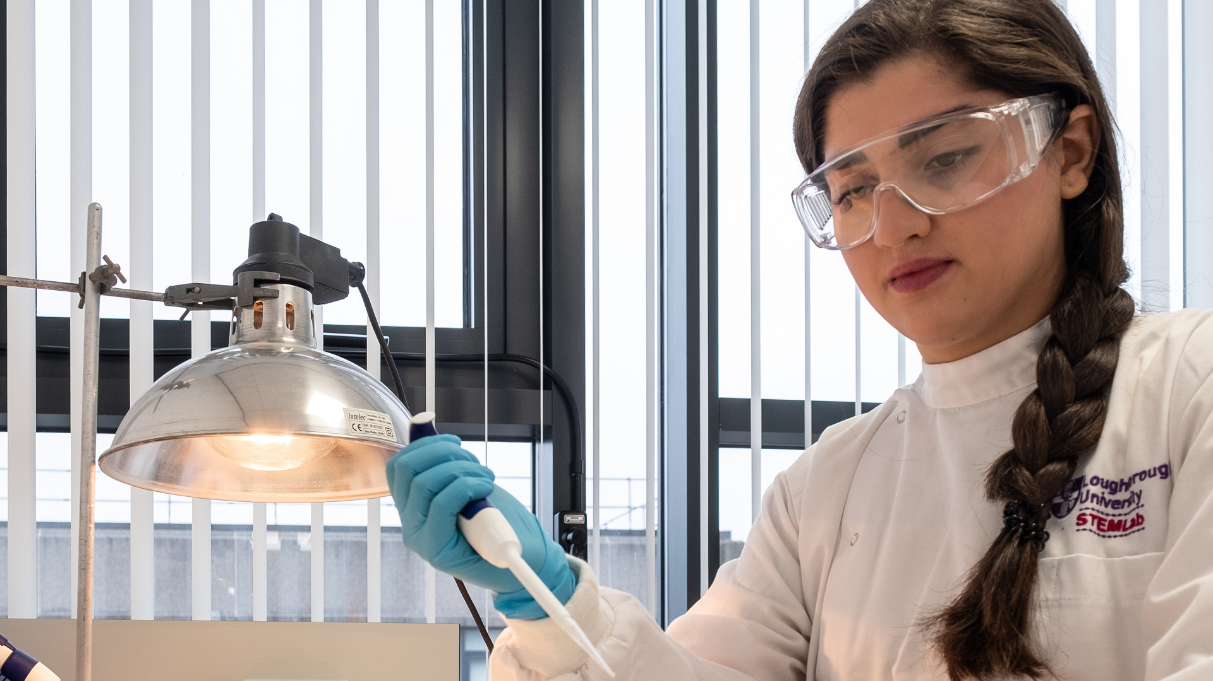
Health and life sciences in the Midlands
Businesses can work with a range of research and development facilities, which can help them translate their research, innovate their product, or co-locate to access research and NHS facilities, and a skilled community of life sciences experts. Companies could choose to co-locate with innovators in biological sciences at BioCity in Nottingham, at the Charnwood Life Sciences Cluster in Loughborough, or in the Edgbaston Medical Quarter in Birmingham. Co-locating with other innovators can also be an excellent way to access support networks, as well as engage with pre-seed and seed funding partners.
Charnwood Campus Science, Innovation and Technology Park
Is a business-led life sciences ecosystem that provides world-class flexible laboratories, specialist manufacturing facilities and a comprehensive support package for life science and associated companies. Set in 70 acres of landscaped grounds, the park combines nature with modern facilities to create the ideal conditions for start-ups and established enterprises to grow their businesses. The site offers immediately occupiable laboratory and office space, and over 12 acres of development land. Ideally situated on the outskirts of Loughborough, in the heart of the UK, the Campus benefits from excellent transport links.

Slide 24
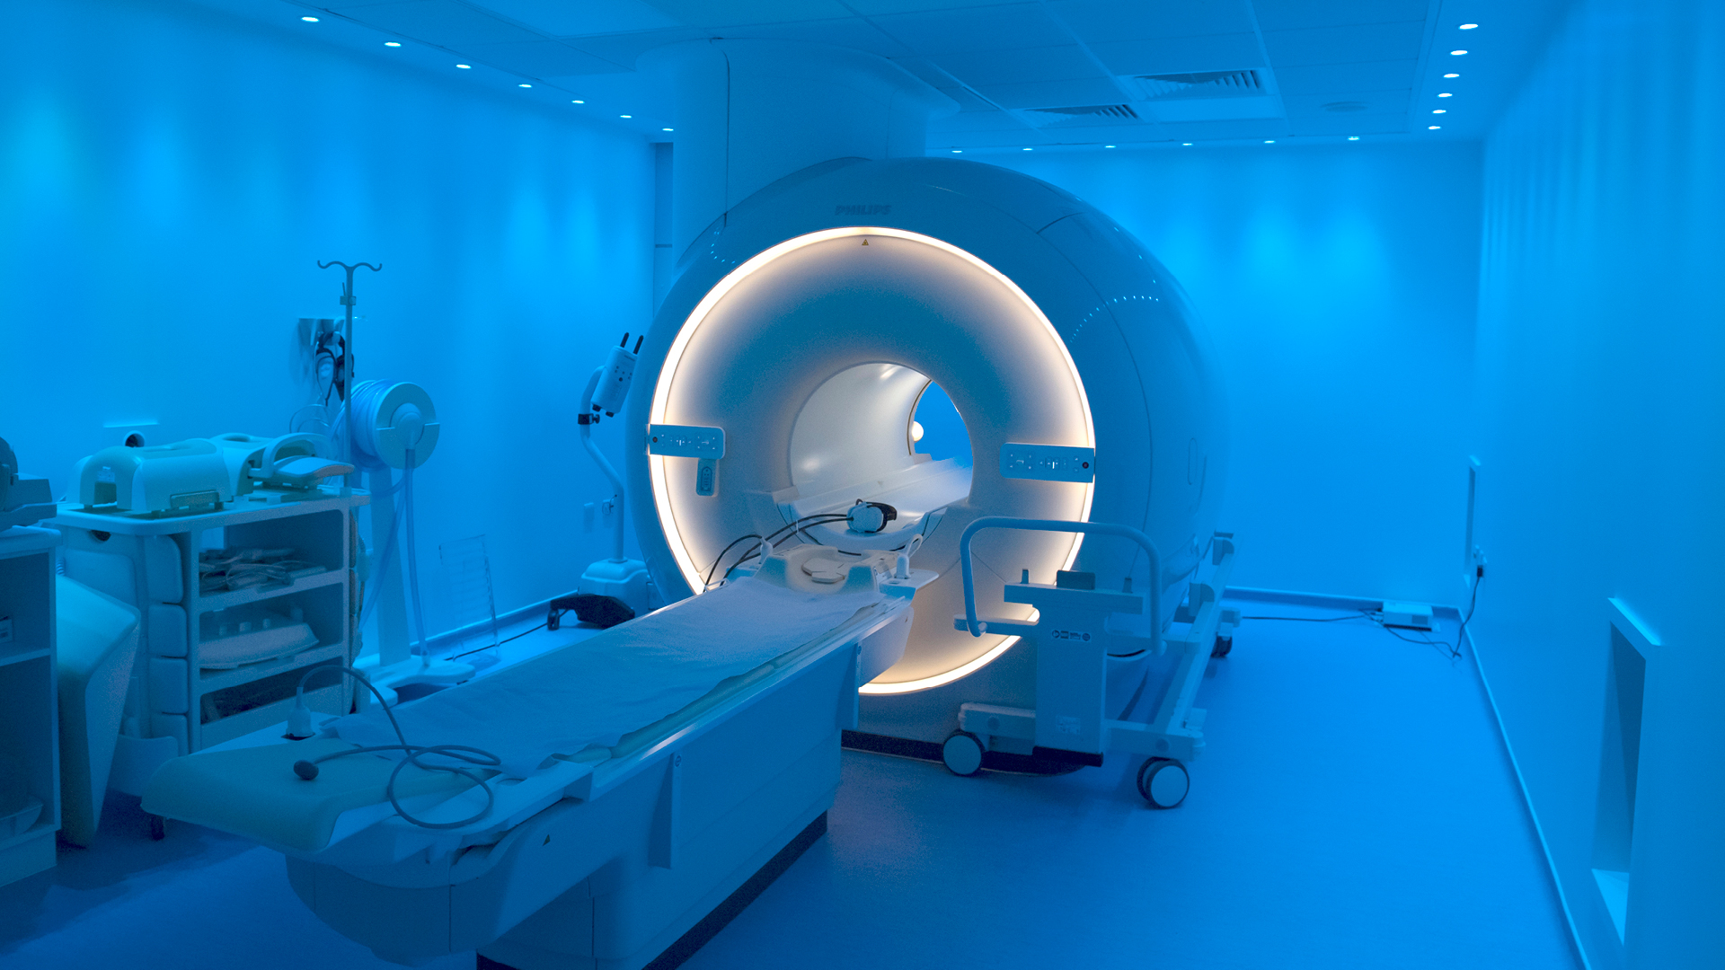
Sectors
AI, health data science and medical imaging
Sir Peter Mansfield Imaging Centre
The Sir Peter Mansfield Imaging Centre is an interdisciplinary, cross-faculty centre for innovation imagining in experimental and translation medicine, bringing together researchers who develop new medical imaging techniques with clinicians and scientists who use them. Staff come from the schools of physics and astronomy, medicine, psychology, and life sciences. It houses MRI, MEG, EEG, and fNIRS medical imaging equipment, and staff with training and experience in working to Good Clinical Practice standards, as well as clinically qualified radiographers available. There is a wide ranging list of partners covering collaborative networks, MR safety actors, learned societies, charities, research groups, other centres, and manufacturers. The Centre has recently been awarded over £29 million to develop the UK’s most power MRI scanner.
Research assets
University based
Cluster organisations

Slide 25
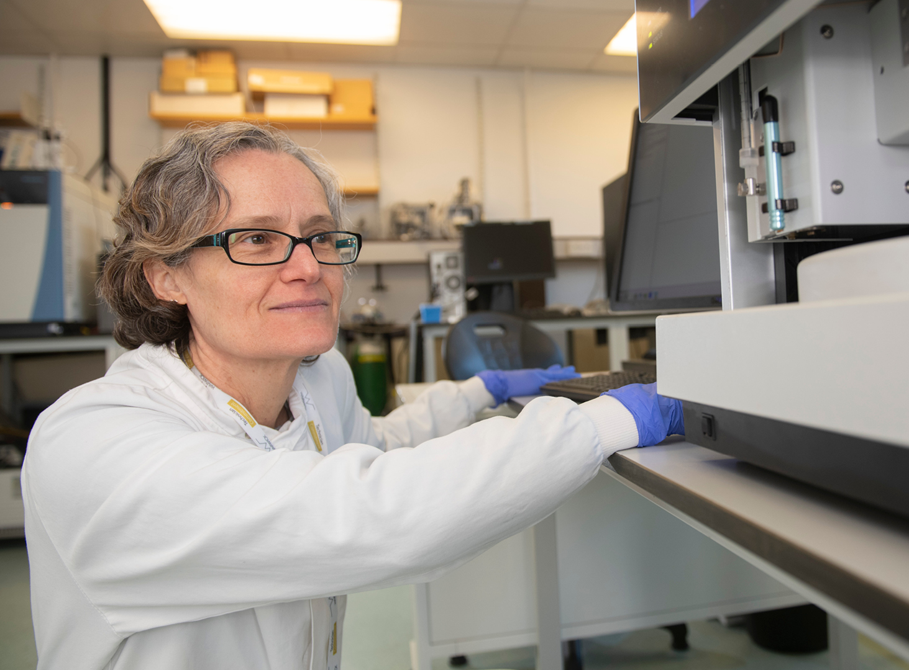
Sectors
Biological sciences
Research assets
University based
Training
Cluster organisations
BioCity
BioCity, run by Pioneer Group, is a former Boots R&D site that has been transformed into a centre of excellence for pharmaceutical and biotech innovation. It provides flexible access to lab space, research facilities and serviced offices across four buildings - perfect for life science start-ups and scale-ups. BioCity was founded by Nottingham Trent University, the University of Nottingham, and the East Midlands Development Agency and is serviced by the Pioneer Group. Pioneer Group provides coaching for entrepreneurialism at every stage and has a specialty accelerator programme, as well as operating several funds that invest in young businesses and specialise in pre-seed and seed funding. The lab space at BioCity is serviced with easy-in, easy-out leases for start-ups and longer term leases for established companies, and will work to modify spaces to make them right for a company’s specific needs.

Slide 26
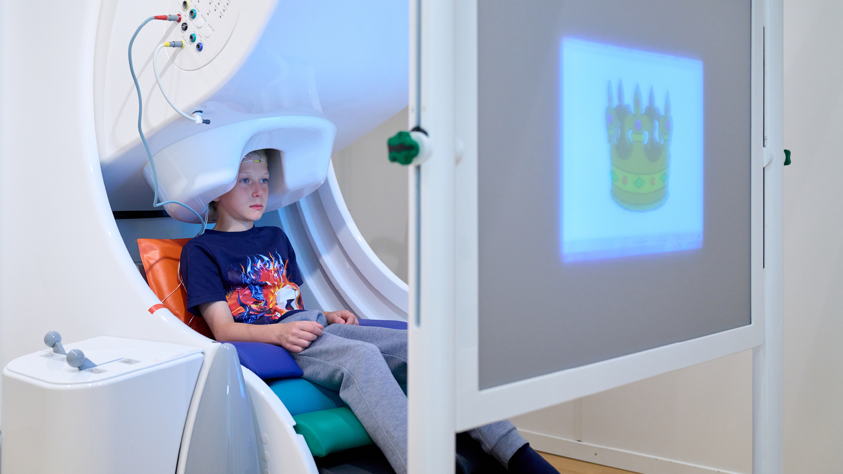
Sectors
Health and social care
Aston University – Aston Institute of Health and Neurodevelopment
The Aston Institute of Health and Neurodevelopment puts children at the heart of research. Their vision is unlocking the potential of research to support the health and development of children and young people; answering the questions that matter to children and young people, their families and the services that support them; and developing the next generation of research leaders in children’s health and development. Their research establishes new models and understanding of childhood disease, disorder and developmental processes and uses this to inform therapeutic and social interventions. Facilities in the IHN include eating and behaviour labs, neuroimaging facilities, neuropsychology labs, and electrophysiology labs. Partners include the Birmingham’s Women’s and Children’s NHS Foundation Trust and the Deaking University in Melbourne. Current funders for research include Autistica, ESRC, Epilepsy Research UK, Food Standards Agency, Innovate UK, and GW Research.
Research assets
University based
Cluster organisations

Slide 27
Sectors
Health and social care
An Investible Opportunity in Rehabilitation in Leicester and Leicestershire
From fundamental research to commercialisation, Leicester and Leicestershire have everything to take your technologies from concept to market. The region is home to numerous assets specialising in chronic disease prevention, rehabilitation, regenerative medicine, biomedical imaging, digital health, injury, frailty, digital fabrication, additive manufacturing, human factors and ergonomics. With facilities like the Leicester and Nottingham Biomedical Research Centres and the Centre for Exercise and Rehabilitation Sciences (CERS) at the University of Leicester, the Midlands is the place to be to drive new rehabilitation products and technologies in the international market. It is also home to the Defence Medical Rehabilitation Centre, a new £300 million centre that will soon also house the £110 million National Rehabilitation Centre (NRC) for civilian care. Patients in both centres will benefit from shared expertise, knowledge, and facilities, and being part of the wider Midlands rehabilitation cluster.
Research assets
University based
Cluster organisations

Slide 28
Sectors
Medical technology
Medical Technologies Innovation Facility
The MTIF is a dual site research and development facility available to industry and academic institutions to support and accelerate the development of innovative medical technologies. The development centre is part of the Boots Enterprise Zone, in Nottingham. The MTIF team consists of commercial and technical professionals based in MTIF facilities, working with seasoned academics and strategic partners. It provides laboratories, clean rooms, specialist equipment and a dedicated team of experts to support the innovation process. New product development is accelerated for innovative medical technologies by bringing together technical expertise with regulatory know-how, a network of clinical trial facilities, and access to both government and private funding. The MTIF team can help develop IP or capitalise on MTIF’s IP through strategic partnerships and tactical support.
Research assets
University based
Training
Cluster organisations and other research collaboration opportinunities

Slide 29
Sectors
Medical technology
An Investible Opportunity in Data driven health innovation in Greater Birmingham and Solihull
Demand for data-driven health and care technologies is increasing, with innovations like artificial intelligence (AI) and machine learning radically improving early intervention and the creation of tailored therapies. Companies based in the Midlands can access opportunities to develop diagnostics solutions, digital health innovations and satisfy the need for life-changing devices from a location with excellent access to data, including a large number of data sets and one of the largest clinical trials portfolios in Europe, giving the information needed to develop diagnostic solutions, digital technologies and applications and devices. The region is home to world-class research centres with cross-sectional focus on data-driven healthcare and technologies. You’ll have access to leading research centres in health innovation and regulatory science as well as Centres for Doctoral Training. Key nearby institutions include the Aston Institute of Health and Neurodevelopment (IHN), the Birmingham Health Innovation Campus (BHIC), the Birmingham Health Partners (BHP) Centre for Regulatory Science and Innovation, the Healthcare Technologies Institute, and the Institute of Digital Healthcare (IDH).
Research assets
University based
Training
Cluster organisations and other research collaboration opportunities

Slide 30
Enablers
Materials
Research assets
University based
National Biofilm Innovation Centre
The National Biofilm Innovation Centre exists to create a fusion of world class interdisciplinary research and industry partnerships to deliver breakthrough science and technologies to control and exploit biofilms by providing a mechanism for industrial partners to explore their unmet needs with the researchers. It is jointly funded by the BBSRC, Innovate UK, and the Hartree Centre. Biofilms have an impact in the biggest challenges facing the world today, from antimicrobial resistance and food safety to water security and have significant economic, social, and environmental impacts. The Centre is part of a partnership that has more than 60 Research Institutions and support from more than 100 companies.

Slide 31
Enablers
Sport
Research assets
University based
National Centre for Sport and Exercise Medicine East Midlands
The NCSEM-EM aims to apply world-class expertise to policies and practice that will benefit the health and wellbeing of the nation from everyday people at risk of ill health through to elite athletes. Evidence shows that sport, exercise, and physical activity are effective in the prevention, treatment and management of disease and can enhance mental health and wellbeing, reducing the risk of mental illnesses such as depression, dementia, and Alzheimer’s. The NCSEM-EM will build on this evidence in four key research areas which will be translated into teaching and training through our educational programmes and the clinical services we offer. The NCSEM-EM is one of three hubs formation the National Centre for Sport and Exercise Medicine, along with London and Sheffield. The East Midlands hub is a partnership between the University of Leicester, Loughborough University, University of Nottingham, University Hospital of Leicester NHS Trust, and Nottingham University Hospital NHS Trust.

Slide 32
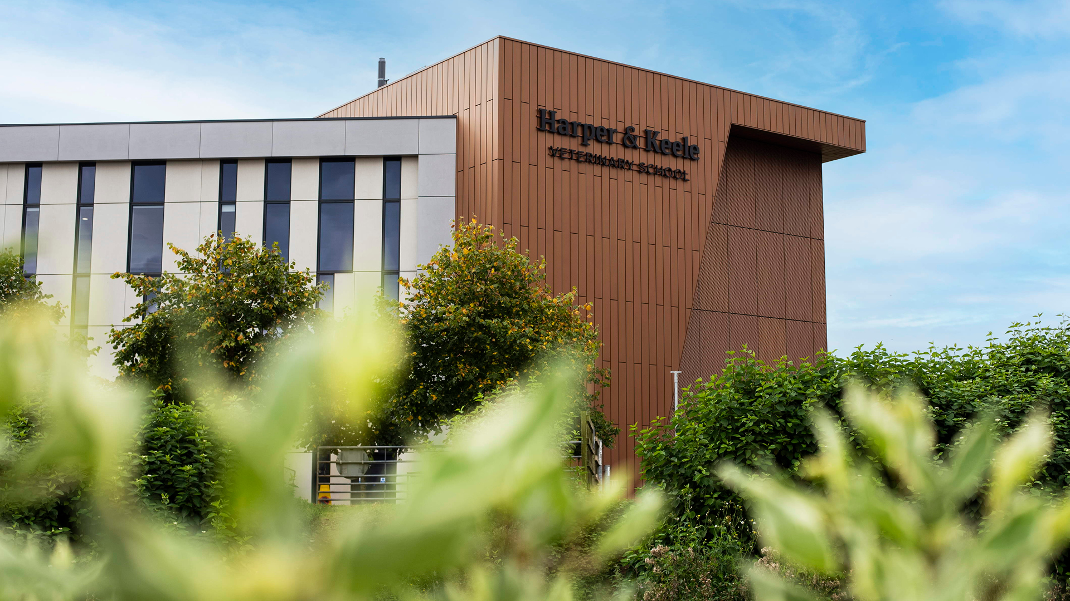
Work with us

Slide 33
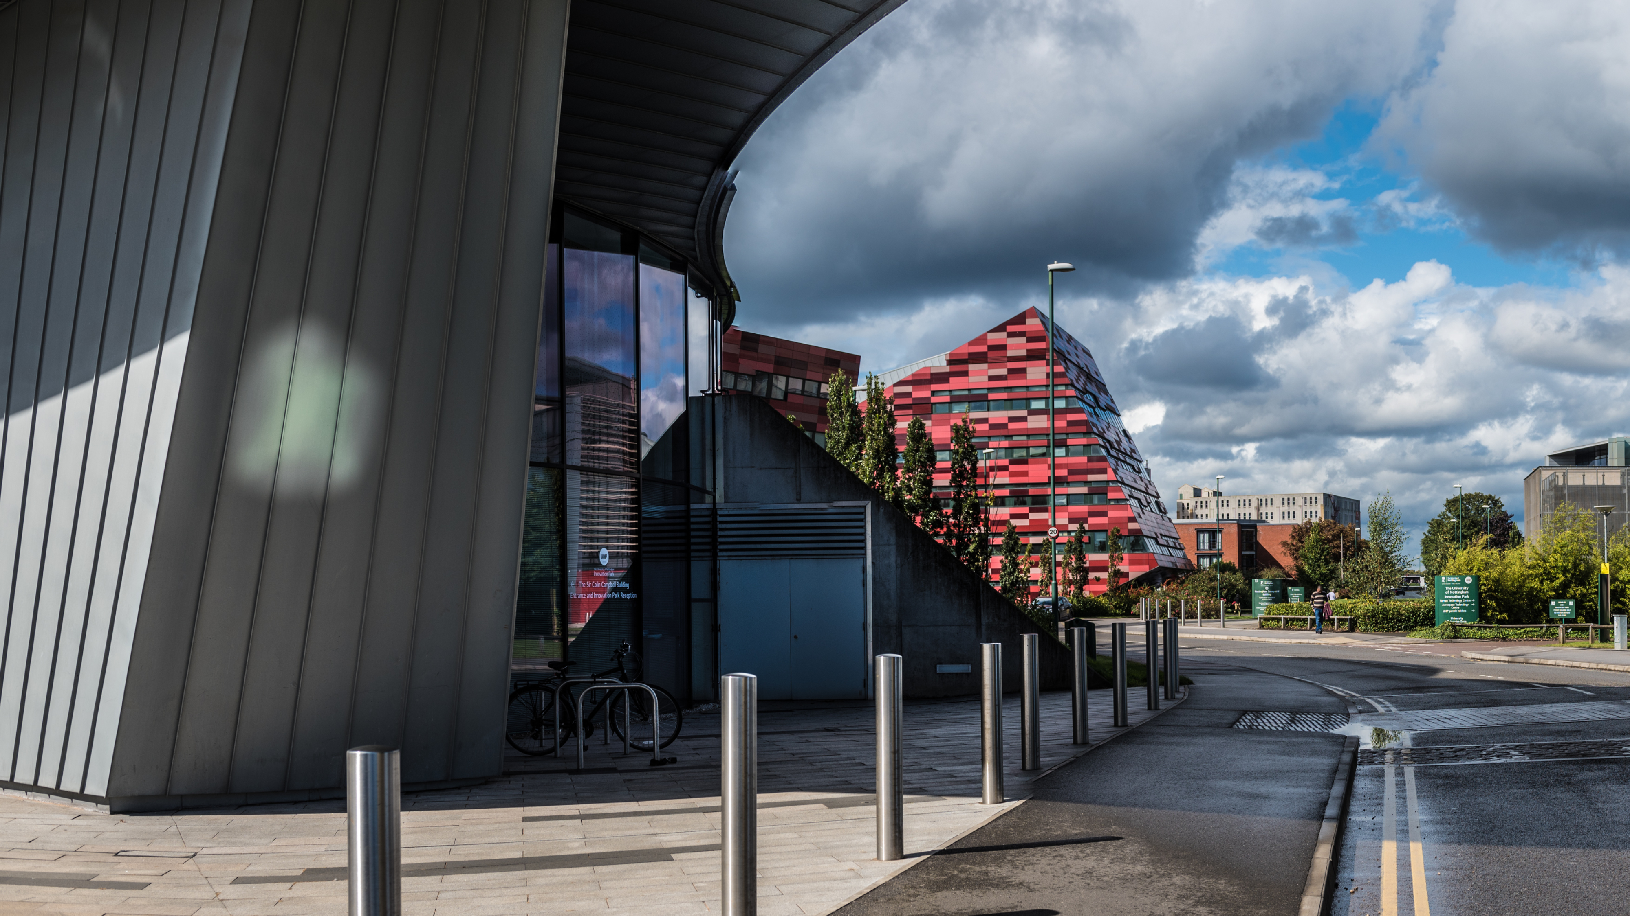
Our universities
From the Midlands, 90% of the UK’s population and businesses are less than a four-hour drive away; 45% of heavy rail freight and 33% of heavy road freight comes from, goes to, or passes through the Midlands and, with the advent of HS2, London will be less than an hour away. By air, the Midlands is home to two international airports – Paris is just a 90 minute flight away – with access to the seaports of the Humber. The Midlands are home to 11 million people, 15% of the UK’s GVA, and the only inland freeport. This is critical to dispersing the output of the Midlands and accessing the potential markets of not only the wider UK, but Europe and international buyers. The region is constantly growing with new development sites and spaces for bespoke builds, including labs, test spaces, and offices.

Slide 34
Directory of contacts across the Midlands
University | Business engagement and Technology Transfer | Careers service
Aston University | rke@aston.ac.uk | employerteam@aston.ac.uk
University of Birmingham | info@enterprise.bham.ac.uk | recruiters@contacts.bham.ac.uk
Coventry University | ei@coventry.ac.uk | talentteam@coventry.ac.uk
Cranfield University | business@cranfield.ac.uk | cranfieldcareers@cranfield.ac.uk
De Montfort University | businessservices@dmu.ac.uk | employerliaison@dmu.ac.uk
University of Derby | businessgateway@derby.ac.uk | employerteam@derby.ac.uk
Harper Adams University | reception@harper-adams.ac.uk | careers@harper-adams.ac.uk
Keele University | gateway@keele.ac.uk | gateway@keele.ac.uk
University of Leicester | redenterprise@le.ac.uk | employer.services@le.ac.uk
University of Lincoln | enterprise@lincoln.ac.uk | careers@lincoln.ac.uk
Loughborough University | innovation@mailbox.lboro.ac.uk | employer.services@lboro.ac.uk
University of Nottingham | workwithus@nottingham.ac.uk | recruiterservices@nottingham.ac.uk
Nottingham Trent University | workingwithyou@ntu.ac.uk | talent@ntu.ac.uk
University of Warwick | ventures@warwick.ac.uk | employerconnect@warwick.ac.uk
University of Wolverhampton | engage@wlv.ac.uk | theworkplace@wlv.ac.uk
University of Worcester | researchforbusiness@wor.ac.uk | careers@worc.ac.uk
Aston University | rke@aston.ac.uk | employerteam@aston.ac.uk

Slide 35
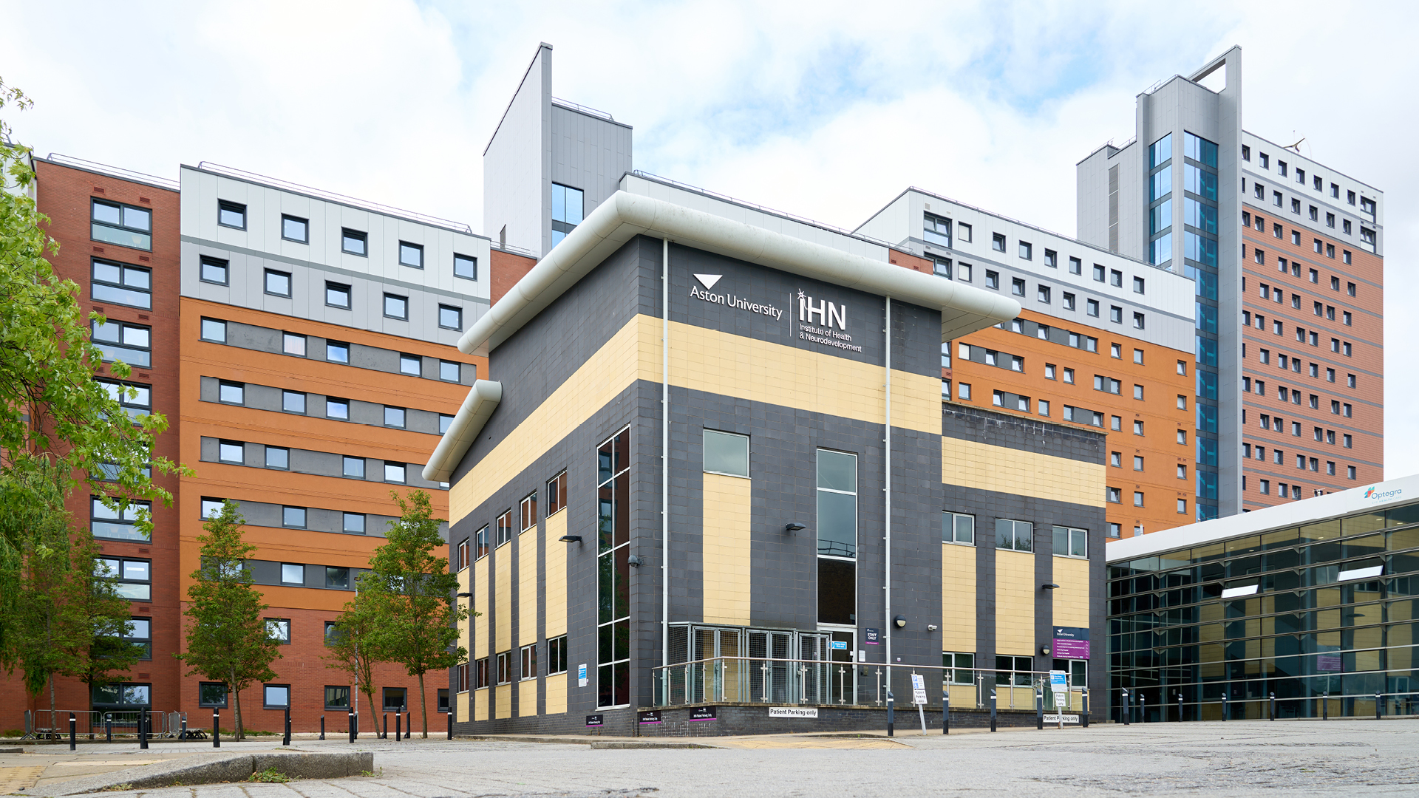
Science Park Contacts
University | Science or Technology Park
Birmingham Science Park Aston, Birmingham | info@astonsciencepark.co.uk
Birmingham Research Park, Birmingham | brpl@bham.ac.uk
Coventry University Technology Park, Coventry | +44 (0) 2476236000
Cranfield University Technology Park, Bedfordshire | joshua.parello@kirkbydiamond.co.uk
The Innovation Centre, Leicester | innovationcentre@dmu.ac.uk
University of Derby Science Park | +44 (0) 1332 742 800
INFINITY Park, Derby | ssalloway@salloway.com
Keele University Science and Innovation Park, Staffordshire | gateway@keele.ac.uk
Space Park, Leicester | enquiries@space-park.co.uk
Lincoln Science and Innovation Park | enquiry@lincolnsciencepark.co.uk
Loughborough University Science and Enterprise Park | lusep@lboro.ac.uk
University of Nottingham Innovation Park, Nottingham | reception@unip.nottingham.ac.uk
Nottingham Science Park | regeneration@nottinghamcity.gov.uk
University of Warwick Science Park, Coventry | more-info@uwsp.co.uk
University of Wolverhampton Science Park, Wolverhampton | joinus@wolverhamptonsp.co.uk
Birmingham Innovation Quarter, Birmingham | hello.scitech@bruntwood.co.uk
Skylon Park, Herefordshire | info@skylonpark.co.uk

Slide 36
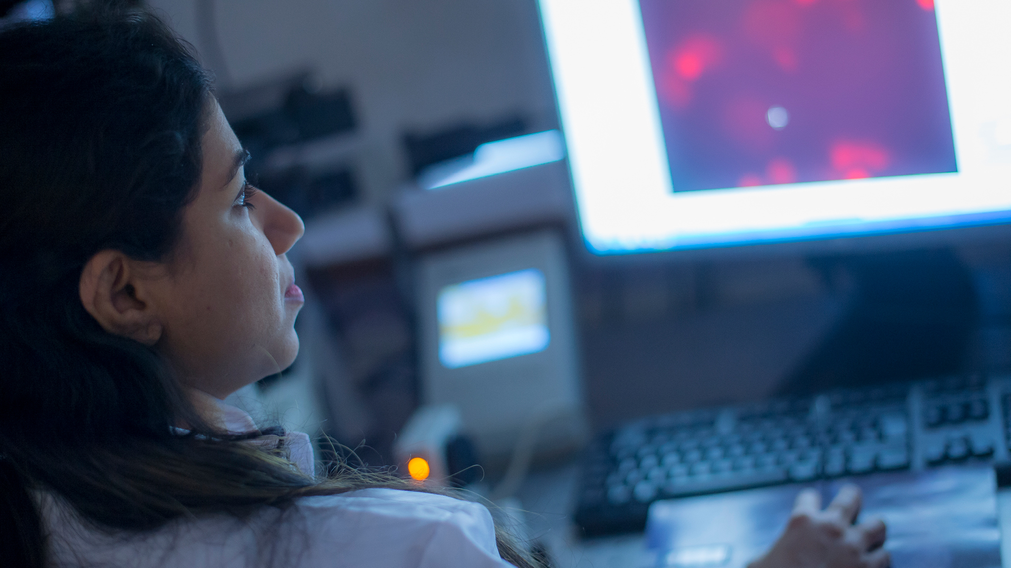
Investment support across the Midlands
Place focused inward investment support
Inward investment is supported by dedicated organisations in other parts of the Midlands, as detailed below.
Destination Chesterfield +44 (0) 1246 207207
Invest Coventry and Warwickshire contact@investcw.co.uk
Marketing Derby invest@marketingderby.co.uk
Invest in Leicester enquiries@investinleicester.com
Invest in Nottingham enquiries@investinnottingham.co.uk
Invest Telford Invest@telford.gov.uk
Invest Shropshire invest@shropshire.gov.uk
Invest Stoke-on-Trent enquiries@investstoke.co.uk
Invest Staffordshire hello@wearestaffordshire.co.uk
Invest in West Midlands invest@wmgrowth.com
Invest Wolverhampton invest@wolverhampton.gov.uk
Invest in Worcestershire +44 (0) 1905 677888
Team Lincolnshire investment@lincolnshire.gov.uk
The West Midlands Growth Company offers investors support to find the right networks, receive advice on locations, secure sector specific market research, identify funding support, and generate publicity.

Slide 37
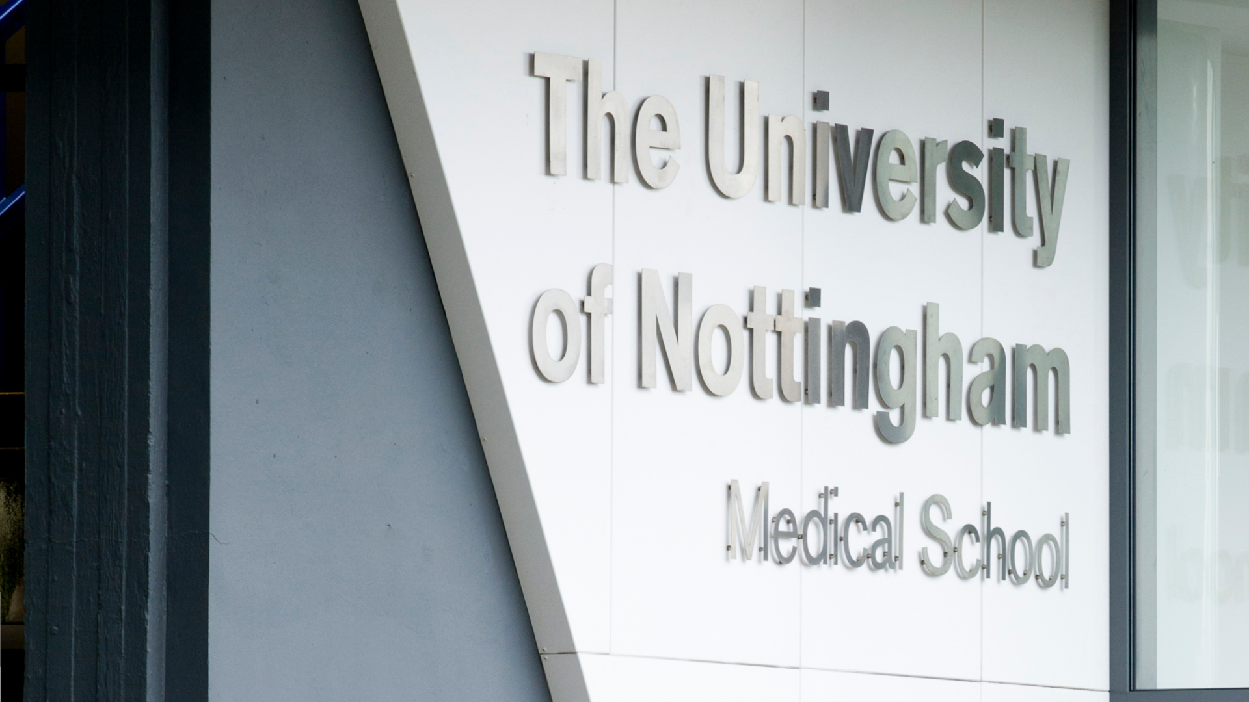
UK Investment Support
The UK’s ability to develop new ideas is one of our great strengths, from the jet engine and the bagless vacuum cleaner to MRI scanners and the world wide web. The UK’s talent pool, funding and incentives and business infrastructure all help create an environment of business innovation. Our commitment to world-leading research and development will help your business reach its full potential. We are one of the most innovative countries in the world - ranked in the top 5 countries in the Global Innovation Index 2019. For companies such as Ford, Pfizer, Eli Lilly, Nokia and Eisai, the UK’s business environment is the natural choice for investment in innovation.

Slide 38
Department for Business and Trade We support growth by backing businesses in the UK and globally, promoting investment and championing free trade.
Disclaimer Whereas every effort has been made to ensure that the information in this document is accurate, the Department for Business and Trade and the Contributors do not accept liability for any errors, omissions or misleading statements, and no warranty is given or responsibility accepted as to the standing of any individual, firm, company or other organisation mentioned.
© Crown copyright 2023 This publication is licensed under the terms of the Open Government Licence v3.0 except where otherwise stated. To view this licence, visit https://www.nationalarchives.gov.uk/doc/open-government-licence/version/3/
Where we have identified any third party copyright information you will need to obtain permission from the copyright holders concerned.
Published by Department for Business and Trade October 2023

