Slide 1
Prospectus
Invest in UK University R&D
Agritech in the Midlands

Slide 2
Forge the future of agritech with universities in the Midlands

Slide 3
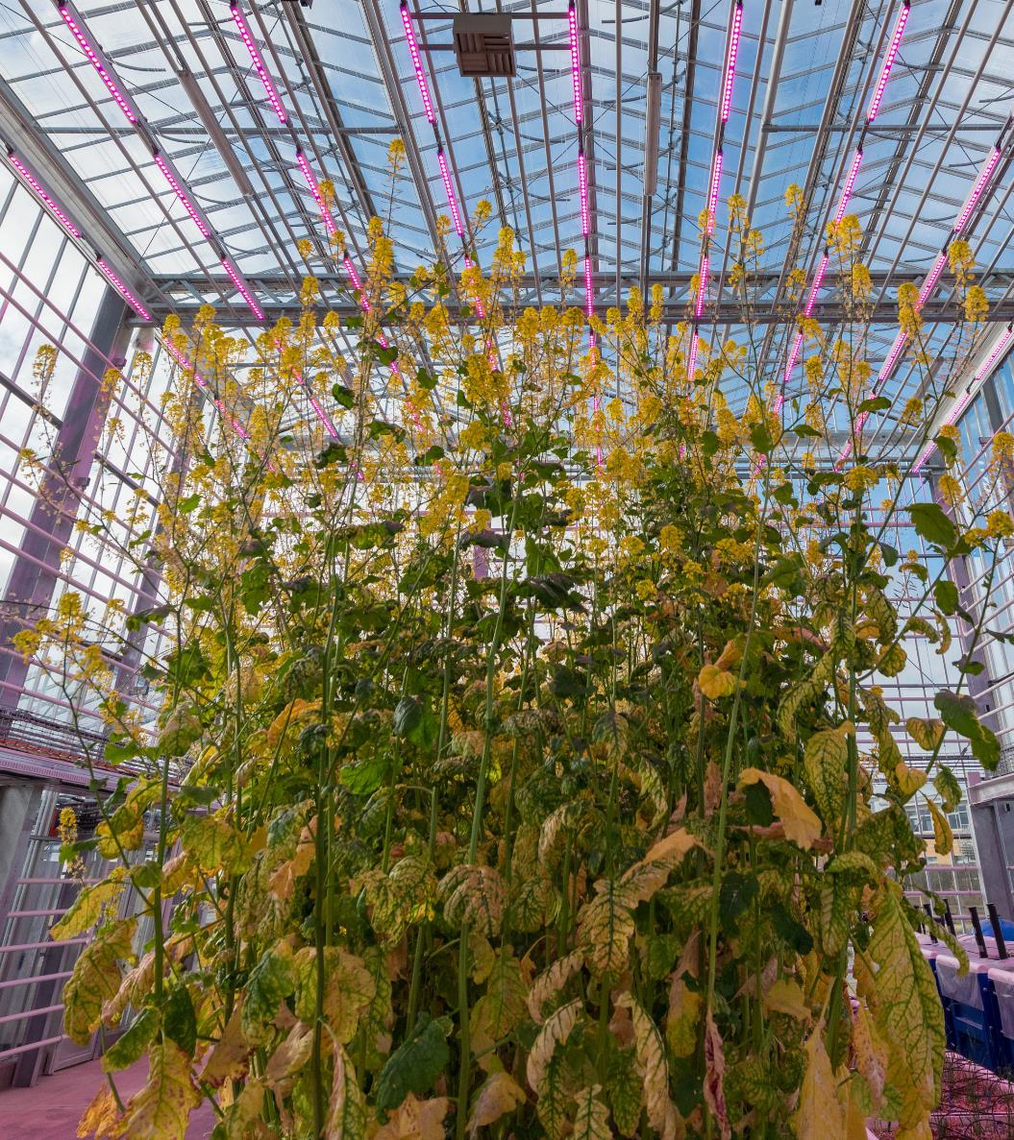
The UK‘s agricultural market is one of Europe’s biggest. Its population of professional farmers and growers are keen to adopt new technologies that will help them become more efficient

Slide 4
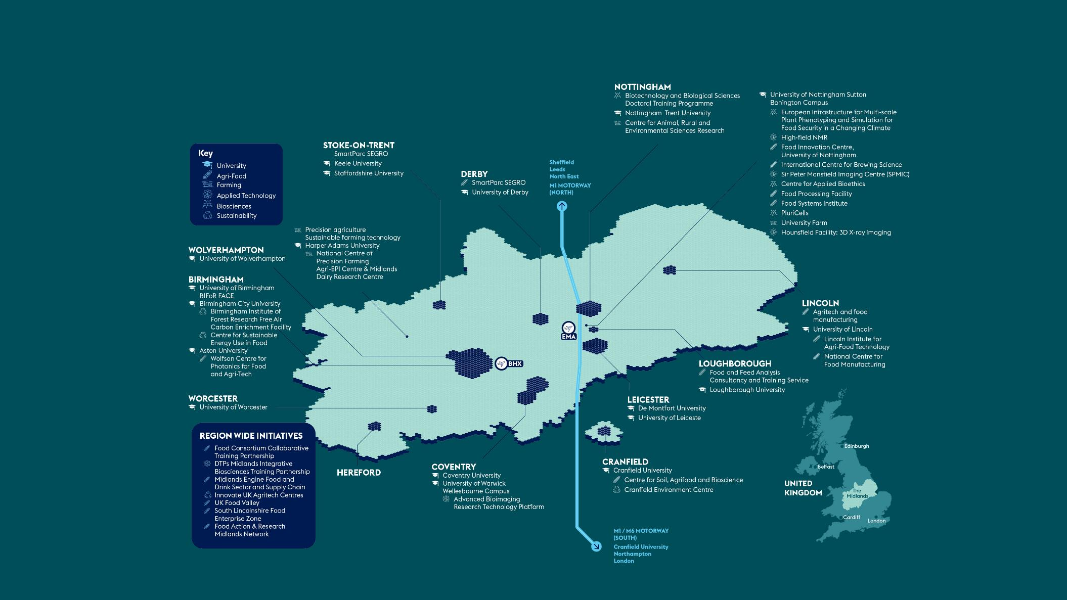
Universities and agritech in the Midlands – major R&D assets

Slide 5
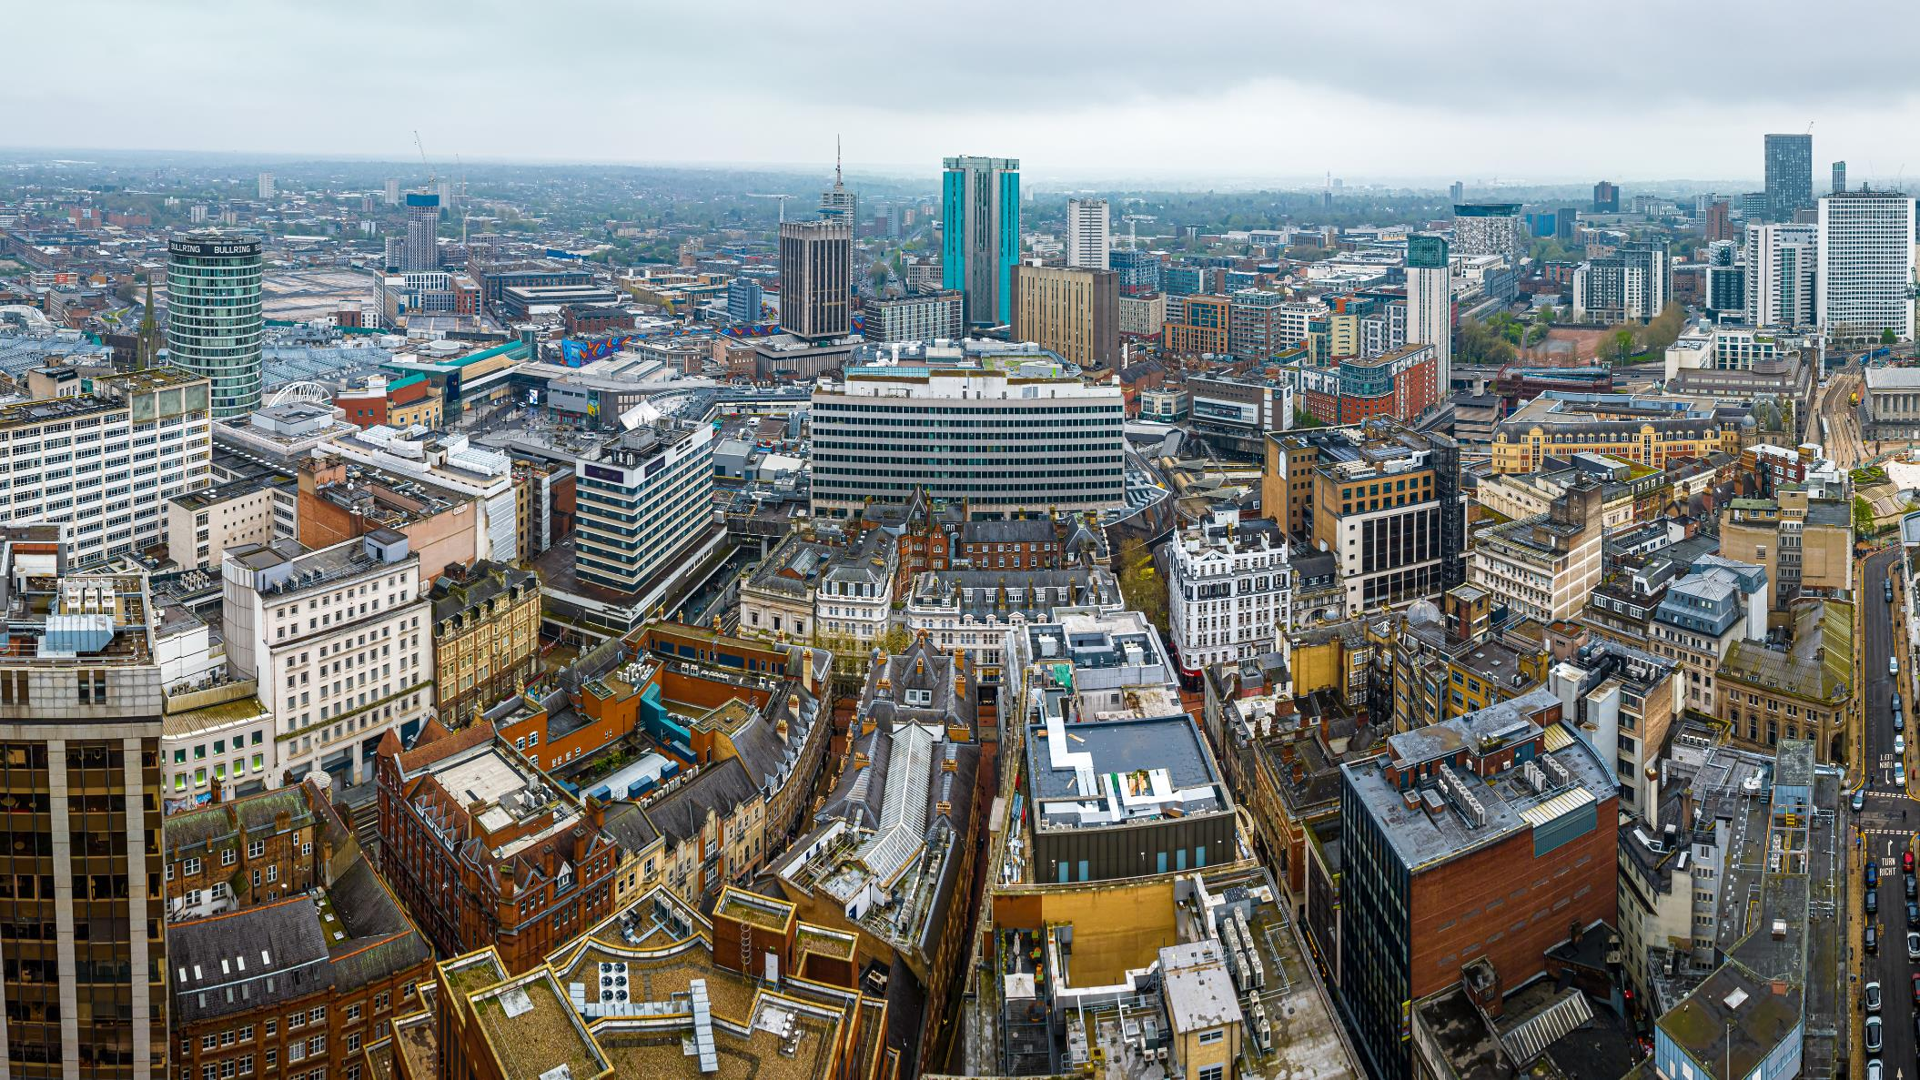
Science and innovation pedigree
At the heart of the Midlands' science and innovation landscape are its world-class universities. Midlands Innovation (MI) is a partnership of eight research-intensive universities in the Midlands region of England: Aston University, University of Birmingham, Cranfield University, Keele University, University of Leicester, Loughborough University, University of Nottingham, and University of Warwick.

Slide 6
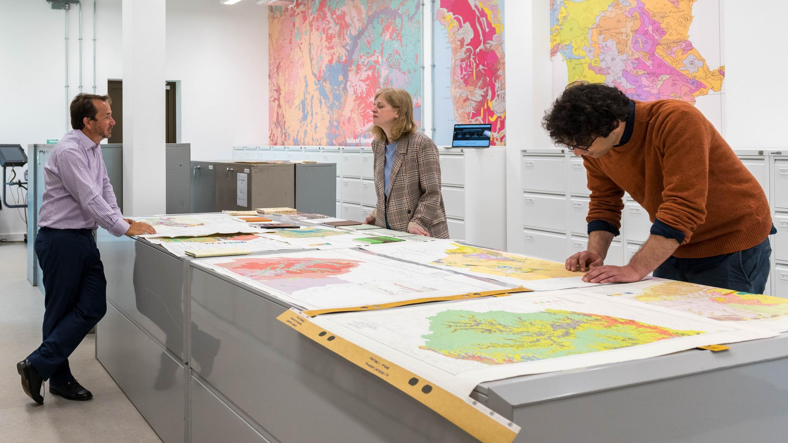
World-leading
agritech sectors
in the Midlands

Slide 7
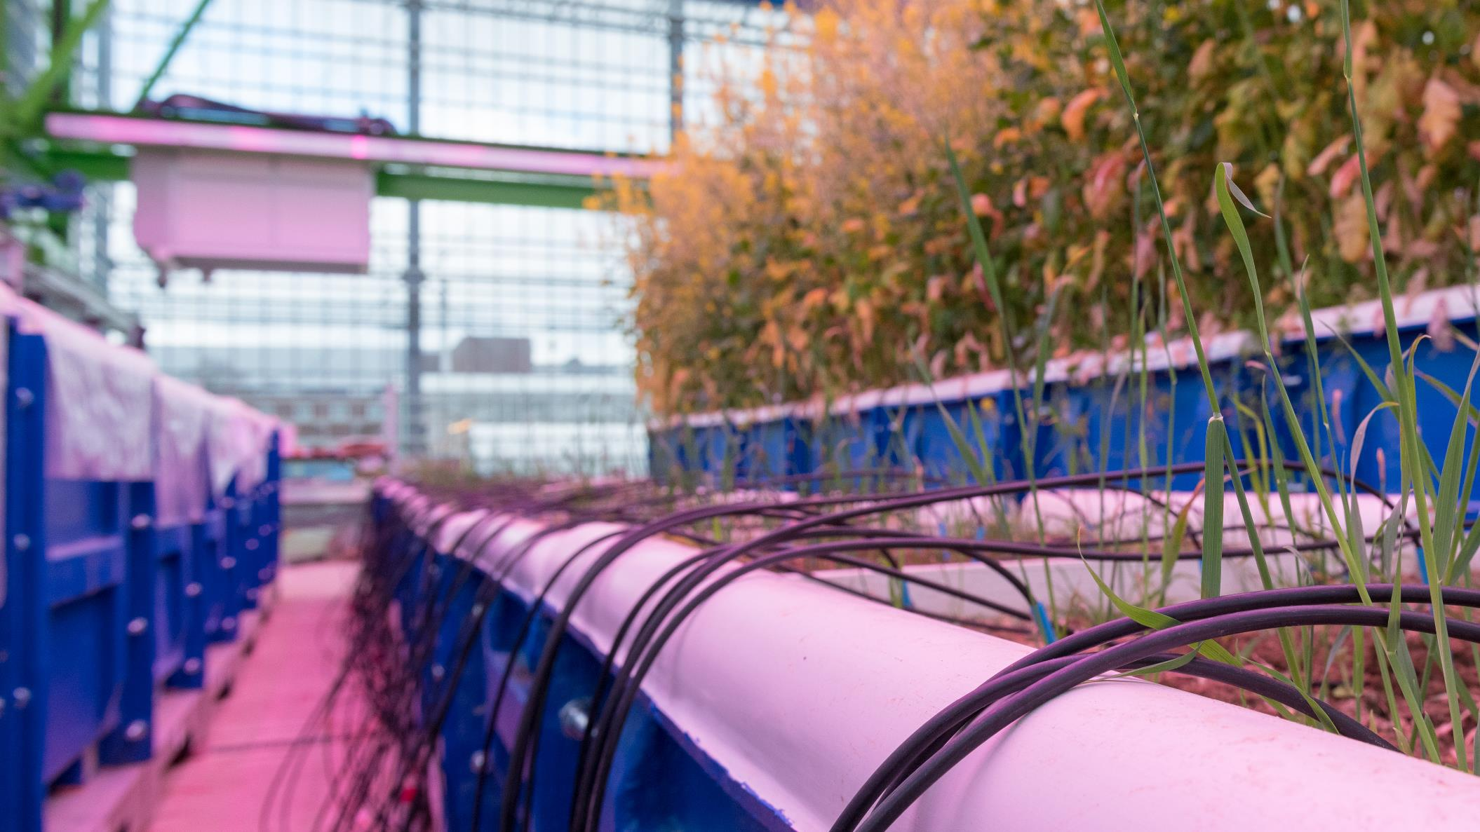
Agrifood manufacturing
The UK’s export strengths in food and drink are driven by innovation built on many decades of investment in food production processes, brands and local product identities. Food and drink manufacturing constitutes the largest manufacturing sector in the UK, contributing over £96bn per annum, and employing over 3.3m people, and buying two thirds of the UK’s agricultural produce.
Over 11million packets of crisps are produced each day, at the Walkers factory in Leicester.
The University of Nottingham has been an internationally recognised centre of agriculture and food research for 125 years, through the University Farm at the Sutton Bonington Campus.
Over 200,000 Midlands jobs are supported through the food production supply chain.

Slide 8
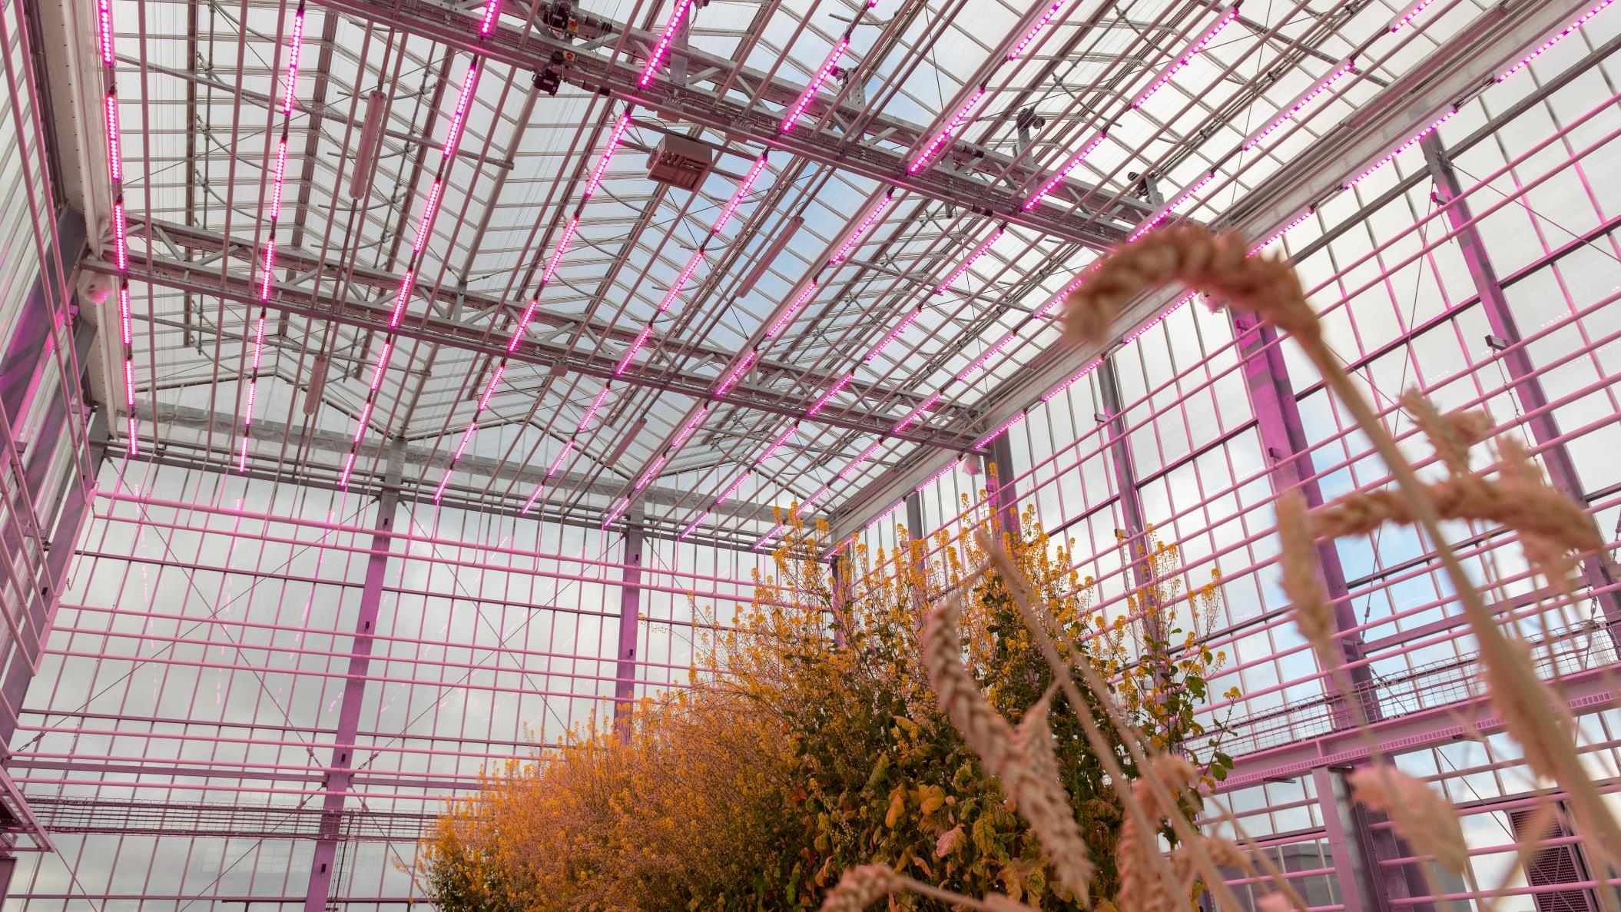
Agritech farming
One of Midlands’ biggest economic strengths is in farming, with the Midlands being the second highest exporting region for food in the UK - £1.8bn of food was exported in 2021. Well known examples include Stilton cheese, Bramley apples and Melton Mowbray pork pies.
Up to 30% of the UK’s vegetable crop is grown and picked in Lincolnshire.
Worcestershire, Herefordshire and Warwickshire make up over 20% of the UK’s soft fruit industry
70% of all fish consumed in the UK is processed in Grismby.

Slide 9
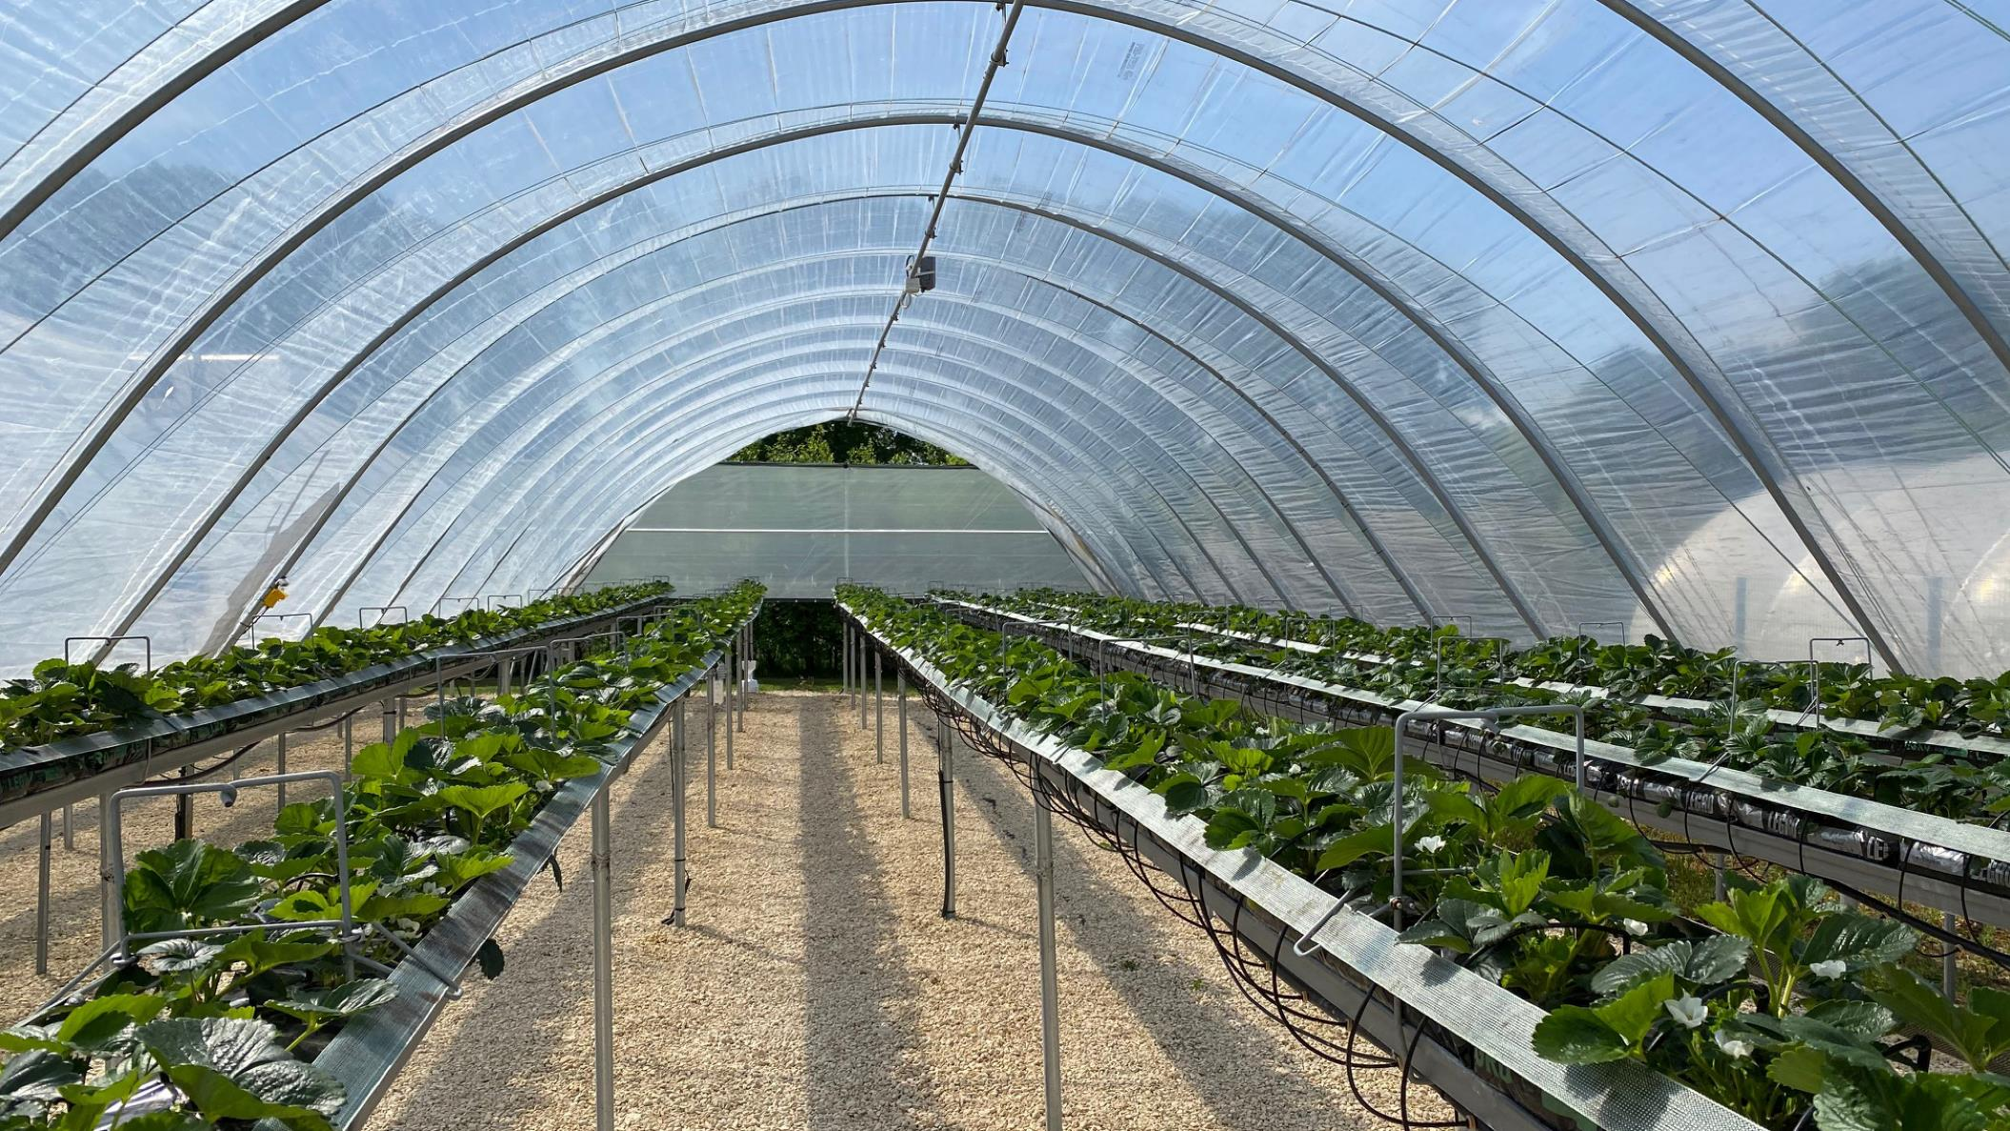
Enablers of research and development in agritech

Slide 10
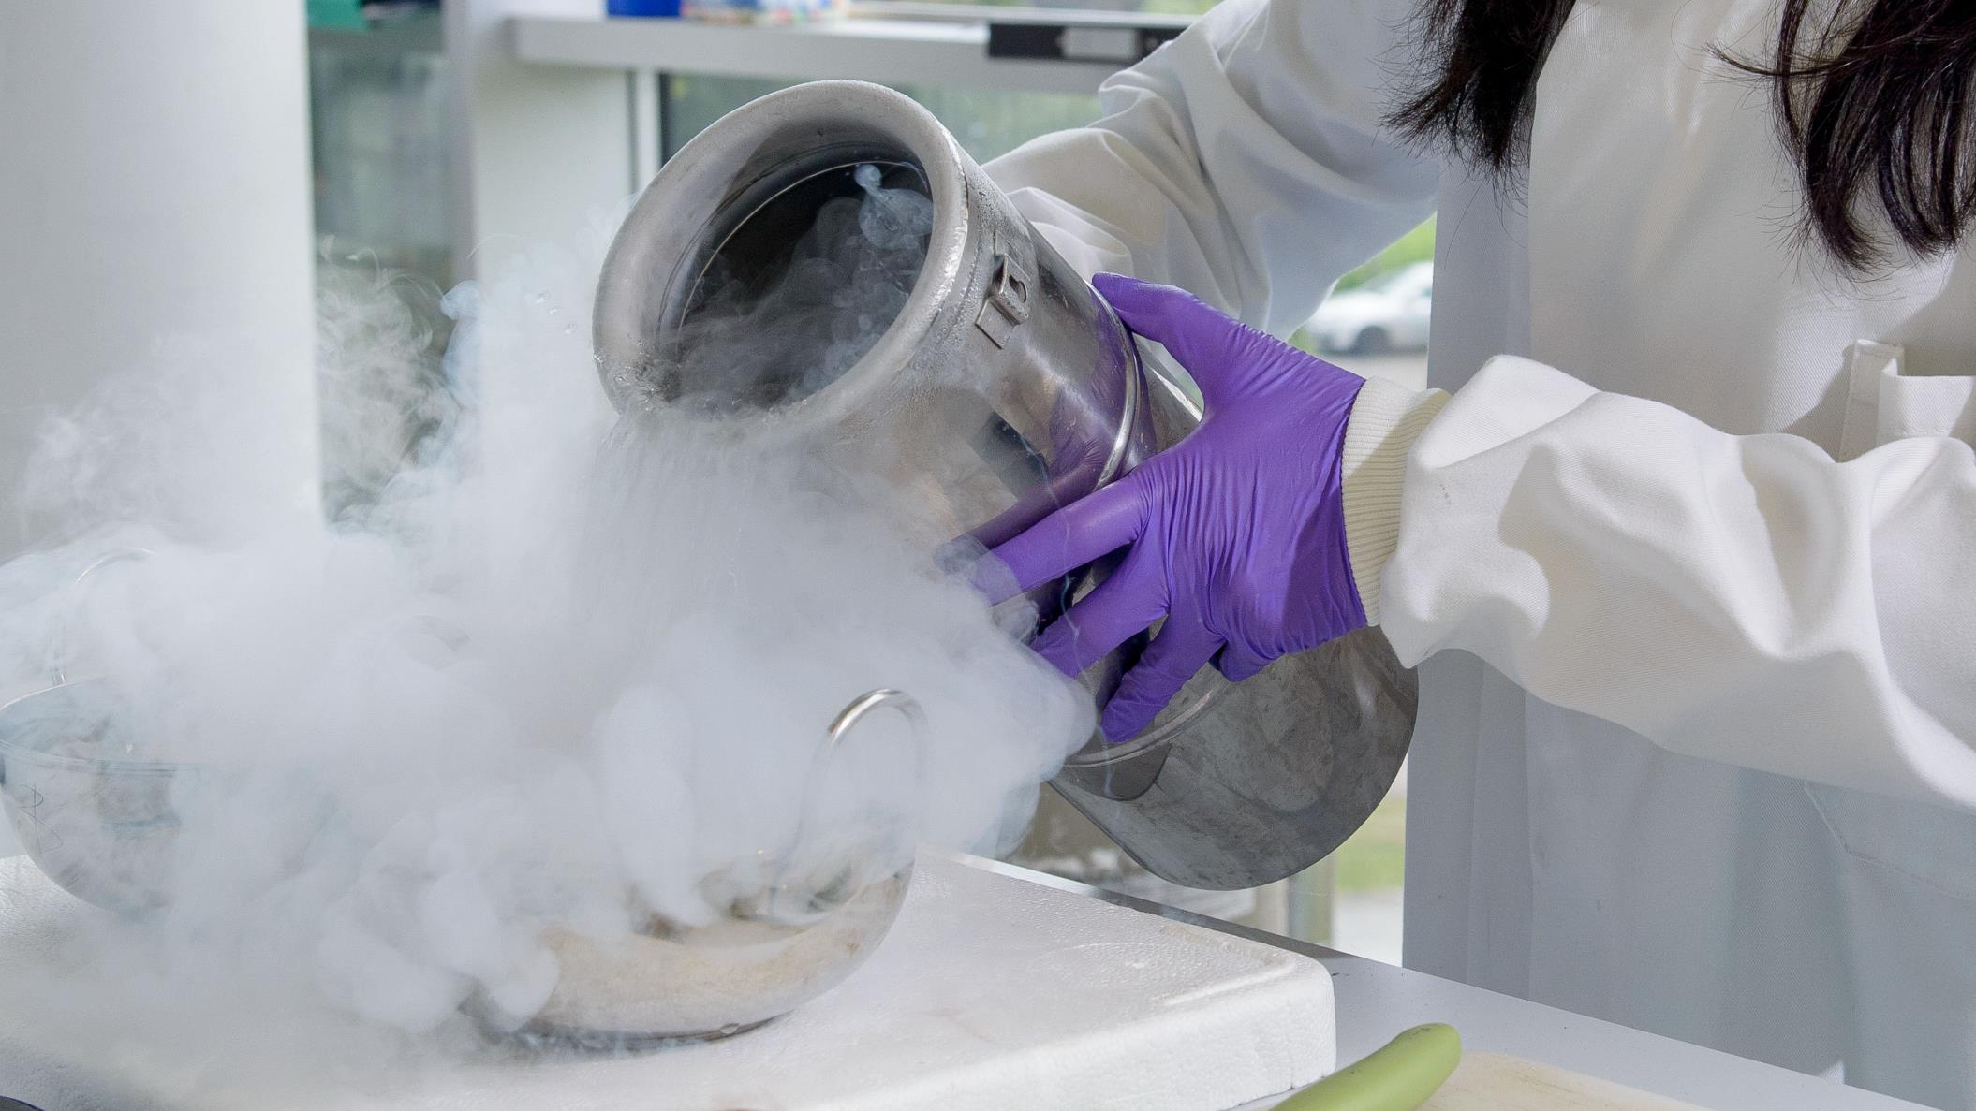
Biosciences
The Midlands has the highest crop and livestock output of all English regions. Along with swathes of arable land, agritech clusters in the Midlands benefit from dedicated cluster support environments and connectivity with leading research and innovation spaces.
Customers now actively seek to reduce their meat intake with 31% more adults planning to eat more meat-free than in the previous year, and 43% of UK consumers changing their habits to help the environment. Between 2021 and 2022, investment in the cultivated meat sector in the UK rose from £12m to £59m. This makes Britain the number one nation in Europe for sustainable protein funding.

Slide 11
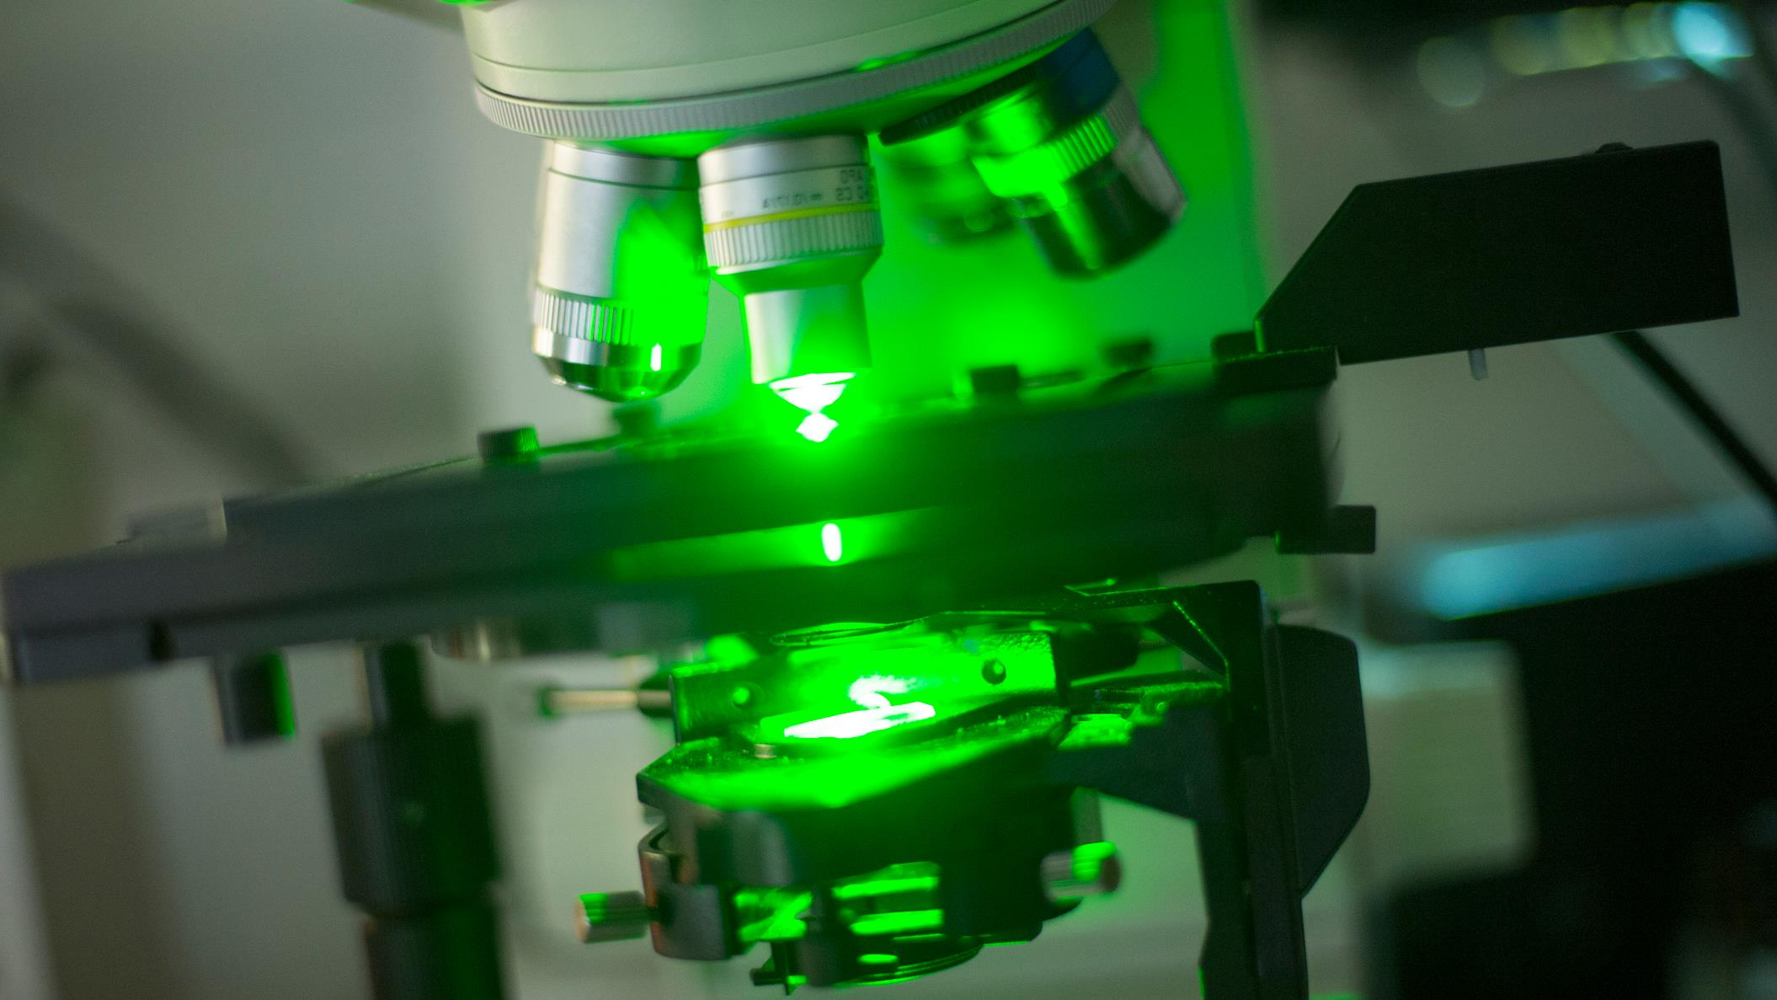
Applied technologies
There are four designated UK Agritech Centres, working with farmers and businesses across the agrifood value chain to support greater efficiency, resilience and profitability. Each Centre has a base in the Midlands. The Centres work to drive greater efficiency, resilience and wealth across the agri-food sector, and are supported by Innovate UK. The UK Agri-Tech Centres will now be forming a single entity and working with Innovate UK to develop a proposal for a new single agri-tech catapult with integrated capability. These centres are: Crop Health and Protection, Centre for Innovation Excellence in Livestock and Agricultural Engineering, Precision and Innovation Centre.
30% of UK food logistics starts or passes through Greater Lincolnshire.
Greater Lincolnshire has more than 4,000 high-technology agri-food SMEs.

Slide 12
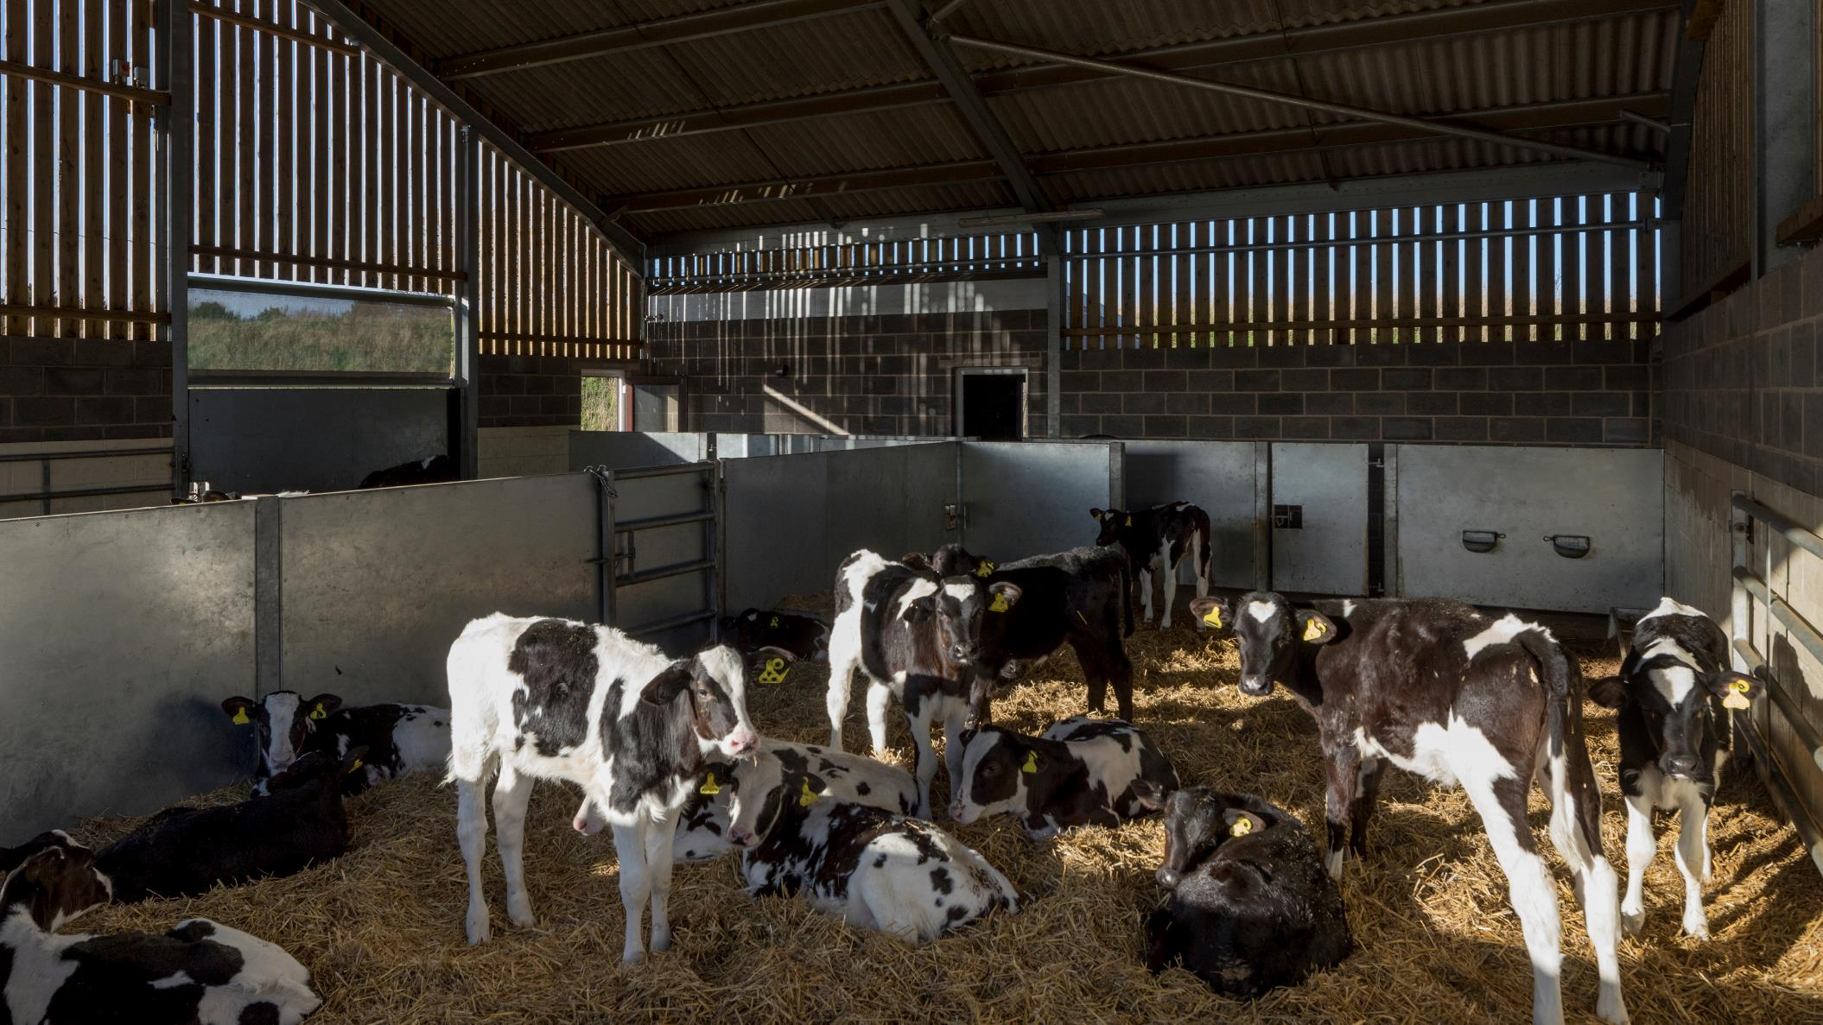
Sustainability
Moving toward net zero remains a key challenge for the food production supply chain. Agritech has sustainability at the core of its research goals, be it in farming, agri-food manufacturing, applied research, or the supply chain. For agritech businesses seeking to develop more sustainable methods of production, the Midlands is well placed to support your needs.
The Midlands also has a strong pipeline of high quality graduates and researchers, working in sustainable methods connected to agritech.

Slide 13
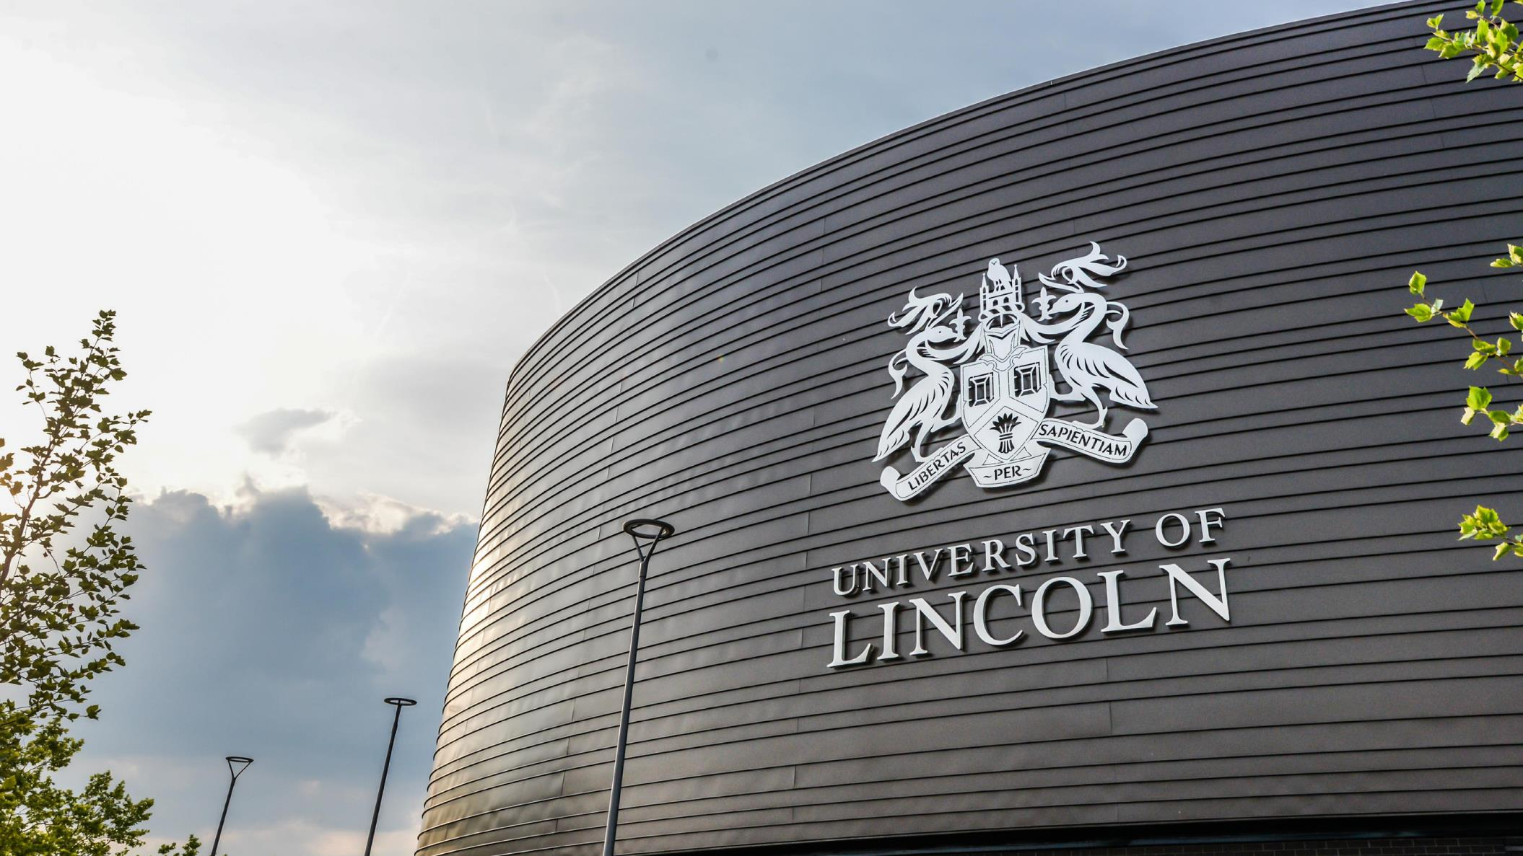
Invest in a partnership with Midlands universities

Slide 14
Research translation
Universities in the Midlands have an exceptional track-record of working with the world’s largest companies, helping translate fundamental research into industry-leading innovations.
The University of Warwick and the University of Nottingham are both in the Top 5 recipients of the £885m of Innovate UK Funding allocated across the UK in the last 10 years.

Slide 15
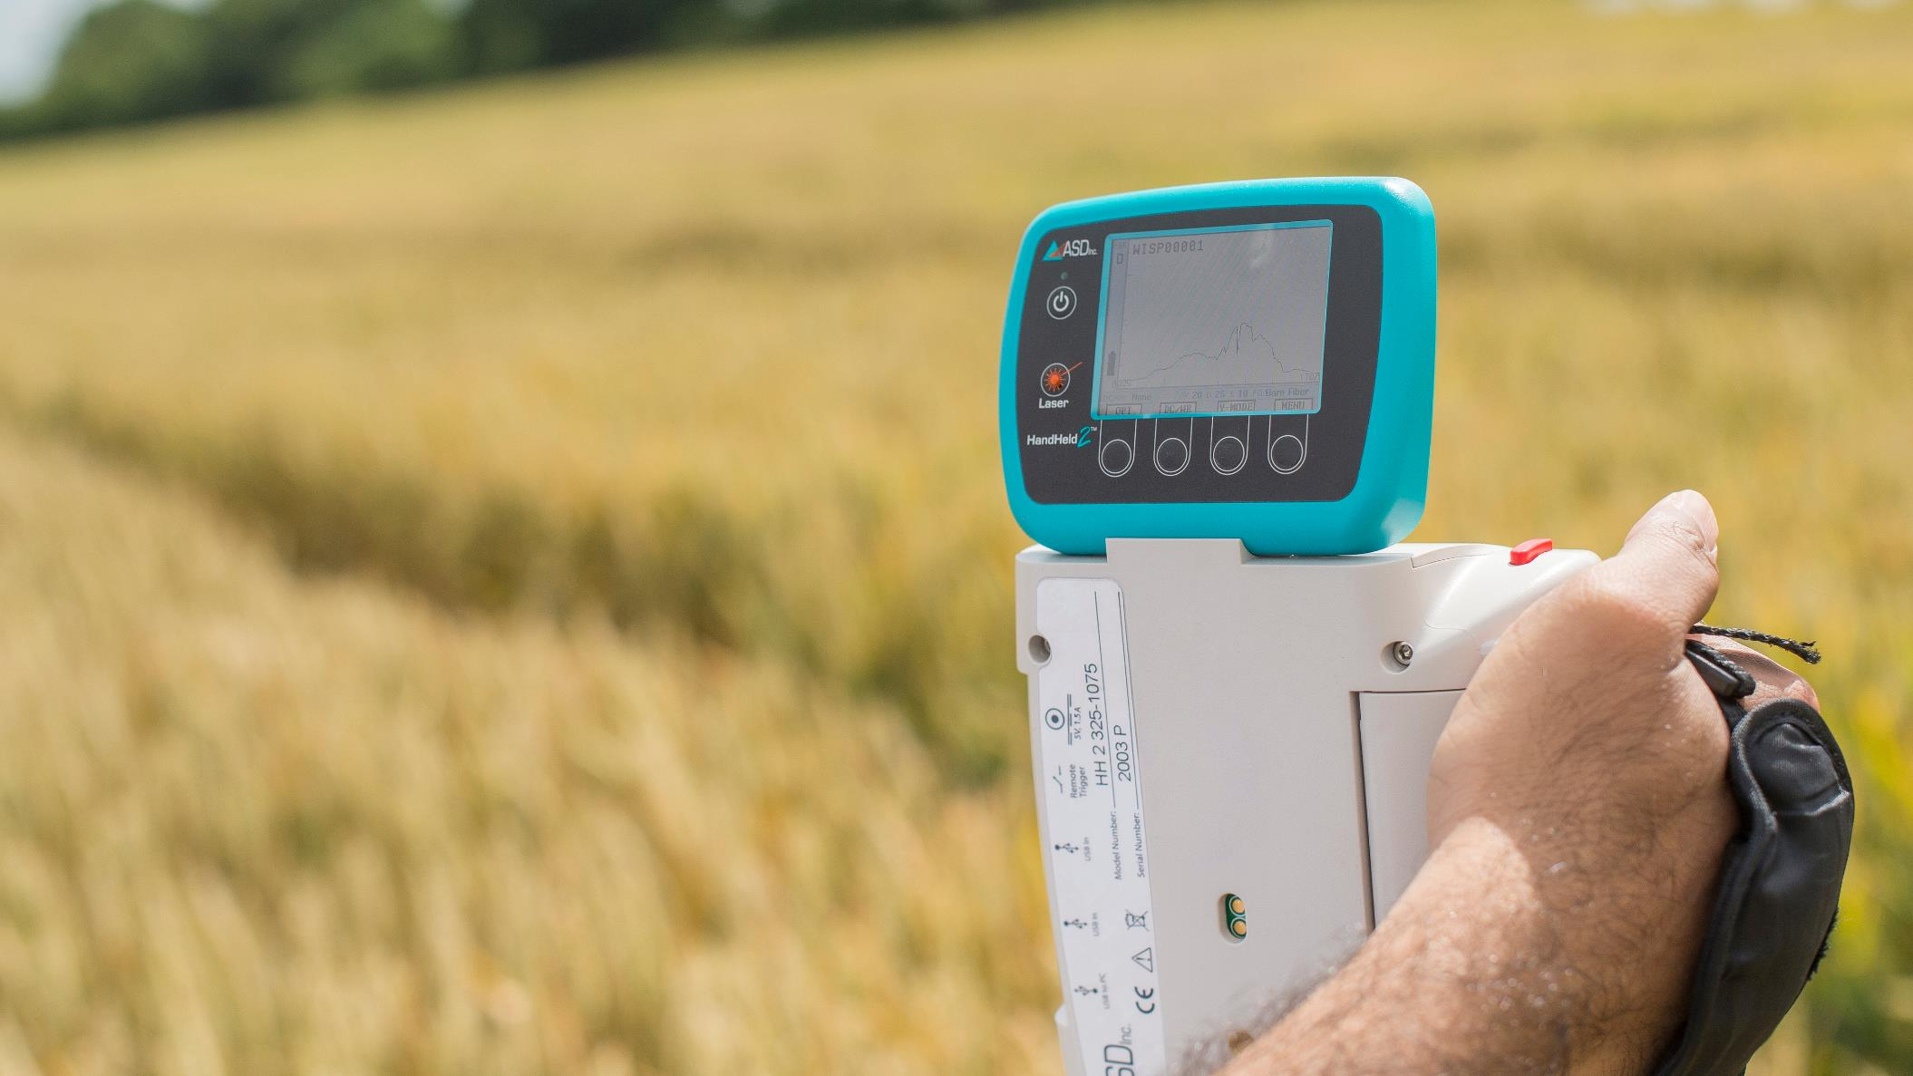
Innovation
Midlands universities have been supporting the innovation eco-system of their local and regional economies for decades. If your business is looking to access innovation support chains, our dedicated support programmes, funding and networks can help you do this. Through co-funded Government schemes like Knowledge Transfer Partnerships (KTPs), which is one of the most successful, long-running innovation schemes anywhere in the world, we help business of all sizes to innovate using the knowledge and expertise of UK universities.

Slide 16
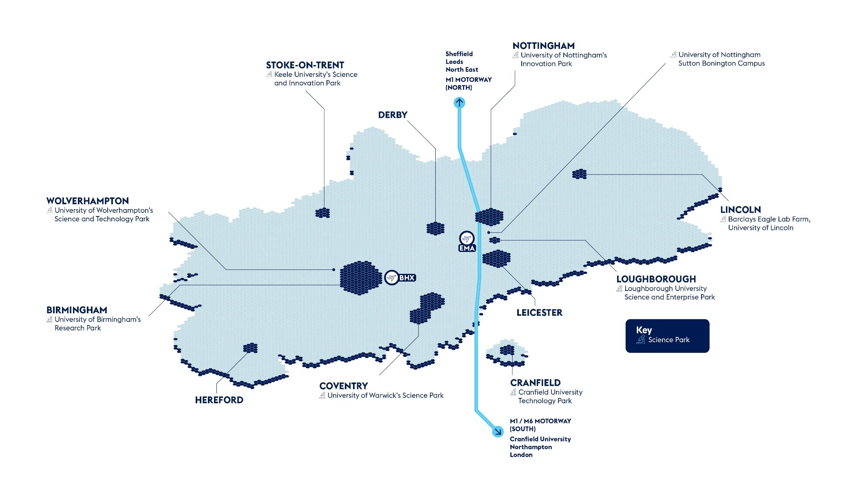
Co-location

Slide 17
Regeneration
and integration
Universities across the Midlands work in partnership with the UK and Local Government to help drive economic growth through innovation and inward investment. Through a range of public-private partnerships, universities are involved in over 20 major economic development opportunities identified by the Midlands Investment Portfolio, worth over £10bn in Gross Development Value. In the West Midlands, universities work with the Combined Authority and Growth Company to host one of only three UK Innovation Accelerators.

Slide 18
Talent
Home to 20 universities, the Midlands hosts over 350,000 students and 100,000 graduates a year. Our universities will work in partnership with local economic growth organisations to develop tailored skills and training package – from degree apprenticeships, to dedicated training and skills programme, to industry-funded PhDs – to support the growth of future industries and your business.

Slide 20
Midlands Mindforge - £250m patient capital fund combining the spinout portfoliosof eight leading UK universities
Midlands Mindforge is an ambitious, patient capital investment company aiming to transform ground-breaking science and technology into successful businesses with the potential to positively impact our world and accelerate the commercialisation of research from our partner universities - Aston, Birmingham, Cranfield, Keele, Leicester, Loughborough, Nottingham, and Warwick.
By providing capital and company-building skills to university spinouts and early-stage IP rich businesses in the Midlands, we will build the foundations of a new technology eco-system in the region and create companies that can drive economic growth whilst delivering real-world impact.
enquiries@midlandsmindforg

Slide 21
Midlands Mindforge - £250m patient capital fund combining the spinout portfoliosof eight leading UK universities
Midlands Mindforge is an independent company that aims to raise up to £250m from strategic corporate partners, institutional investors and qualifying individuals.
Mindforge will “invest with impact” to found and scale transformational science backed companies in sectors such as Clean Technologies, AI and Computational Science, Life Sciences and Health Tech, to create highly skilled jobs and support the UK’s ambition to become a science and technology superpower.
enquiries@midlandsmindforg

Slide 22
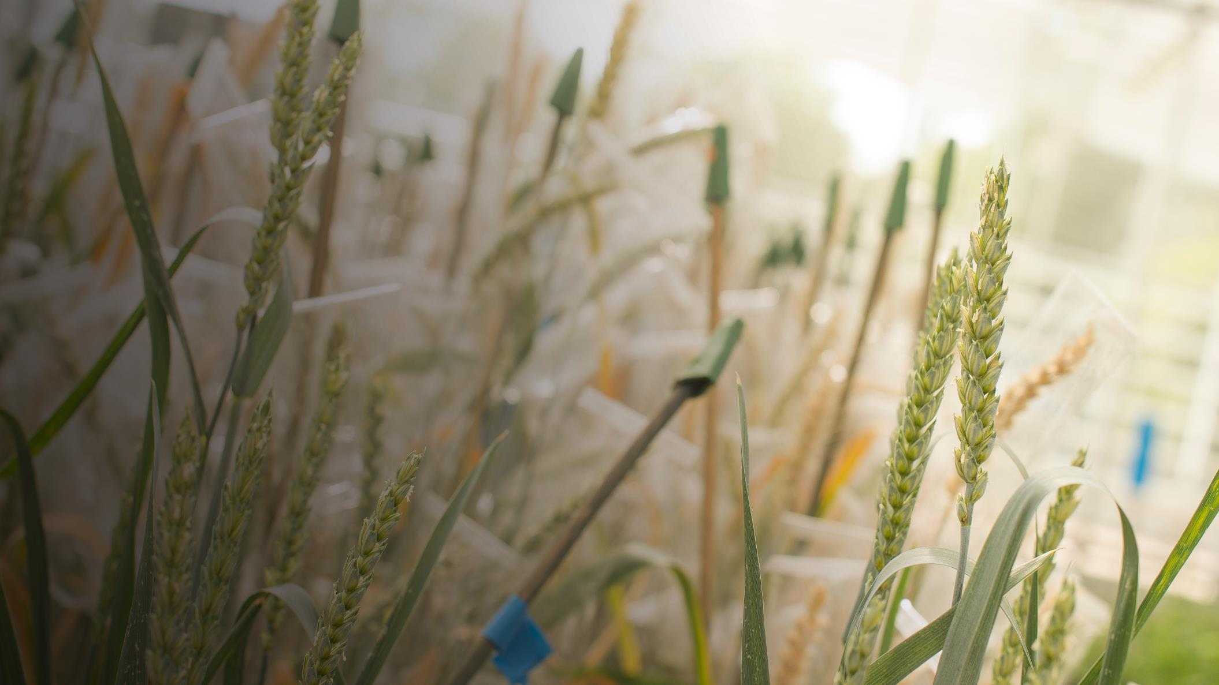
Directory of significant Agritech R&D assets across the Midlands and its universities

Slide 23
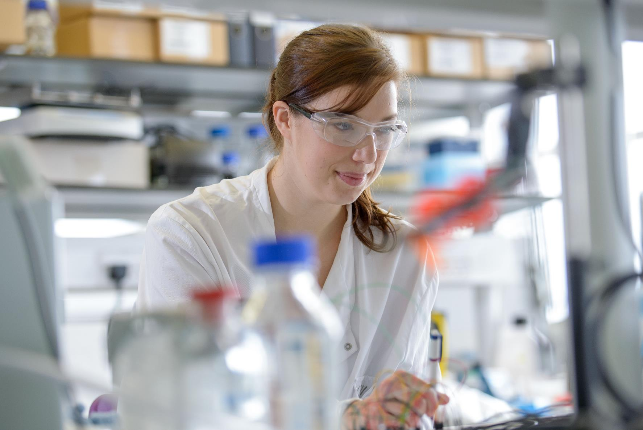
Sectors
Investor support
Remarkable new technology means the UK can now decarbonise its agriculture sector and help its food supply chain become more sustainable. The UK‘s agricultural market is one of Europe’s biggest. Its population of professional farmers and growers are keen to adopt new technologies that will help them become more efficient.
Agritech investment opportunities in the UK are focused around 3 main areas:
World-class science
Progressive farming
A dynamic business environment

Slide 24
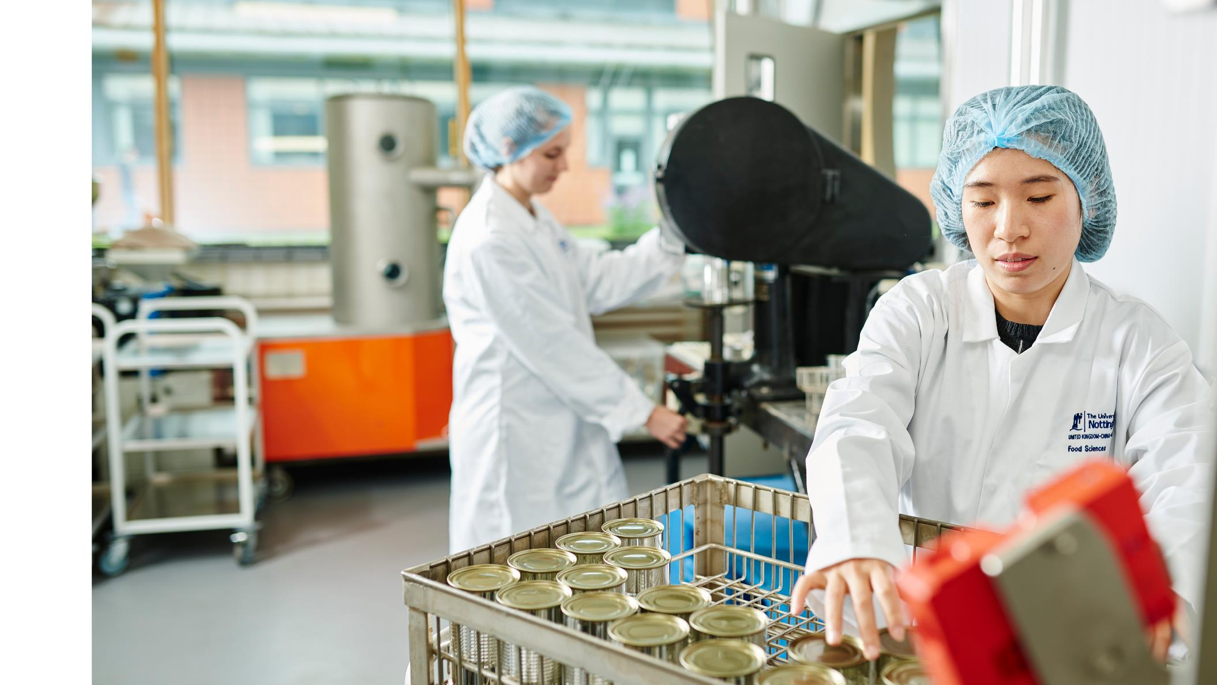
Sectors
Agri-food
Research assets
University based
Training
Cluster organisations
Warwick Crop Centre
Warwick Crop Centre is part of the University’s School of Life Sciences and is an internationally recognised centre for translational research in sustainable agriculture and horticulture and in food security. The School of Life Sciences was ranked second in the UK for Agriculture, Food and Veterinary research in the Government's 2014 “Research Excellence Framework”.

Slide 25
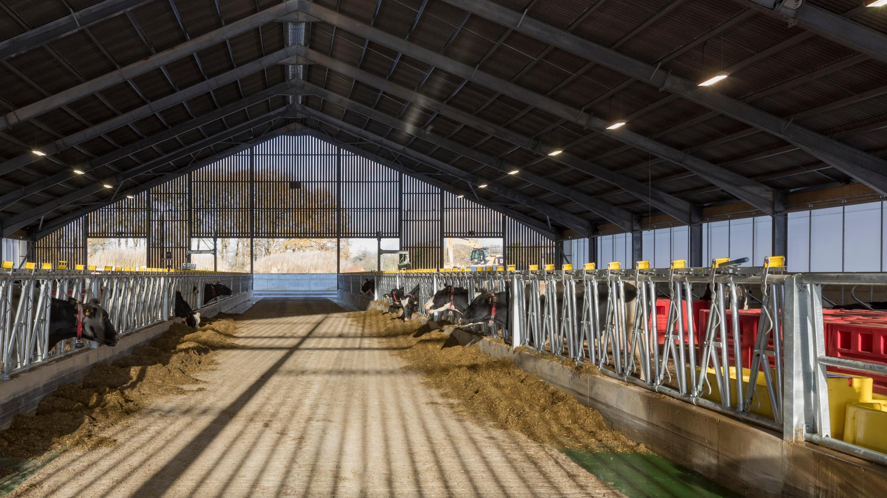
Sectors
Agritech farming
National Centre for Precision Farming
The Centre’s mission is to establish global visibility and excellence in education and training, research and development, innovation and enterprise in precision farming and its exploitation in addressing global farming and food security issues.
Research assets
University based
Training

Slide 26
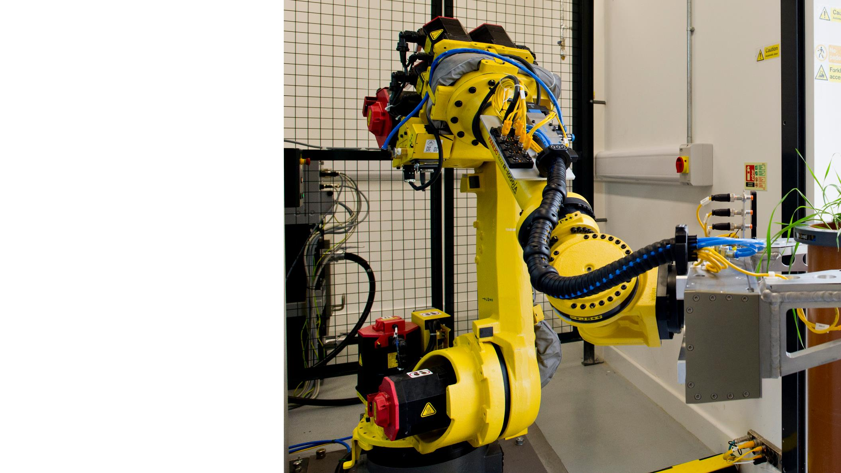
Enablers
Applied technology
Research assets
University based
Training
The Hounsfield Facility, University of Nottingham
The Hounsfield Facility is based within the School of Biosciences at the Sutton Bonington campus, as part of the University of Nottingham. Opened in 2014, it houses state-of-the-art X-ray CT equipment integrated with automated robotics. This enables scientists to explore the internal architecture of biomaterials and support research into environmental sustainability and global food security.

Slide 27
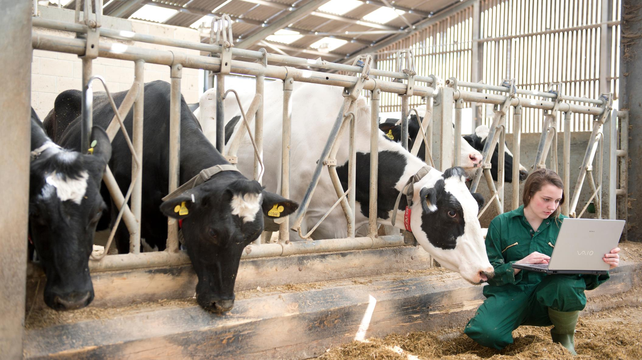
Enablers
Biosciences
Centre for Formulation Engineering
The Centre for Formulation Engineering is developing solutions to problems facing industries in the pharmaceutical, biotechnological, food, fast moving consumer goods and speciality products sectors. This is vital to many issues affecting the quality of life; such as better economical processes to reduce the environmental burden, and longer lasting food due to the right combination of chemistry, ingredients and processes.
Research assets
University based
Training

Slide 28
Enablers
Sustainability
Birmingham Institute of Forest Research
One of the key challenges BIFoR addresses is the impact of climate and environmental change on woodlands.
Carbon Dioxide (CO₂) levels in our air are rising, mostly due to our use of fossil fuels. As CO₂ rises, so does the world’s temperature. Trees and the soil around them help us capture some of this CO₂. In a giant experiment in a Staffordshire woodland, we are pumping CO₂ around trees to simulate the atmosphere we’re predicted to have in 2050. This helps us see how the woodland responds – do the trees grow faster, locking away more carbon, or will changes in the soil and insect life cause problems? Learning about the effects of increased CO₂ helps us plant woodland most likely to survive and thrive in the future.
Research assets
University based

Slide 29
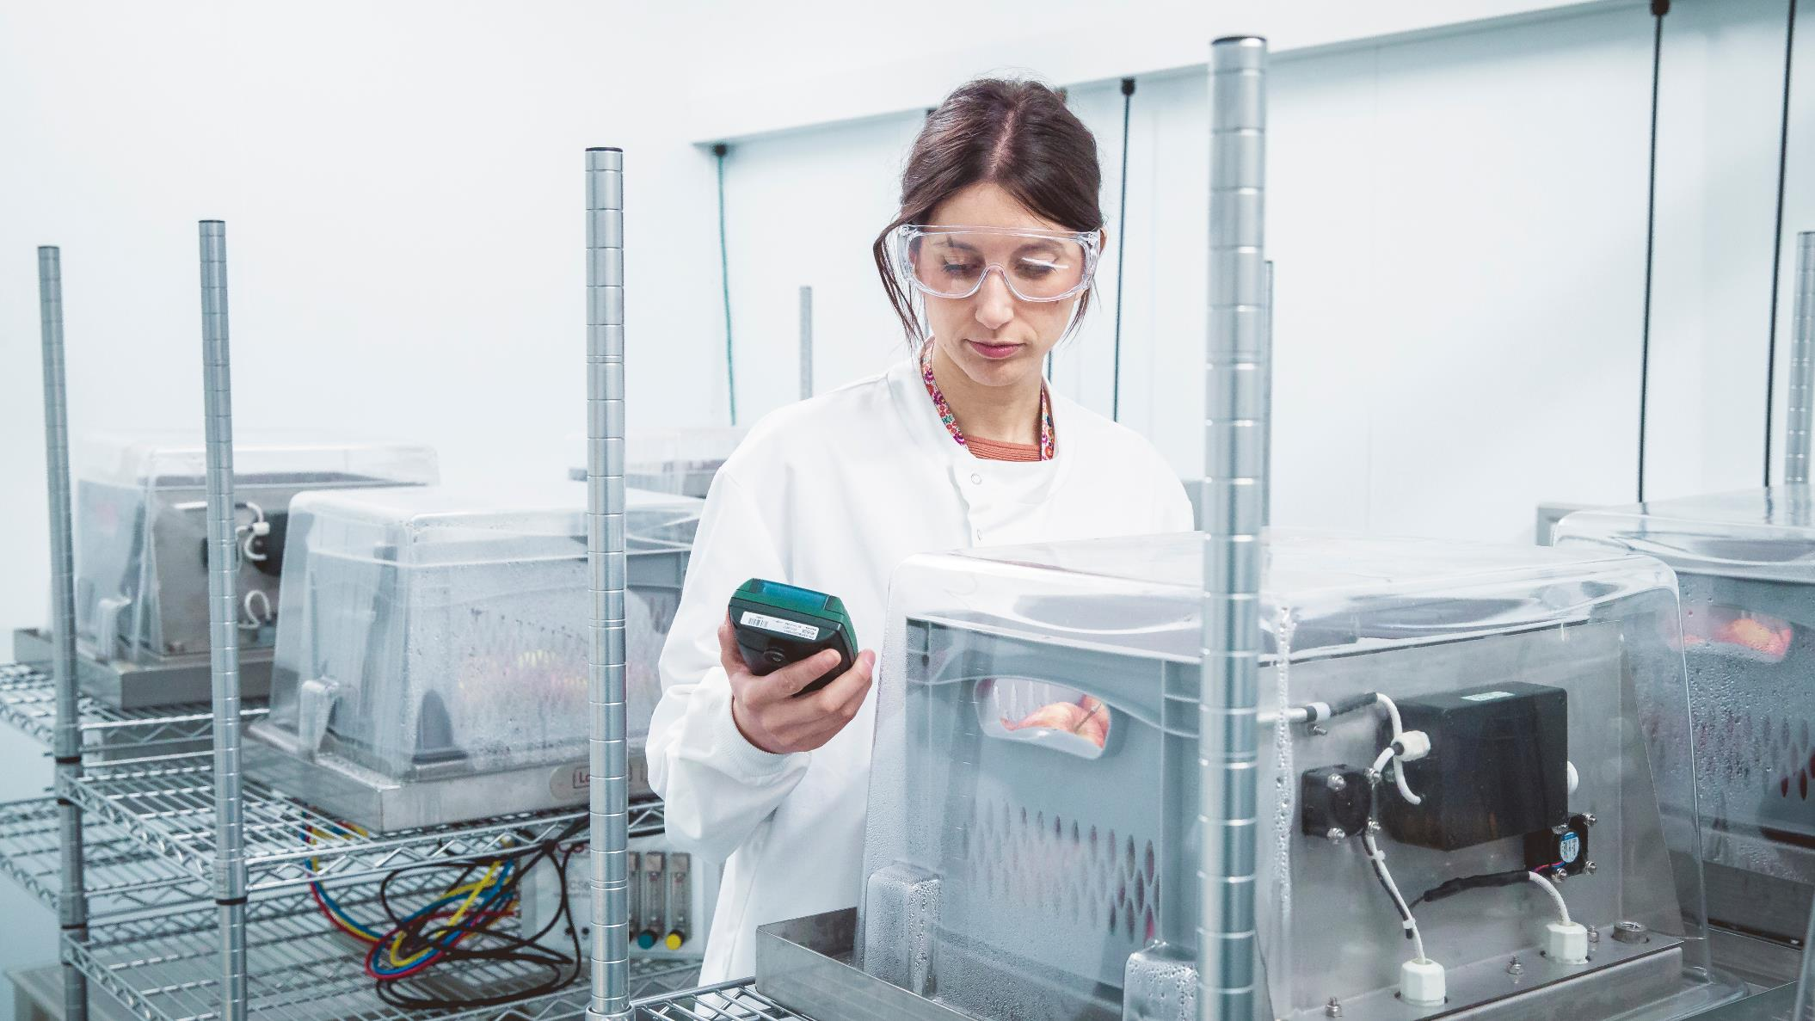
Work with us

Slide 30
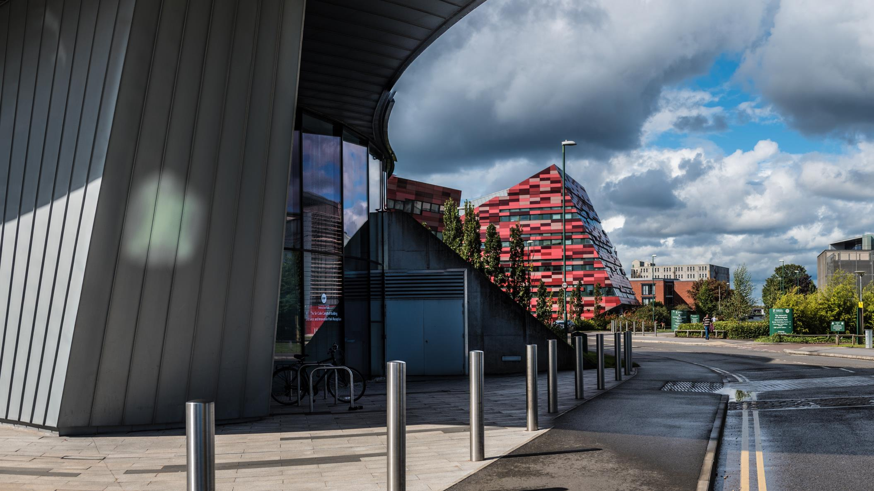
Our universities
From the Midlands, 90% of the UK’s population and businesses are less than a four-hour drive away; 45% of heavy rail freight and 33% of heavy road freight comes from, goes to, or passes through the Midlands and, with the advent of HS2, London will be less than an hour away. By air, the Midlands is home to two international airports – Paris is just a 90 minute flight away – with access to the seaports of the Humber. The Midlands are home to 11 million people, 15% of the UK’s GVA, and the only inland freeport. This is critical to dispersing the output of the Midlands and accessing the potential markets of not only the wider UK, but Europe and international buyers. The region is constantly growing with new development sites and spaces for bespoke builds, including labs, test spaces, and offices.

Slide 31
Directory of contacts across the Midlands
University | Business engagement and Technology Transfer | Careers service
Aston University | rke@aston.ac.uk | employerteam@aston.ac.uk
University of Birmingham | info@enterprise.bham.ac.uk | recruiters@contacts.bham.ac.uk
Coventry University | ei@coventry.ac.uk | talentteam@coventry.ac.uk
Cranfield University | business@cranfield.ac.uk | cranfieldcareers@cranfield.ac.uk
De Montfort University | businessservices@dmu.ac.uk | employerliaison@dmu.ac.uk
University of Derby | businessgateway@derby.ac.uk | employerteam@derby.ac.uk
Harper Adams University | reception@harper-adams.ac.uk | careers@harper-adams.ac.uk
Keele University | gateway@keele.ac.uk | gateway@keele.ac.uk
University of Leicester | redenterprise@le.ac.uk | employer.services@le.ac.uk
University of Lincoln | enterprise@lincoln.ac.uk | careers@lincoln.ac.uk
Loughborough University | innovation@mailbox.lboro.ac.uk | employer.services@lboro.ac.uk
University of Nottingham | workwithus@nottingham.ac.uk | recruiterservices@nottingham.ac.uk
Nottingham Trent University | workingwithyou@ntu.ac.uk | talent@ntu.ac.uk
University of Warwick | ventures@warwick.ac.uk | employerconnect@warwick.ac.uk
University of Wolverhampton | engage@wlv.ac.uk | theworkplace@wlv.ac.uk
University of Worcester | researchforbusiness@wor.ac.uk | careers@worc.ac.uk

Slide 32
Science Park Contacts
University | Science or Technology Park
Barclays Eagle Lab Farm | lisa.bagley@barclays.com
Birmingham Health Innovation Campus | hello.scitech@bruntwood.co.uk
Birmingham Innovation Quarter, Birmingham | hello.scitech@bruntwood.co.uk
Birmingham Science Park Aston, Birmingham | info@astonsciencepark.co.uk
Birmingham Research Park, Birmingham | brpl@bham.ac.uk
Charnwood Campus Science, Innovation, and Technology Park | lucy.alexander@charnwoodcampus.com
Coventry University Technology Park, Coventry | +44 (0) 2476236000
Cranfield University Technology Park, Bedfordshire | joshua.parello@kirkbydiamond.co.uk
INFINITY Park, Derby | ssalloway@salloway.com
Keele University Science and Innovation Park, Staffordshire | gateway@keele.ac.uk
Lincoln Science and Innovation Park | enquiry@lincolnsciencepark.co.uk
Loughborough University Science and Enterprise Park | lusep@lboro.ac.uk
Nottingham Science Park | regeneration@nottinghamcity.gov.uk
Skylon Park, Herefordshire | info@skylonpark.co.uk
Space Park, Leicester | enquiries@space-park.co.uk
The Innovation Centre, Leicester | innovationcentre@dmu.ac.uk
University of Derby Science Park | +44 (0) 1332 742 800
University of Nottingham Innovation Park, Nottingham | reception@unip.nottingham.ac.uk
University of Warwick Science Park, Coventry | more-info@uwsp.co.uk
University of Wolverhampton Science Park, Wolverhampton | joinus@wolverhamptonsp.co.uk

Slide 33
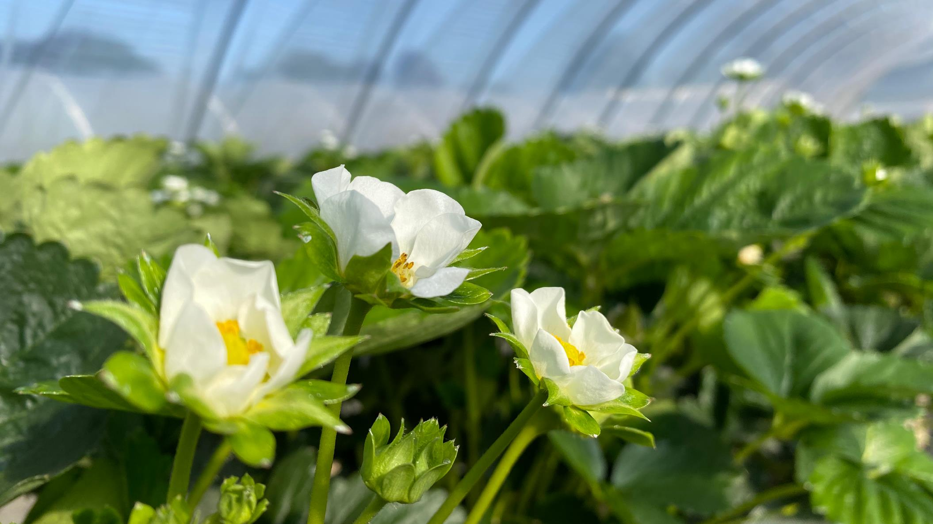
Investment support across the Midlands
Place focused inward investment support
Inward investment is supported by dedicated organisations in other parts of the Midlands, as detailed below.
Destination Chesterfield +44 (0) 1246 207207
Invest Coventry and Warwickshire contact@investcw.co.uk
Marketing Derby invest@marketingderby.co.uk
Invest in Leicester enquiries@investinleicester.com
Invest in Nottingham enquiries@investinnottingham.co.uk
Invest Telford Invest@telford.gov.uk
Invest Shropshire invest@shropshire.gov.uk
Invest Stoke-on-Trent enquiries@investstoke.co.uk
Invest Staffordshire hello@wearestaffordshire.co.uk
Invest in West Midlands invest@wmgrowth.com
Invest Wolverhampton invest@wolverhampton.gov.uk
Invest in Worcestershire +44 (0) 1905 677888
Team Lincolnshire investment@lincolnshire.gov.uk
The West Midlands Growth Company offers investors support to find the right networks, receive advice on locations, secure sector specific market research, identify funding support, and generate publicity.

Slide 34
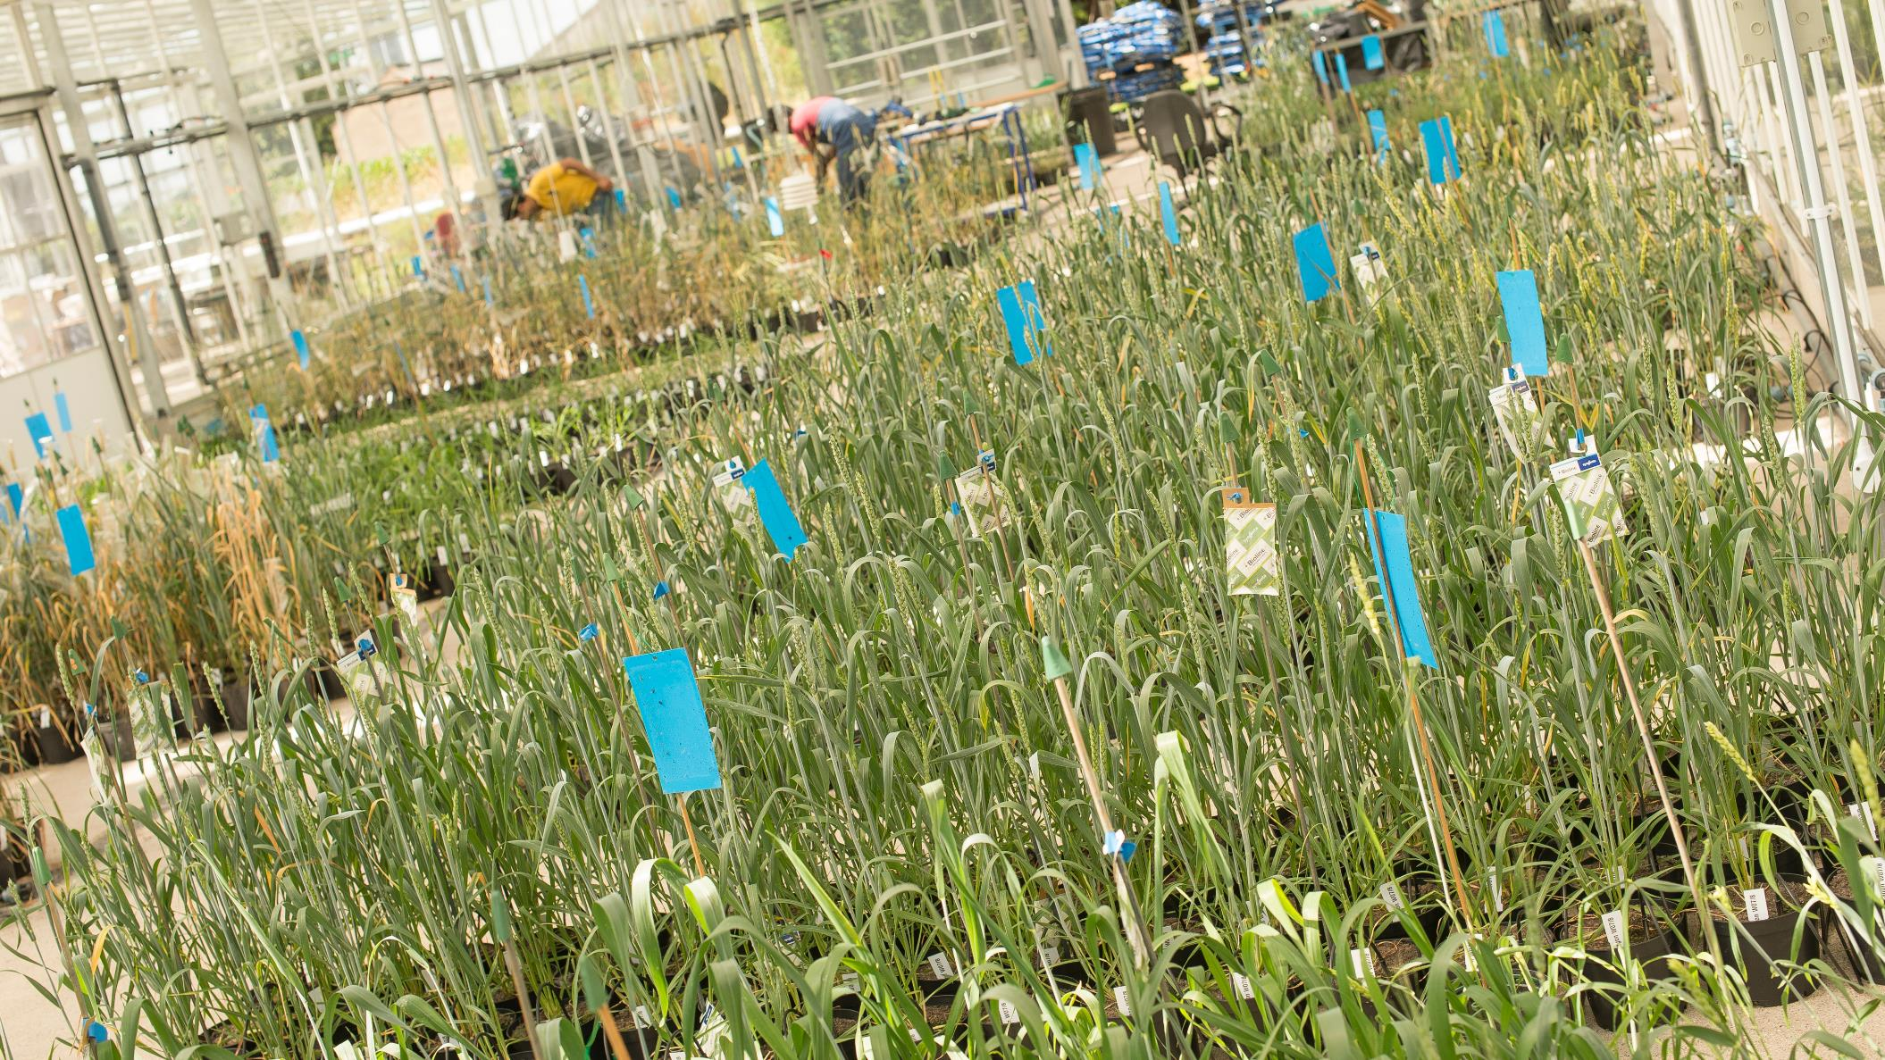
UK Investment Support
The UK’s ability to develop new ideas is one of our great strengths, from the jet engine and the bagless vacuum cleaner to MRI scanners and the world wide web. The UK’s talent pool, funding and incentives and business infrastructure all help create an environment of business innovation. Our commitment to world-leading research and development will help your business reach its full potential. We are one of the most innovative countries in the world - ranked in the top 5 countries in the Global Innovation Index 2019. For companies such as Ford, Pfizer, Eli Lilly, Nokia and Eisai, the UK’s business environment is the natural choice for investment in innovation.

Slide 35
Department for Business and Trade We support growth by backing businesses in the UK and globally, promoting investment and championing free trade.
Disclaimer Whereas every effort has been made to ensure that the information in this document is accurate, the Department for Business and Trade and the Contributors do not accept liability for any errors, omissions or misleading statements, and no warranty is given or responsibility accepted as to the standing of any individual, firm, company or other organisation mentioned.
© Crown copyright 2023 This publication is licensed under the terms of the Open Government Licence v3.0 except where otherwise stated. To view this licence, visit https://www.nationalarchives.gov.uk/doc/open-government-licence/version/3/
Where we have identified any third party copyright information you will need to obtain permission from the copyright holders concerned.
Published by Department for Business and Trade October 2023

