Slide 1
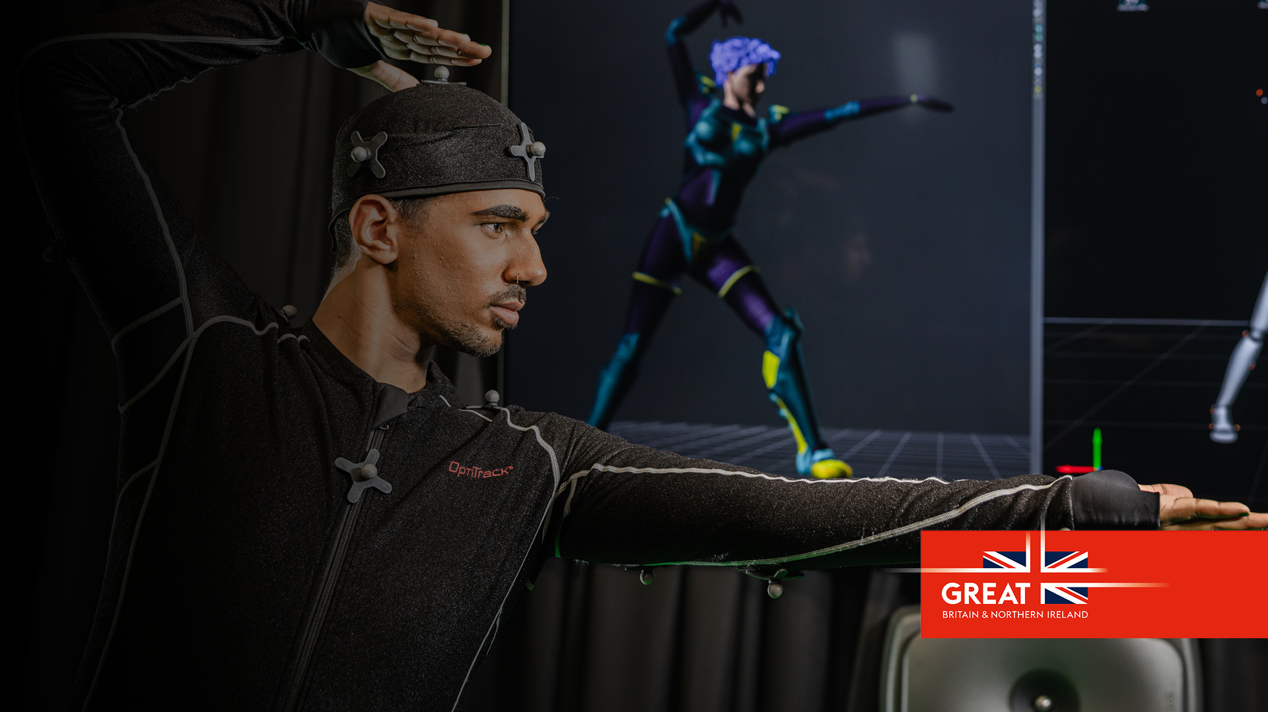
Prospectus
Invest in UK R&D
Universities and the creative and digital industries in the Midlands

Slide 2
Design the future of the Creative and Digital Industries in partnership with universities in the Midlands

Slide 3
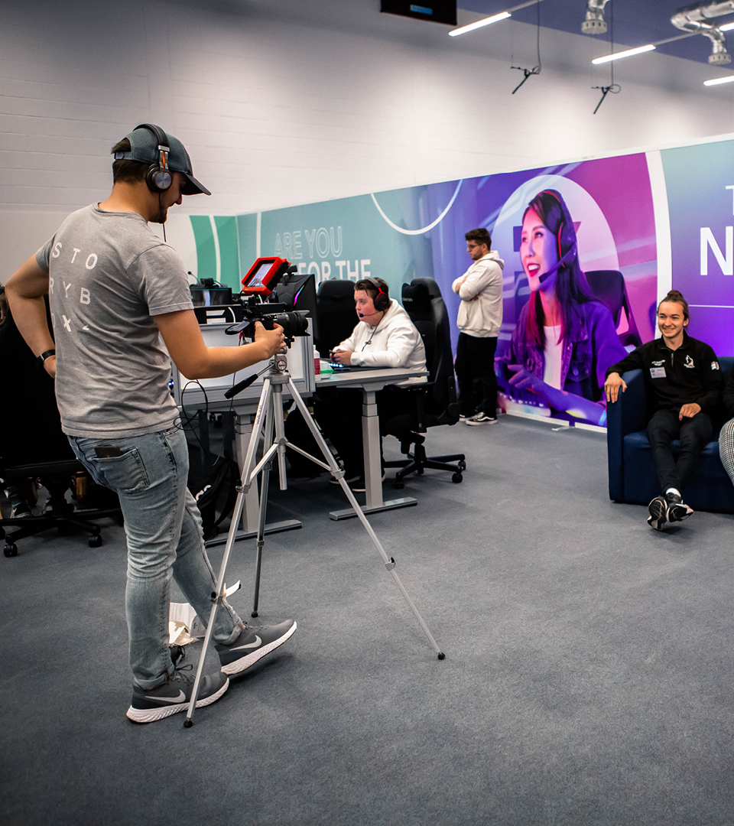
For decades, the Midlands has produced films, developed software, designed fashion, and created media that has been experienced and enjoyed the world over.

Slide 4
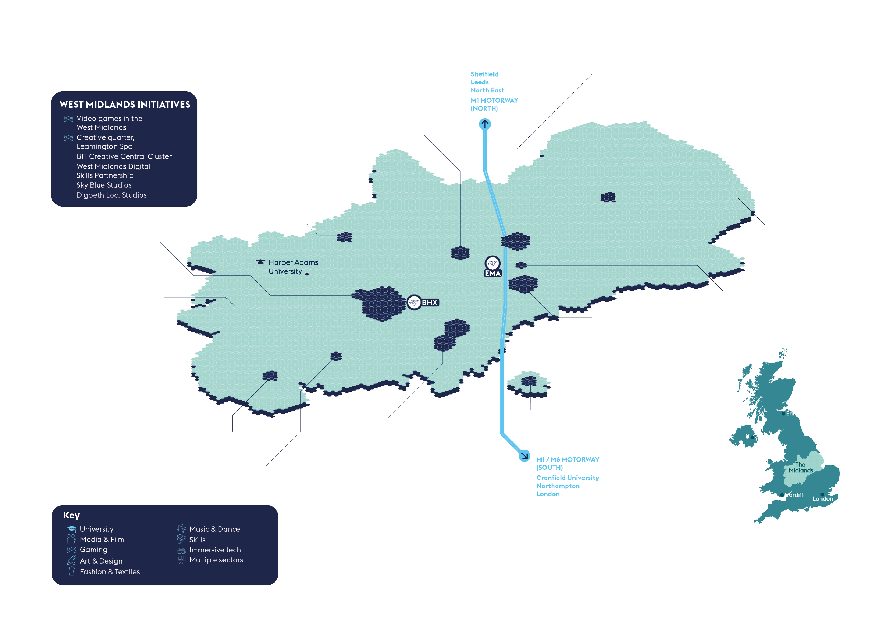
Universities and the creative and digital industries in the Midlands – major R&D assets

Slide 5
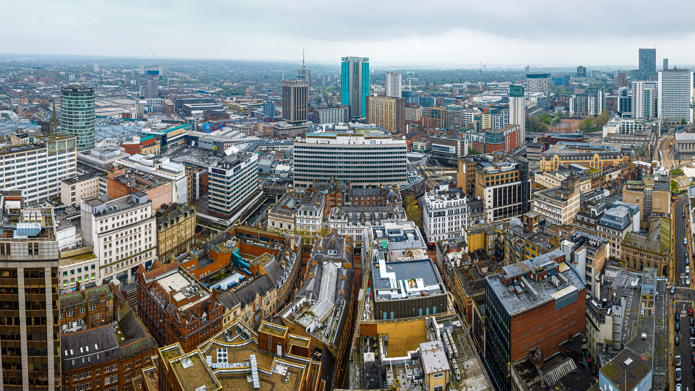
Research and innovation pedigree
At the heart of the Midlands' research and innovation landscape are its world-class universities. Midlands Innovation (MI) is a partnership of eight research-intensive universities in the Midlands: Aston University, University of Birmingham, Cranfield University, Keele University, University of Leicester, Loughborough University, University of Nottingham, and University of Warwick. The collective of universities has £4bn revenue, 15,000 academics, 50,000 postgraduates and are one of the most efficient producers of world class research in the UK with 40% more world class science than Oxford or Cambridge.

Slide 6
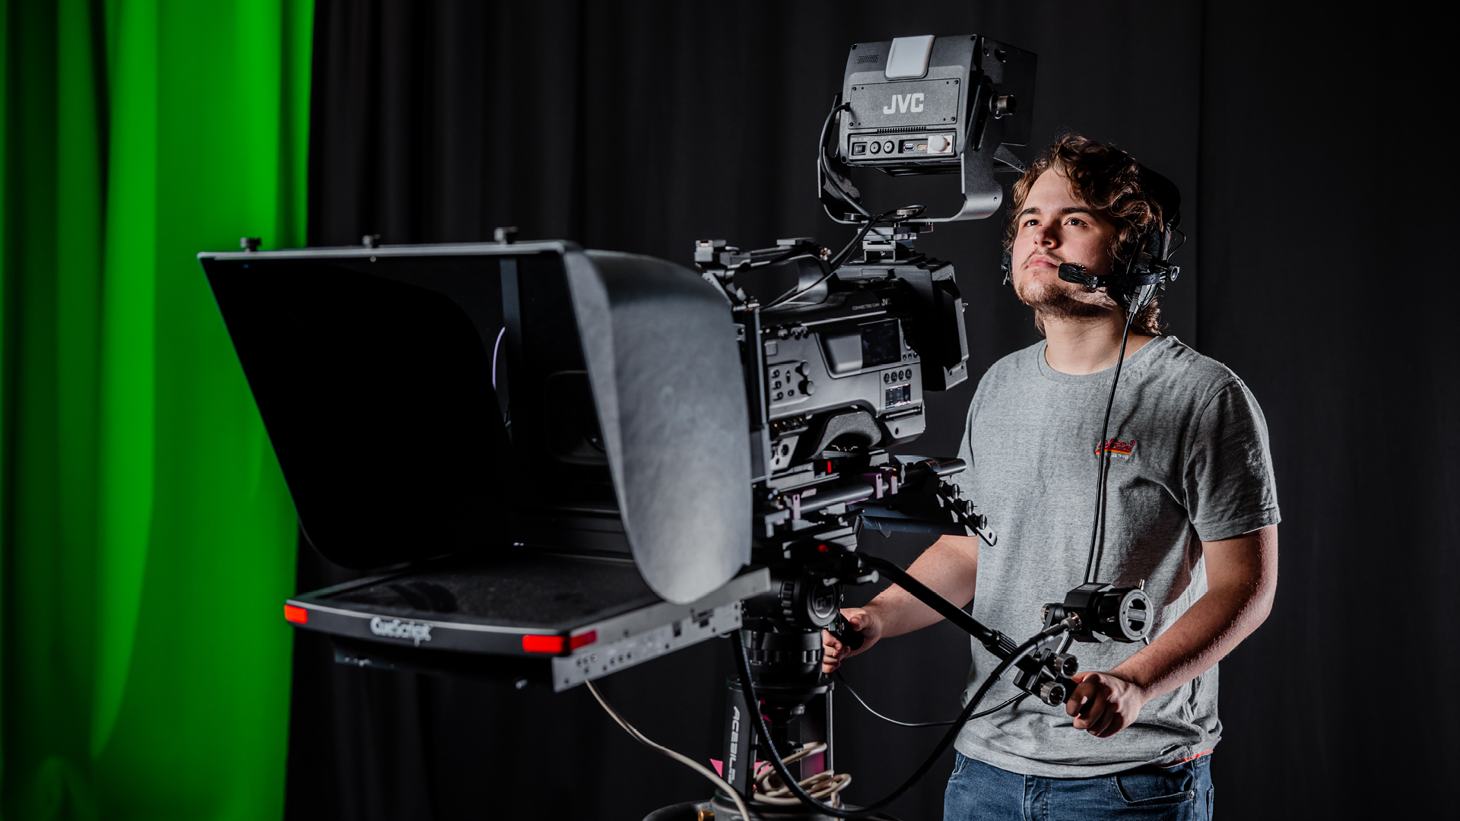
World-leading creative and digital industry clusters in the Midlands

Slide 7
Video games in Coventry, Warwick and Leamington Spa
The games development industry is worth £1 billion to the UK economy and employs some of the UK’s most creative minds. The Midlands is responsible for 25% of the UK’s video game output and home to ‘Silicon Spa’, a sub sector cluster based in Leamington Spa. 37,000 people work in gaming software development in the West Midlands alone, across 230 companies. The Midlands boasts strengths across console, PC, mobile, and AR/VR gaming content. Major studios include Codemasters, Sega Hardlight, Pixel Toys, and Playground Games.
Case study
Creative Futures at the University of Warwick hosts the gateway between the University and the regional creative digital sector (inc. Silicon Spa), providing incubation, support for business growth and innovation and linking industry with degree courses and creating student opportunities. Its impact is supported by the Warwick Esports Centre, a unique innovation in Europe, recognized as a national leader; recently achieving second place at the Esports Awards 2022 for Collegiate Programme of the Year, and bestowed the accolade of Best University for Gamers in the UK 2023 (USwitch).

Slide 8
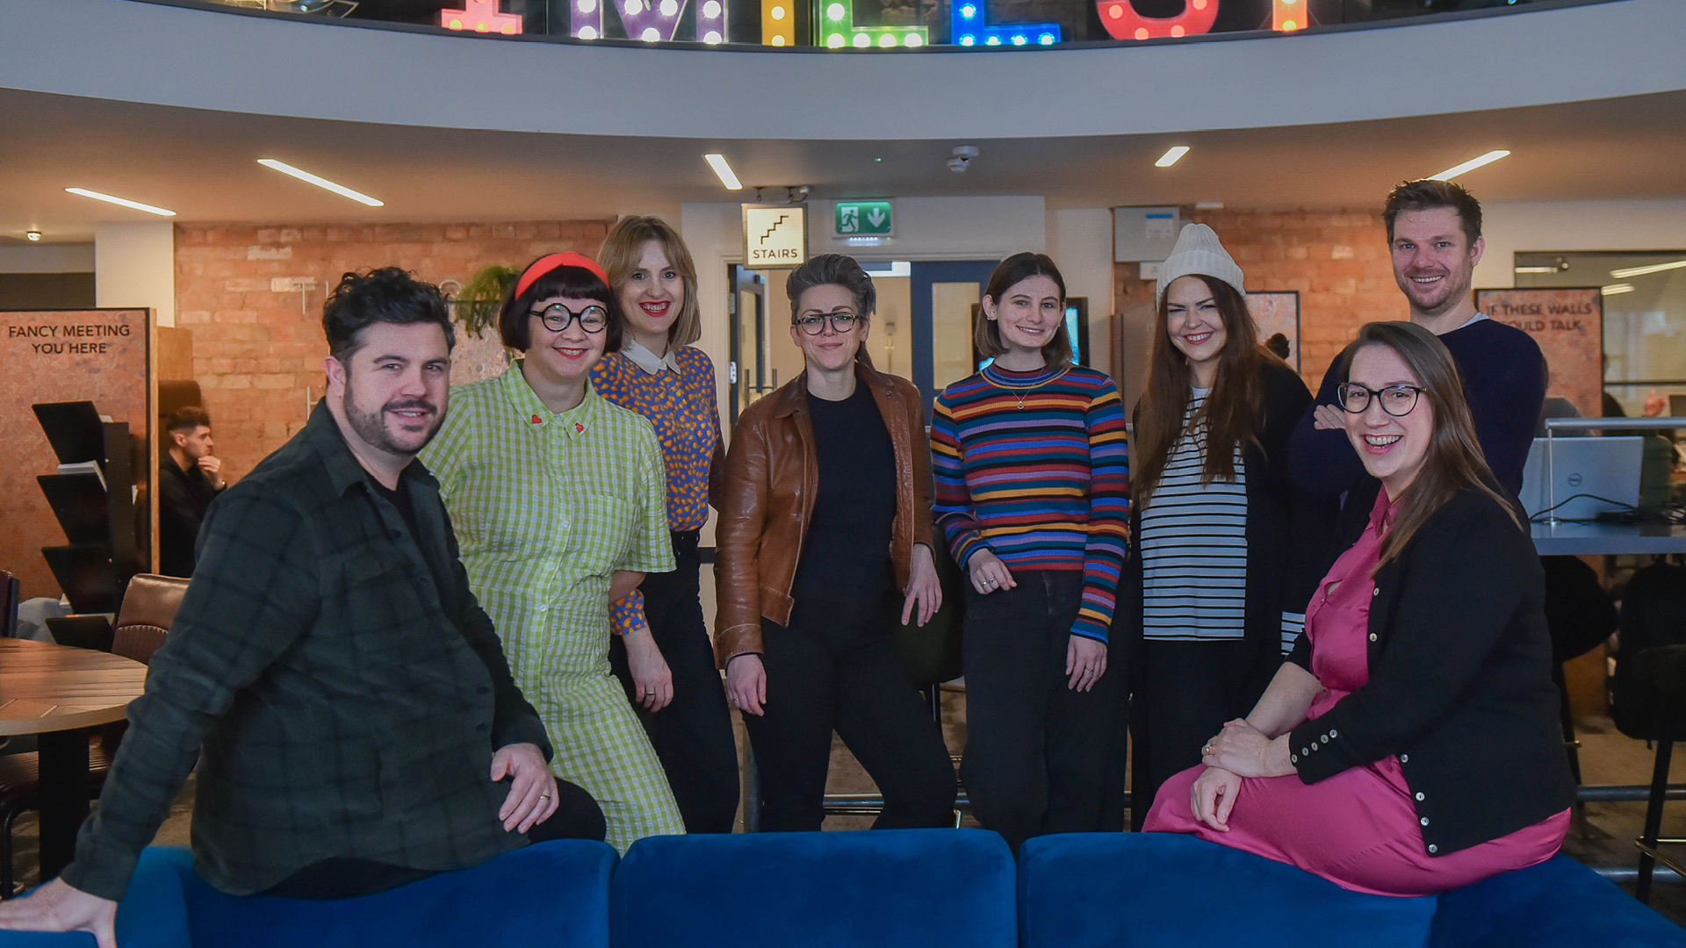
Film and media in Birmingham
Case study
Helping to push this forward is Create Central, an industry body comprising creative thinkers and leaders involved in promoting West Midlands talent and opportunities. Their vision is to have a creative ecosystem that makes the region internationally renowned as ‘the place to create’ for any storyteller. Create Central has recently been selected by the British Film Institute (BFI) to deliver one of their seven skills clusters in the UK, in recognition of Birmingham’s growing film and TV industry. This is aimed at addressing skills gaps, developing pathways into the industry and providing opportunities for local people. £1 million has been secured from the BFI to address skill deficiencies within the screen industry. The WMCA is contributing over £1.6 million to bolster this creative skills support. The region is actively promoted as an international hub for film and TV production by influential industry bodies such as Film Birmingham, Create England, and the BFI, with a dedicated West Midlands Production Fund.
Film and media is a high growth industry in the UK. Production has boomed in recent years, with production studios being constructed across the country. Total expenditure within the industry has increased from £3.4 billion in 2017 to over £5.64 billion in 2021, driven largely by inward investment and the rise of high-quality productions made for streaming platforms.

Slide 9
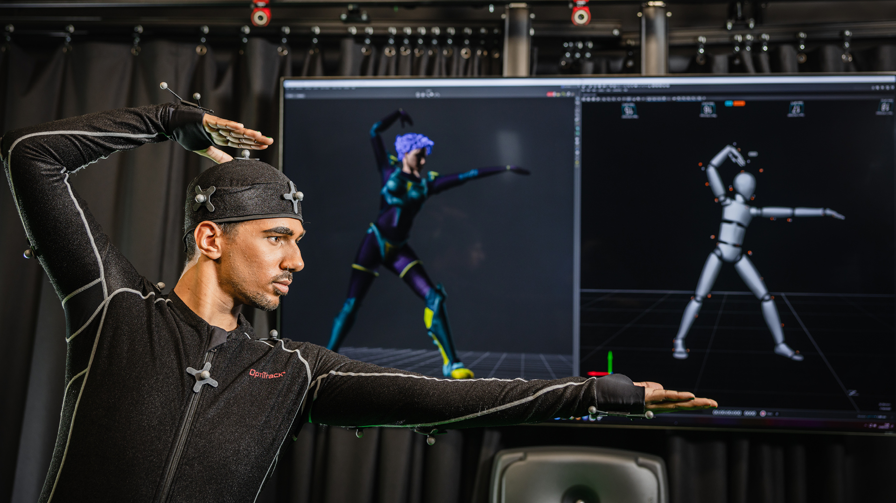
Immersive technology in Nottingham and the East Midlands
A 2022 NTU study showed that Nottingham has the fastest-growing CDI sector in terms of GVA outside of London.
NTU contributes 4,000 graduates from across 468 CDI undergraduate and postgraduate courses annually.
There are over 35,000 students studying STEAM subjects across the two universities in Nottingham, and 14,000 students in STEAM at Derby.
CDI employ 7% of the Nottingham population, there are 2,500 graduates from the University of Derby in CDI subjects.
The creation and implementation of immersive technology is still an early-stage development but one that benefits both CDI businesses and the wider economy. Immersive technology involves using new ways to create, display or interact with applications, content and experiences by merging the physical world with simulated reality.

Slide 10
Additional sectors in the creative and digital industries

Slide 11
Fashion and textiles
Case study
The UK fashion industry contributed £32.3 billion to the UK's GDP last year and employed almost 900,000 people, making it almost as big as the financial sector. Within this the Midlands is a significant player, with as many fashion and textiles firms as London. The fashion and textiles sector in Leicester and Leicestershire alone is valued at £1.2 billion and supports 25,200 jobs. It has experienced robust growth, creating 2,600 jobs since 2010 and outperforming the UK sector average in terms of productivity by approximately 20%.
The Midlands, combining East and West regions, hosts as many fashion and textiles firms as London, highlighting its significance in the industry.
Leicester and Leicestershire have a concentration of 1,500 fashion and textiles firms, making it the second-largest cluster of textile companies in the UK after Manchester.
The Midlands has a substantial presence in the subsector of technical textiles and materials for aerospace and automotive industries, housing over 17% of the nation's materials composites companies and generating £150 million in turnover, employing 1,500 individuals.
Research by Loughborough University Environmental Ergonomics Research Centre in partnership with adidas developed the first-ever sweat body maps of males, females, and children to inform the company’s sector-leading clima® product range. These body maps are now widely used as a benchmark for thermal comfort, informing product innovation in technical textiles in the global sports industry. The knowledge is integrated into the world’s first virtual Human Thermal Model which enables organisations worldwide to optimise product design for multiple populations across a range of industry sectors.

Slide 12
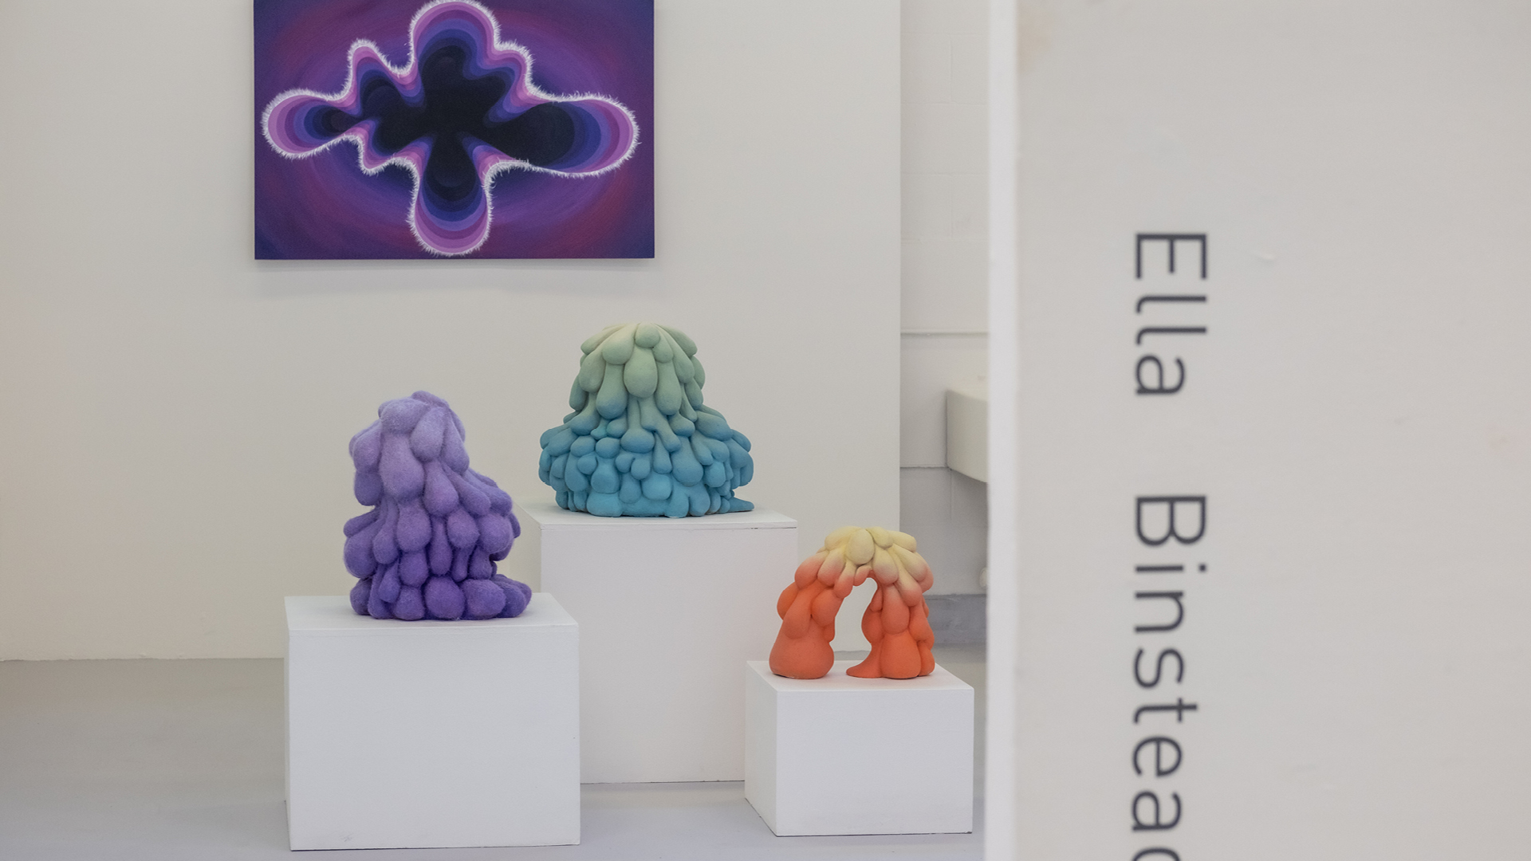
Art and design
The Midlands has a thriving art and design sector, covering subsectors such as web, product, marketing, and advertising. Each year, over 9,000 students study art and design at a Midlands university. In the West Midlands alone, there has been a 240% growth in design jobs from 2010 to 2015, making art and design a key regional strength.
240% increase in design jobs in the West Midlands from 2010 to 2015.
7 universities with art and/or design specific faculties and research centres.
Over 9,000 art and design students across the Midlands.

Slide 13
Music and dance
The Midlands is home to an international dance cluster, focused on the Birmingham Royal Ballet and the International Dance Festival. Birmingham has an exemplary professional dance and music sector to draw upon. Organisations like Dance Hub Birmingham provide support for the wider region’s professional dance sector. Dance Hub includes a new studio facility, an investment programme, and collaborations with organisations and individuals in the region.
940,000 music tourists, £433 million spend, and 4,180 jobs from music tourism in the West Midlands in 2022.
510,000 music tourists, £321 million spend, and 3,150 jobs from music tourism in the East Midlands in 2022.
Birmingham Royal Ballet employs almost 200 people across dancers, musicians, costumers and stage technicians.

Slide 14
Invest in a partnership with Midlands universities

Slide 15
Research translation
Universities in the Midlands have an exceptional track-record of working with the world’s largest companies, helping translate fundamental research into industry-leading innovations.
The University of Warwick and the University of Nottingham are both in the Top 5 recipients of the £885m of Innovate UK Funding allocated across the UK in the last 10 years.

Slide 16
Innovation
Midlands universities have been supporting the innovation eco-system of their local and regional economies for decades. If your business is looking to access innovation support chains, our dedicated support programmes, funding and networks can help you do this. Through co-funded Government schemes like Knowledge Transfer Partnerships (KTPs), which is one of the most successful, long-running innovation schemes anywhere in the world, we help business of all sizes to innovate using the knowledge and expertise of UK universities.
Case study
Create Central’s Innovate:Create seeks to uncover bold ideas to innovate across digital technology and creative content. Challenge briefs are open to limited companies based in the West Midlands to apply for funding and support to produce innovative pilot projects in collaboration with a range of industry partners.
For the first challenge, Innovate:Create offered the opportunity to win a support package and one of two £50k grants to produce innovative projects in collaboration with the Birmingham 2022 Festival as part of the Commonwealth Games.
The challenge set by National Express was to develop a project to encourage the sustainable use of public transport and get people back on the bus as a greener way to get around.
Further challenges with a variety of organisations covering sectors including sport, technology and healthcare and will focus on new challenges and opportunities for innovation by creative companies in the region.

Slide 17
Innovation
Case study
Confetti is Nottingham's creative hub dedicated to digital media, film and TV, music and live events. It offers students access to some of the best facilities in Europe at four city centre sites: Confetti HQ, Metronome, Space2 and Confetti X, alongside the new DaDA building.
Its digital media hub, Confetti HQ, gives creatives access to industry-standard studios, labs and classrooms, a Learning Resource Centre, a contemporary café and a rooftop terrace. Confetti’s campus also houses Metronome, a cross-media venue with world-class recording studios and rehearsal spaces. Designed by renowned audio architects White Mark Ltd and dubbed an educational centre of ‘European Significance’, it has received admiration from VIP industry guests, including Jools Holland OBE.
Confetti also houses a hub for film & TV, Space2. Containing industry-leading teaching spaces, it provides students access to the same equipment and software they will use once they start their creative career. The newest addition to Confetti’s campus is Confetti X, offering students access to the best facilities and technology for esports production and emerging technologies. This high-class provision of creative services has gained Confetti an East Midlands Bricks Award, being named the Sustainable Development of the Year, as well as nominations by RIBA and RICS East Midlands Awards. Confetti’s growth has been supported with investment from its parent company, Nottingham Trent University, and their success has led to the establishment of a new purpose-designed industry centre, Confetti London, in Whitechapel.

Slide 18
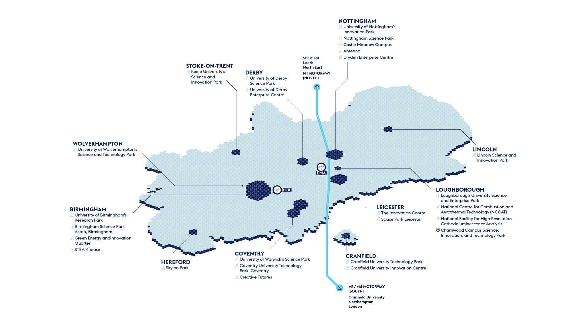
Co-location

Slide 19
Regeneration and integration
Case study
Universities across the Midlands work in partnership with the UK and Local Government to help drive economic growth through innovation and inward investment. Through a range of public-private partnerships, universities are involved in over 20 major economic development opportunities identified by the Midlands Investment Portfolio, worth over £10bn in gross development value. In the West Midlands, universities work with the Combined Authority and Growth Company on a range of projects as a part of one of only three UK Innovation Accelerators.
The Heritage Hub in Leicester will facilitate cross-disciplinary and cross-sector collaborations with a focus on the University’s world-leading strengths in tangible and intangible heritage (physical and virtual) and will coordinate the design and delivery of creative projects and spaces for impactful public engagement, research, learning and enterprise. A key strategic aim is to address inequalities through creative collaborations.

Slide 20
Talent
Home to 20 universities, the Midlands hosts over 350,000 students and 100,000 graduates a year.
Case study
Creative Futures is a gateway between the University of Warwick and the region’s creative industries. The centre delivers impact through various programmes and initiatives including a creative industries network, a start-up incubator, digital skills programmes and a state-of-the-art Esports Centre on campus. Since its inception, the centre has provided nearly £1.5 million in sales, grants and commissions, creating 35 jobs, supporting 30 businesses, and taking on 85 new clients.

Slide 22
Midlands Mindforge - £250m patient capital fund combining the spinout portfoliosof eight leading UK universities
Midlands Mindforge is an ambitious, patient capital investment company aiming to transform ground-breaking science and technology into successful businesses with the potential to positively impact our world and accelerate the commercialisation of research from our partner universities - Aston, Birmingham, Cranfield, Keele, Leicester, Loughborough, Nottingham, and Warwick.
By providing capital and company-building skills to university spinouts and early-stage IP rich businesses in the Midlands, we will build the foundations of a new technology eco-system in the region and create companies that can drive economic growth whilst delivering real-world impact.
enquiries@midlandsmindforg

Slide 23
Midlands Mindforge - £250m patient capital fund combining the spinout portfoliosof eight leading UK universities
Midlands Mindforge is an independent company that aims to raise up to £250m from strategic corporate partners, institutional investors and qualifying individuals.
Mindforge will “invest with impact” to found and scale transformational science backed companies in sectors such as Clean Technologies, AI and Computational Science, Life Sciences and Health Tech, to create highly skilled jobs and support the UK’s ambition to become a science and technology superpower.
enquiries@midlandsmindforg

Slide 24
Directory of key transport technology R&D assets across the Midlands

Slide 25
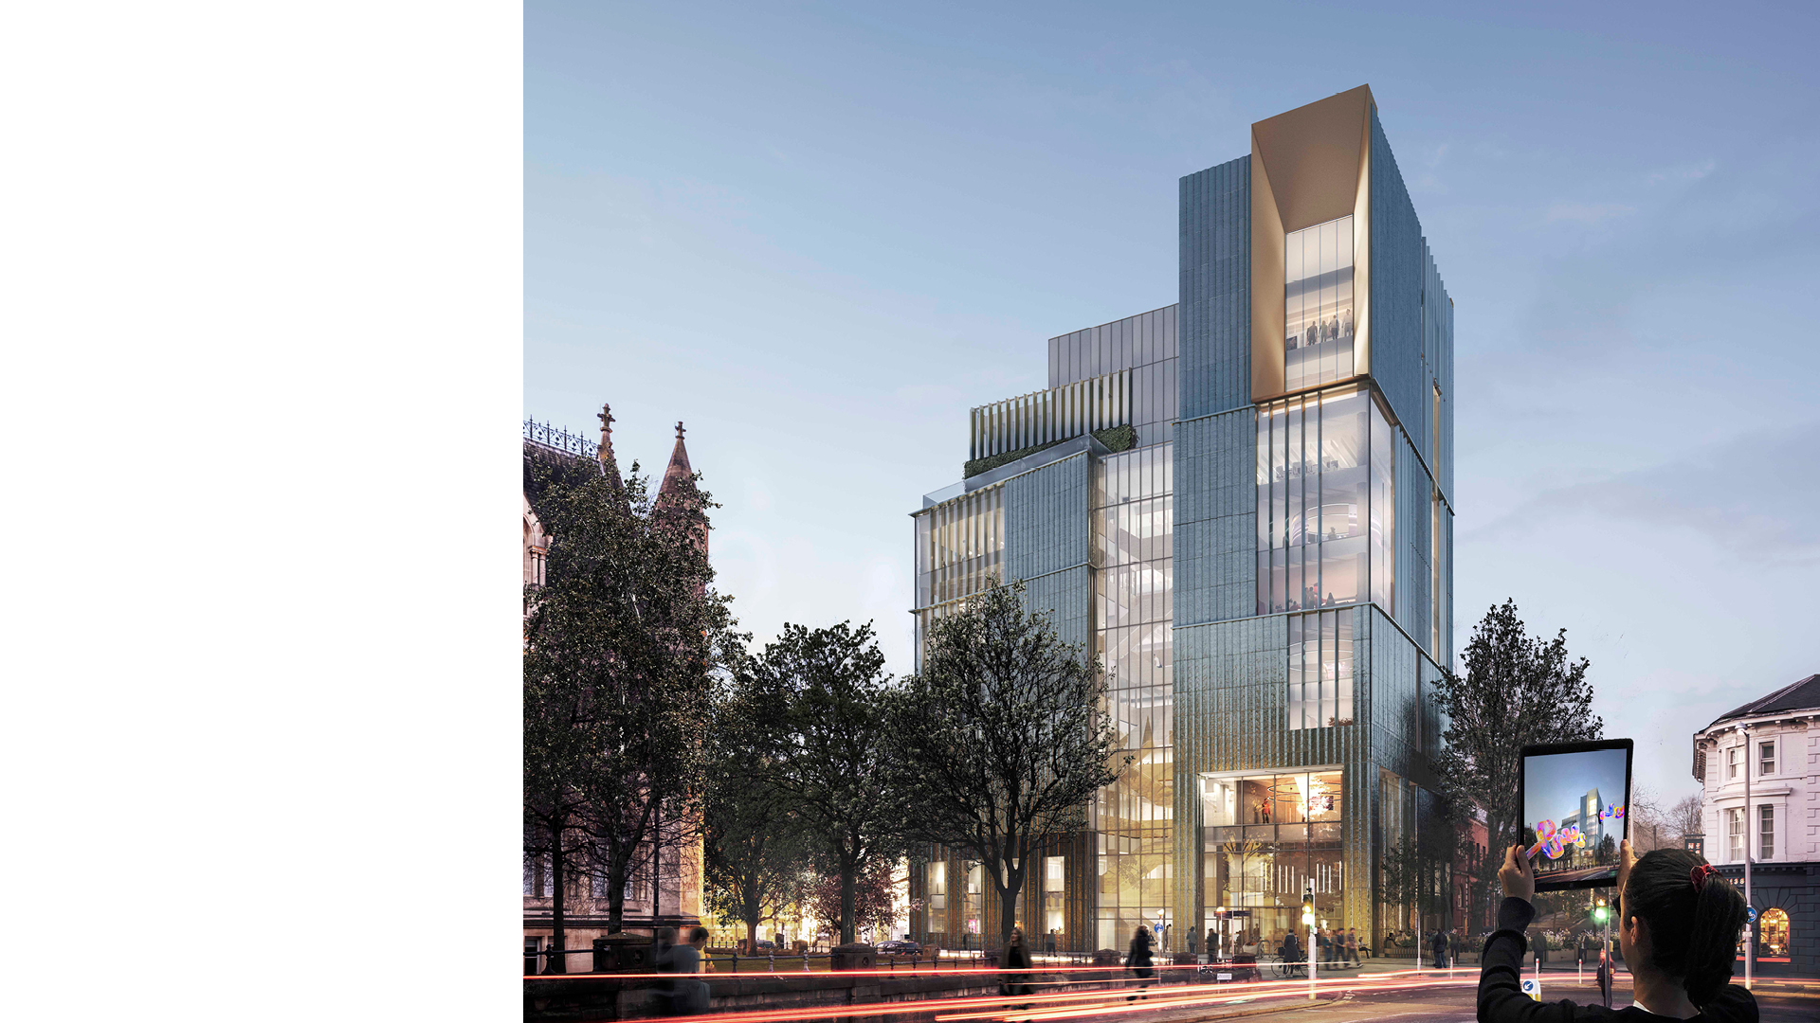
Clusters
Gaming
Research assets
University based
Antenna
First opened by Lord Mandelson in 2009, Antenna’s mission is to support Nottingham’s thriving creative and entertainment industries. From start-ups to international award-winning videogame developers, all kinds of creative businesses have chosen to make Antenna their home.
Situated in the heart of Nottingham’s Creative Quarter, Antenna provides high-quality creative studios and a co-working space and restaurant, with excellent high-speed broadband, reception services, in-house hospitality and expert technical support. This custom-built area for creatives, hosting over 300 enterprises, was a ‘Workspace of the Year’ finalist in the Hustle 2022 awards.
But it is more than just a building. Antenna is an ecosystem of ideas, opportunities, and practical help and support – it’s about community.

Slide 26
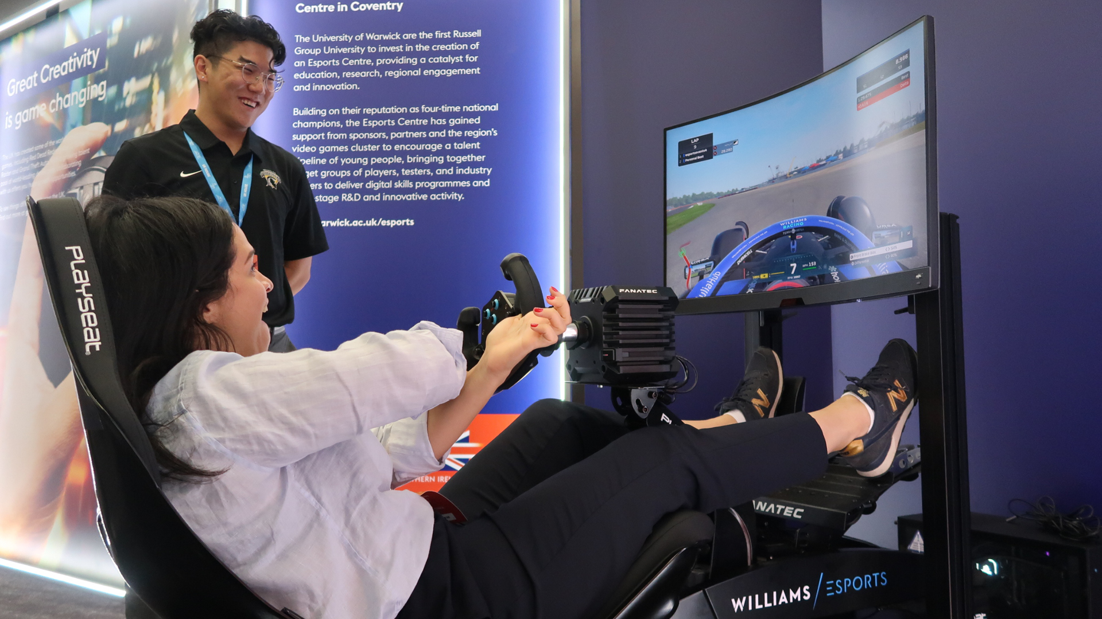
Clusters
Film and media
The Dance, Drama and Performance Studies Research Institute (DDPS)
The institute consists of dynamic researchers from across the Drama, Dance and Performing Arts teams, brought together by their scholarly, practice-based and impact-focused investigations across live art, contemporary performance and theatre, interdisciplinary performance, applied performance and theatre history. These investigations are further fuelled by international collaboration and interaction, social engagement, industry connections and development of our next generation of researchers.
Alongside production of monographs, edited collections, articles, chapters and book series, members have recently produced performances and events at and in partnership with the Royal Albert Hall, ICA, Picturehouse Central, BBC Radio, Nottingham Playhouse, Birmingham Repertory Theatre and Camden People's Theatre.
A recent example of their academic output is their report titled ‘Locked Down and Locked Out: The impact of the COVID-19 pandemic on mothers working in the UK television industry’. The research was led by the institute, in collaboration with sector organisations SMTJ and Telly Mums Network, and with the support of BECTU, which represents 40,000 creative industry workers in the UK.
Research assets
University based

Slide 27
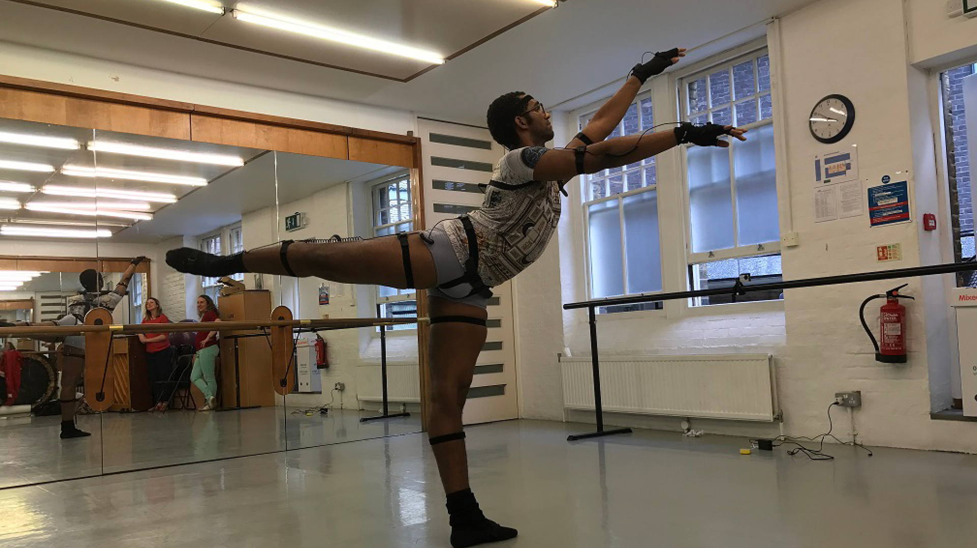
Clusters
Immersive technology
STEAMhouse is an innovation centre, powered by Birmingham City University (BCU). Their mission is to help support businesses, inspire experimentation, deliver growth, and enable members to grow their innovation capacity. The environment pushes for members to engage in meaningful conversations, exchange ideas, and potentially find collaborators or mentors who can elevate their practice.
Besides the facilities and networking opportunities provided in the main body of the STEAMhouse, the STEAMhouse Studio, a brand-new space converted from the former Victorian Belmont Works factory, provides an affordable, purpose-built area in which creatives can maximise their artistic potential.
BCU has invested nearly £5 million in the new STEAMhouse building, with 100,000 sq feet, areas of co-working spaces, creative spaces and a new makerspace (the Production Space) equipped with 3D printers, laser cutting machinery, virtual reality technology and printing studios.
Research assets
University based

Slide 28
Sectors
Fashion and textiles
Research assets
University based
NTU Fashion and Textile Research Centre
Fashion and Textiles represents a complex field of research in a global context and, as such, researchers in this centre focus upon a number of different aspects of the discipline. There are currently six research groups within the centre, focusing on Design, Cultures, Heritage, Business, Clothing Sustainability and Advanced Textiles.
The Centre makes a significant contribution to research within the Nottingham School of Art & Design and to the development of postgraduate researchers. In the Research Excellence Framework (REF) 2021, 83% of the centre’s research in Art and Design was assessed to be world-leading or internationally excellent in terms of research impact.

Slide 29
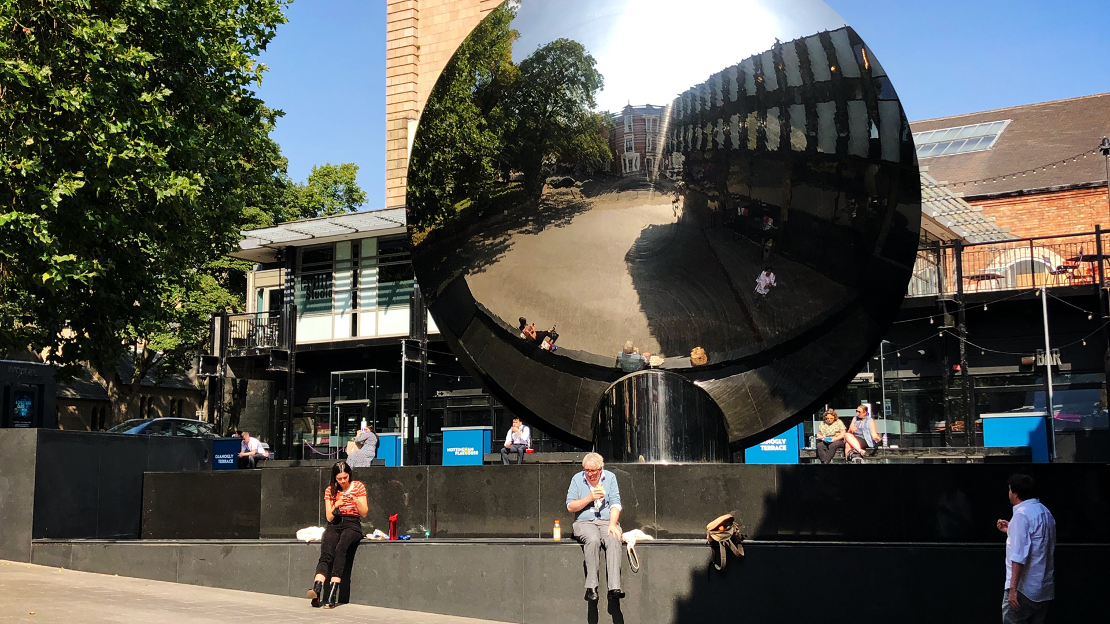
Sectors
Art and design
Research assets
University based
De Montfort Institute of Art and Design
The Institute is home to academics researching textile and product design, building heritage, fine art, fashion, photography, photographic history and history of art and design. It runs a highly successful Design Unit, with links to local business, supports world-leading research in the Fine Arts, in New Product Design, Fashion and Textiles, Critical and Contextual Studies, Textile Engineering and Photographic History.
The institute houses the Design Unit, Textile, Engineering and Materials Research Group (TEAM), and the Photographic History Research Centre. The Design Unit is a highly innovative, design-based research group with a strong track record of research-informed New Product Development (NPD), design implementation strategies and knowledge Transfer (KT) enterprise activities.
The Design Unit has a 25-year history of research-informed NPD, collaborating with a variety of industrial partners – both large and small. The research centre has generated a portfolio of over 160 successful projects and have developed over 120 effective design solutions.

Slide 30
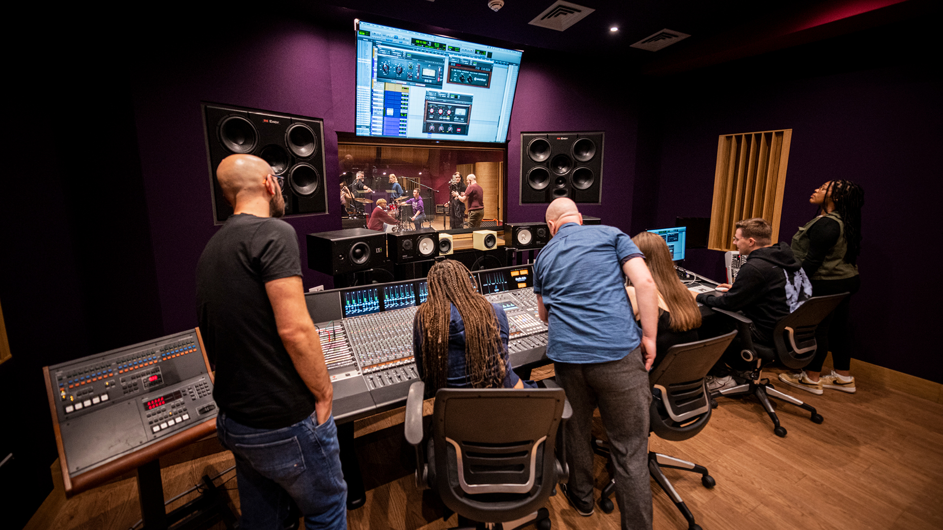
Sectors
Music and dance
Research assets
University based
Centre for Dance Research (C-DaRE)
The research of C-DaRE moves between theory and practice and applies body-centred understandings across disciplinary boundaries. The projects explore a broad range of themes including cultural heritage, computing and AI, intellectual property, practice research, performance philosophy, documentation, archives, health and well-being, digital performance, somatic practices and critical disability studies. They maintain close connections with professional practice and engage in research networks and policy level interventions that aim to sustain and develop movement, dance, and performing arts.
The centre also works closely with partners across the cultural sector, funded by Research Councils, the European Commission, the Leverhulme and Wellcome Trusts, British Academy, British Council, Higher Education Academy and Arts Council England.
Their outputs and publications include books, journal articles, policy reports, films and exhibitions, and live, digital and immersive performances. The centre has produced over 150 academic articles, nearly 40 books and dozens of exhibitions.

Slide 31
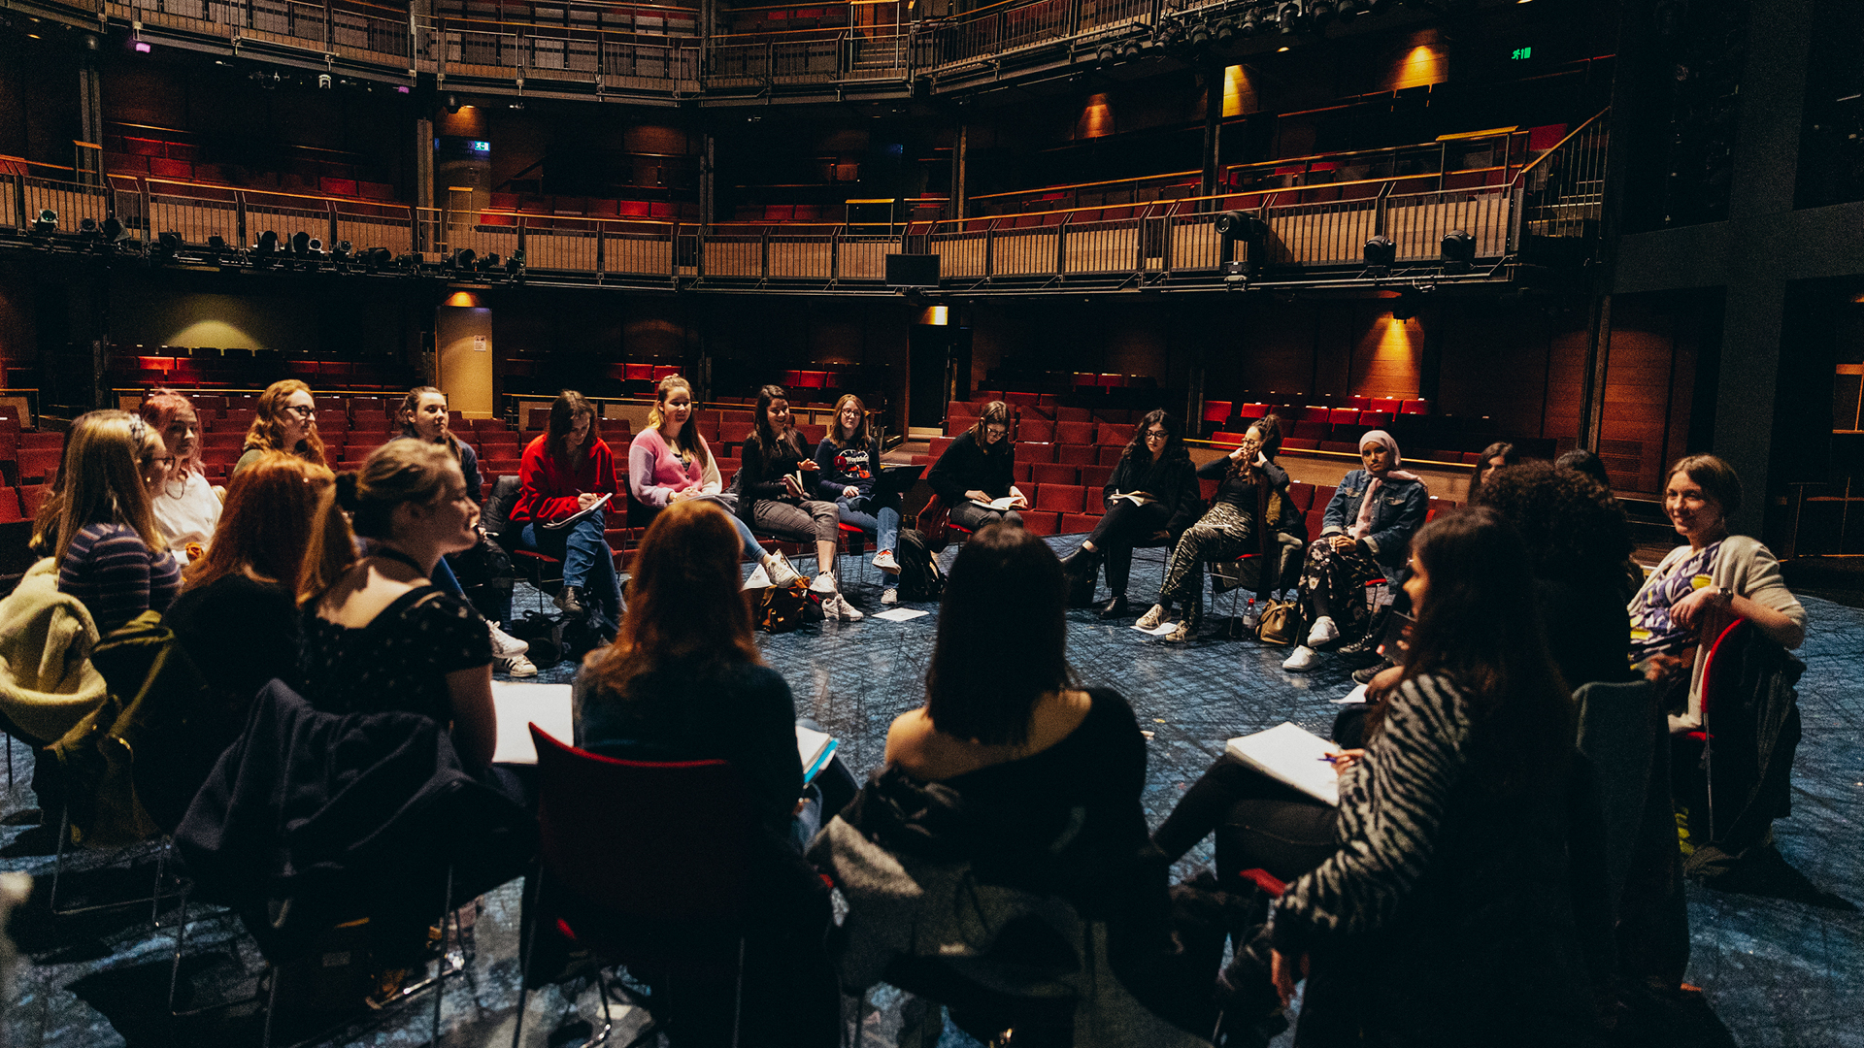
Work with us

Slide 32
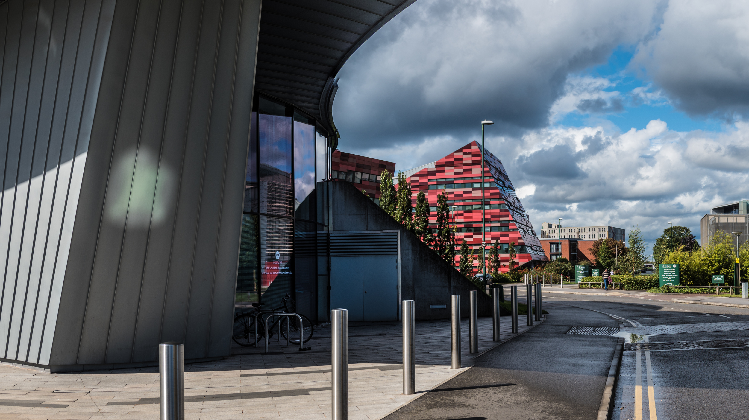
Our universities
From the Midlands, 90% of the UK’s population and businesses are less than a four-hour drive away; 45% of heavy rail freight and 33% of heavy road freight comes from, goes to, or passes through the Midlands and, with the advent of HS2, London will be less than an hour away. By air, the Midlands is home to two international airports – Paris is just a 90 minute flight away – with access to the seaports of the Humber. The Midlands are home to 11 million people, 15% of the UK’s GVA, and the only inland freeport. This is critical to dispersing the output of the Midlands and accessing the potential markets of not only the wider UK, but Europe and international buyers. The region is constantly growing with new development sites and spaces for bespoke builds, including labs, test spaces, and offices.

Slide 33
Directory of contacts across the Midlands
University | Business engagement and Technology Transfer | Careers service
Aston University | rke@aston.ac.uk | employerteam@aston.ac.uk
University of Birmingham | info@enterprise.bham.ac.uk | recruiters@contacts.bham.ac.uk
Coventry University | ei@coventry.ac.uk | talentteam@coventry.ac.uk
Cranfield University | business@cranfield.ac.uk | cranfieldcareers@cranfield.ac.uk
De Montfort University | businessservices@dmu.ac.uk | employerliaison@dmu.ac.uk
University of Derby | businessgateway@derby.ac.uk | employerteam@derby.ac.uk
Harper Adams University | reception@harper-adams.ac.uk | careers@harper-adams.ac.uk
Keele University | gateway@keele.ac.uk | gateway@keele.ac.uk
University of Leicester | redenterprise@le.ac.uk | employer.services@le.ac.uk
University of Lincoln | enterprise@lincoln.ac.uk | careers@lincoln.ac.uk
Loughborough University | innovation@mailbox.lboro.ac.uk | employer.services@lboro.ac.uk
University of Nottingham | workwithus@nottingham.ac.uk | recruiterservices@nottingham.ac.uk
Nottingham Trent University | workingwithyou@ntu.ac.uk | talent@ntu.ac.uk
University of Warwick | ventures@warwick.ac.uk | employerconnect@warwick.ac.uk
University of Wolverhampton | engage@wlv.ac.uk | theworkplace@wlv.ac.uk
University of Worcester | researchforbusiness@wor.ac.uk | careers@worc.ac.uk

Slide 34
Science Park Contacts
University | Science or Technology Park
Birmingham Innovation Quarter, Birmingham | hello.scitech@bruntwood.co.uk
Birmingham Science Park Aston, Birmingham | info@astonsciencepark.co.uk
Birmingham Research Park, Birmingham | brpl@bham.ac.uk
Charnwood Campus Science, Innovation, and Technology Park | lucy.alexander@charnwoodcampus.com
Coventry University Technology Park, Coventry | cutp@cueltd.co.uk
Cranfield University Technology Park, Bedfordshire | joshua.parello@kirkbydiamond.co.uk
INFINITY Park, Derby | ssalloway@salloway.com
Keele University Science and Innovation Park, Staffordshire | gateway@keele.ac.uk
Lincoln Science and Innovation Park | enquiry@lincolnsciencepark.co.uk
Loughborough University Science and Enterprise Park | lusep@lboro.ac.uk
Nottingham Science Park | regeneration@nottinghamcity.gov.uk
Skylon Park, Herefordshire | info@skylonpark.co.uk
Space Park, Leicester | enquiries@space-park.co.uk
STEAMhouse Innovation Hub | steamhouse.org.uk/contact
The Innovation Centre, Leicester | innovationcentre@dmu.ac.uk
University of Derby Science Park | businessgateway@derby.ac.uk
University of Nottingham Innovation Park, Nottingham | reception@unip.nottingham.ac.uk
University of Warwick Science Park, Coventry | more-info@uwsp.co.uk
University of Wolverhampton Science Park, Wolverhampton | joinus@wolverhamptonsp.co.uk

Slide 35
Investment support across the Midlands
Place focused inward investment support
Inward investment is supported by dedicated organisations in other parts of the Midlands, as detailed below.
Destination Chesterfield +44 (0) 1246 207207
Invest Coventry and Warwickshire contact@investcw.co.uk
Marketing Derby invest@marketingderby.co.uk
Invest in Leicester enquiries@investinleicester.com
Invest in Nottingham enquiries@investinnottingham.co.uk
Invest Telford Invest@telford.gov.uk
Invest Shropshire invest@shropshire.gov.uk
Invest Stoke-on-Trent enquiries@investstoke.co.uk
Invest Staffordshire hello@wearestaffordshire.co.uk
Invest in West Midlands invest@wmgrowth.com
Invest Wolverhampton invest@wolverhampton.gov.uk
Invest in Worcestershire +44 (0) 1905 677888
Team Lincolnshire investment@lincolnshire.gov.uk
The West Midlands Growth Company offers investors support to find the right networks, receive advice on locations, secure sector specific market research, identify funding support, and generate publicity.

Slide 36
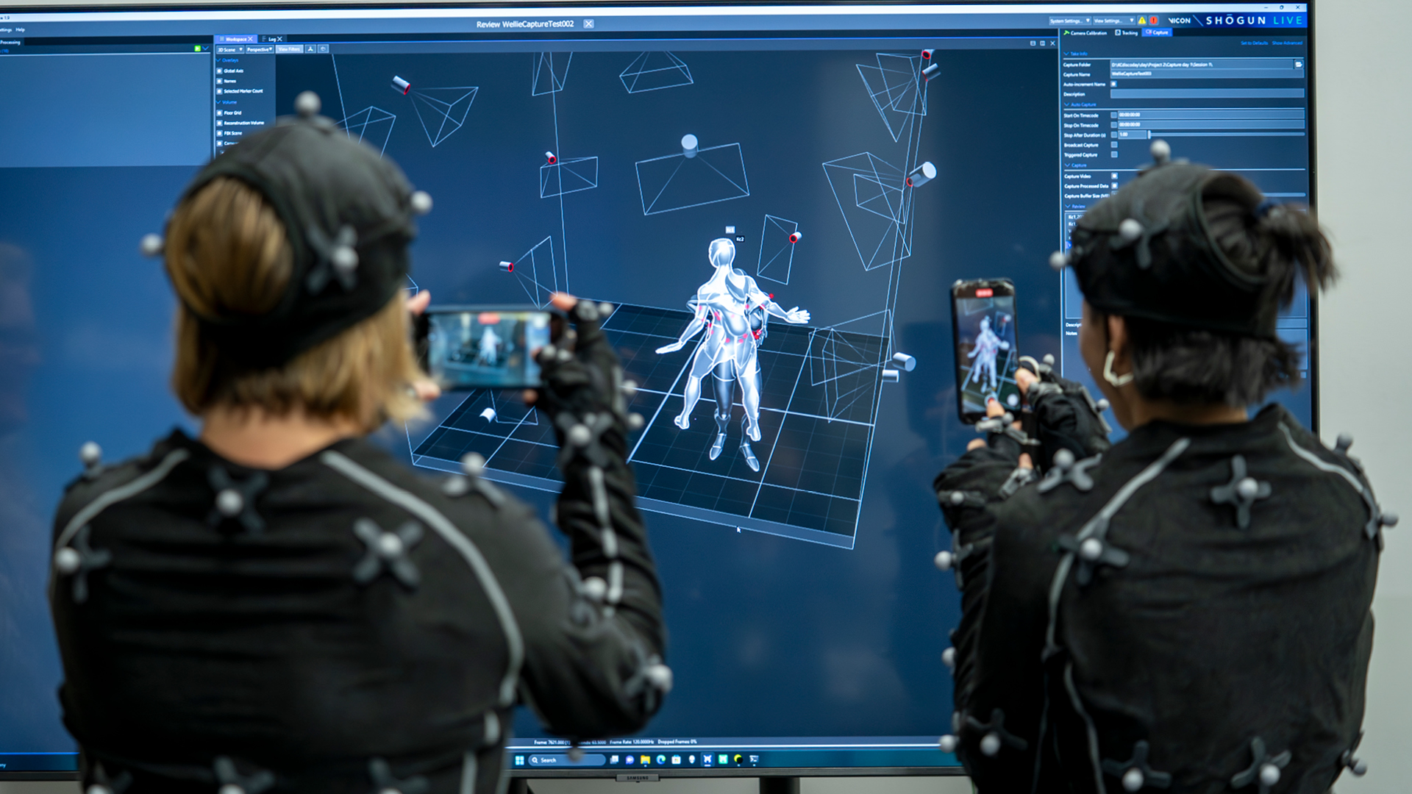
UK Investment Support
The UK’s ability to develop new ideas is one of our great strengths, from the jet engine and the bagless vacuum cleaner to MRI scanners and the world wide web. The UK’s talent pool, funding and incentives and business infrastructure all help create an environment of business innovation. Our commitment to world-leading research and development will help your business reach its full potential. We are one of the most innovative countries in the world - ranked in the top 5 countries in the Global Innovation Index 2019. For companies such as Ford, Pfizer, Eli Lilly, Nokia and Eisai, the UK’s business environment is the natural choice for investment in innovation.

Slide 37
Department for Business and Trade We support growth by backing businesses in the UK and globally, promoting investment and championing free trade.
Disclaimer Whereas every effort has been made to ensure that the information in this document is accurate, the Department for Business and Trade and the Contributors do not accept liability for any errors, omissions or misleading statements, and no warranty is given or responsibility accepted as to the standing of any individual, firm, company or other organisation mentioned.
© Crown copyright 2023 This publication is licensed under the terms of the Open Government Licence v3.0 except where otherwise stated. To view this licence, visit https://www.nationalarchives.gov.uk/doc/open-government-licence/version/3/
Where we have identified any third party copyright information you will need to obtain permission from the copyright holders concerned.
Published by Department for Business and Trade October 2023

