Slide 1
Prospectus
Invest in UK R&D
Universities and transport technology in the Midlands

Slide 2
Forge the future of transport technology with universities in the Midlands

Slide 3
The Midlands is home to an internationally recognised transport technology cluster anywhere in the world. For over a century, the Midlands has grown companies and inventions that have reshaped the way the world moves.

Slide 4
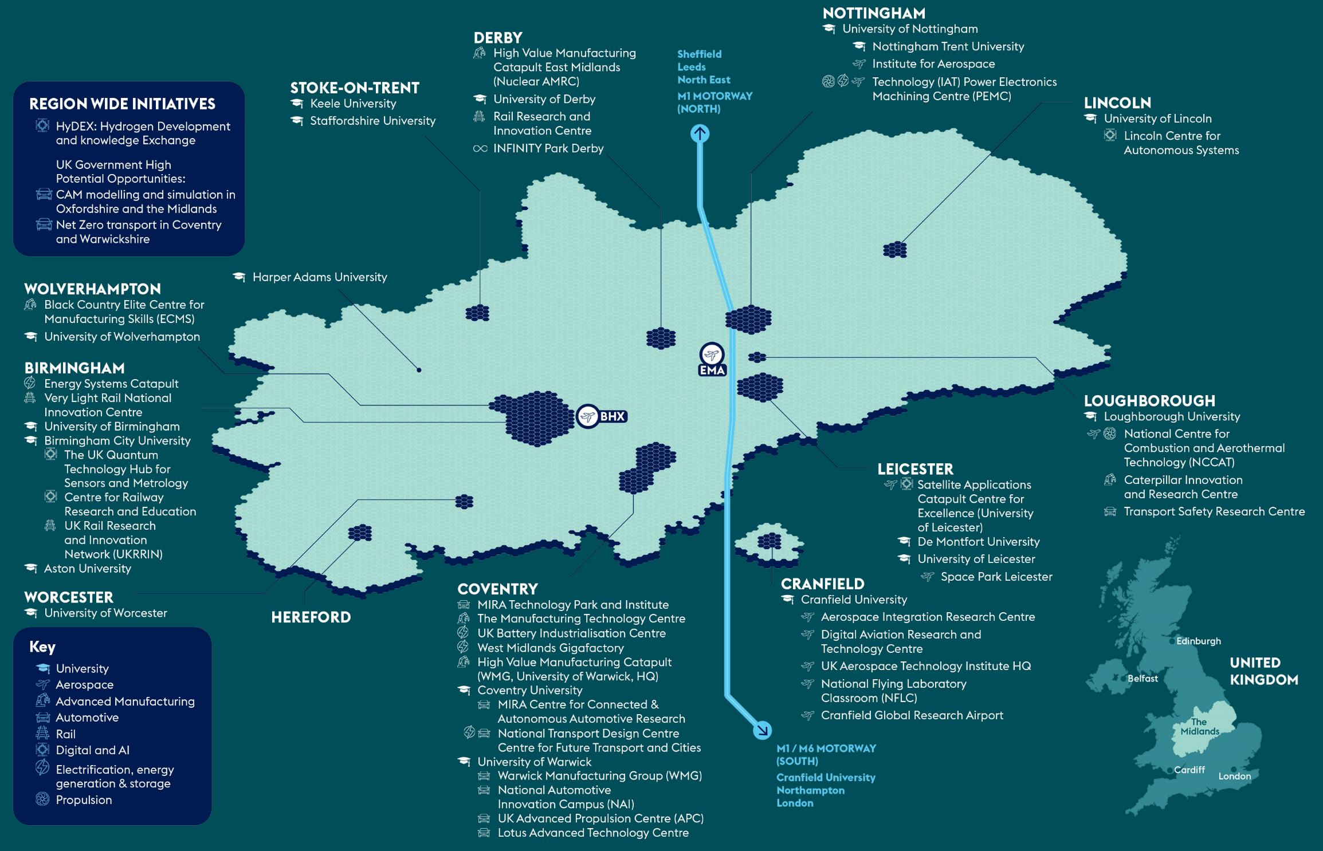
Universities and transport technologies in the Midlands – major R&D assets

Slide 5
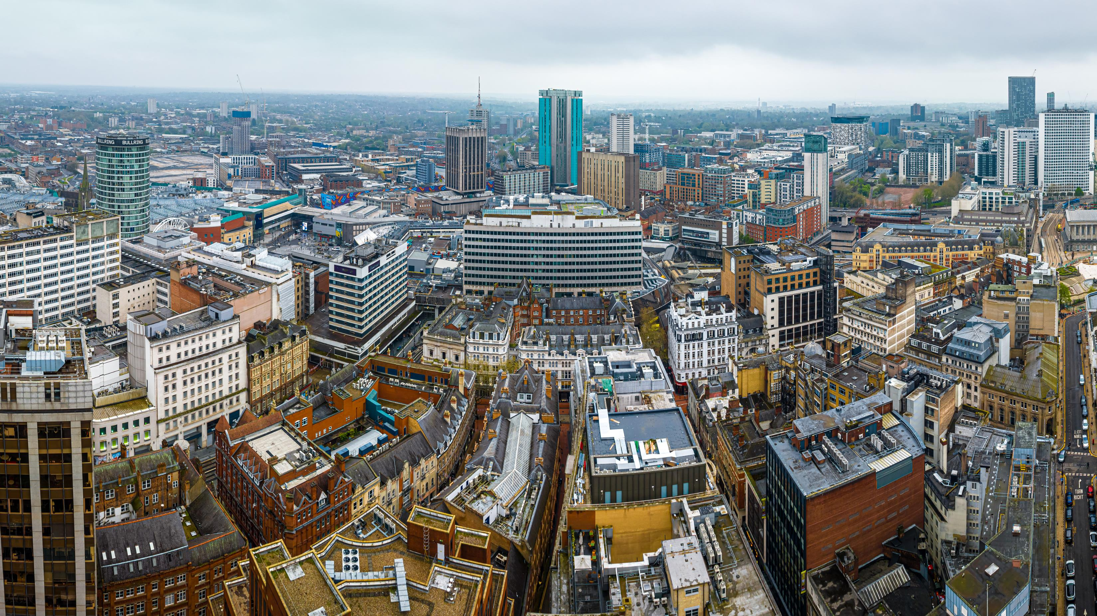
Science and innovation pedigree
At the heart of the Midlands’ science and innovation landscape are its world-class universities. Midlands Innovation is a partnership of eight research-intensive universities in the Midlands: Aston University, University of Birmingham, Cranfield University, Keele University, University of Leicester, Loughborough University, University of Nottingham, and University of Warwick. The collective of universities has £4bn revenue, 15,000 academics, 50,000 postgraduates and are one of the most efficient producers of world class research in the UK with 40% more world class science than Oxford or Cambridge.

Slide 6
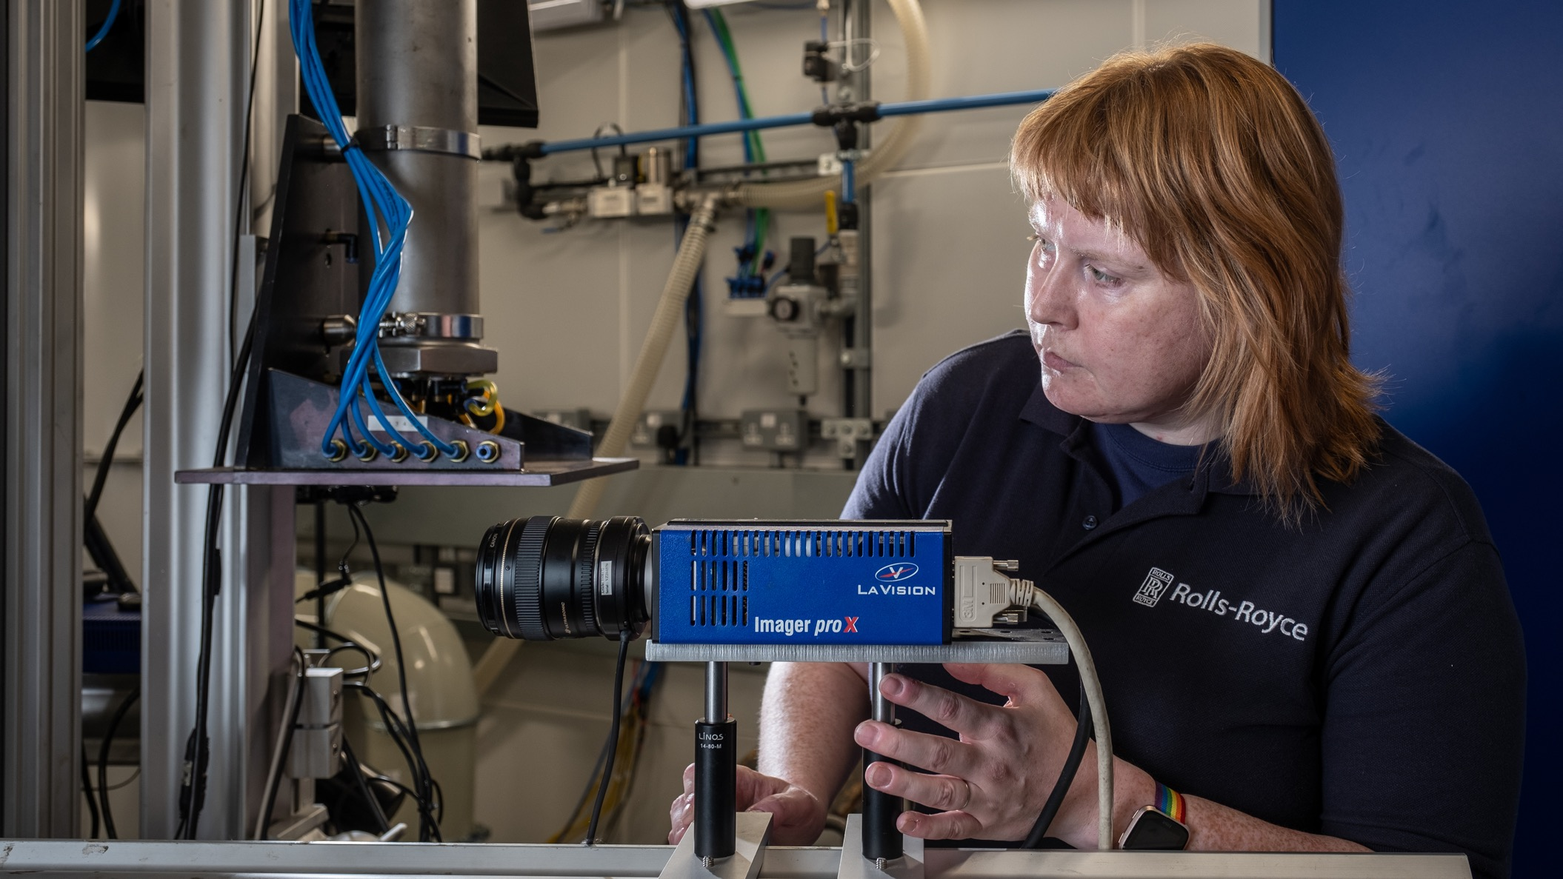
World-leading transport technology sectors in the Midlands

Slide 7
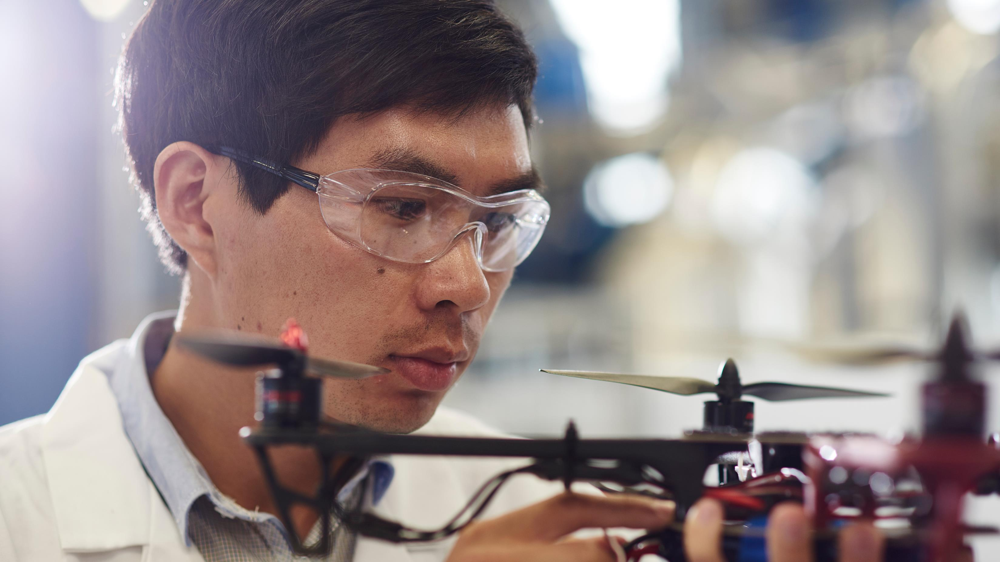
Aerospace
The Midlands is home to 3% of the world’s aerospace industry, as well as 7% of Europe’s, and amounts to 25% of the sector in the UK – which itself hosts the second largest aerospace industry in the world. It is a global hub for aerospace technology, manufacturing, and research and development. It is also at the forefront of the UK and Europe’s space efforts.
The Midlands is home to 3% of the world’s aerospace industry, 7% of Europe’s,
and 25% of the UK’s.
There are 52,000 people employed in aerospace in the Midlands Aerospace cluster.
The University of Nottingham, through its Institute for Aerospace Technology, hosts a portfolio of nearly £100m in aerospace-related research.
Rolls-Royce is a major employer in the region, accounting for 25% of all aerospace jobs.

Slide 8
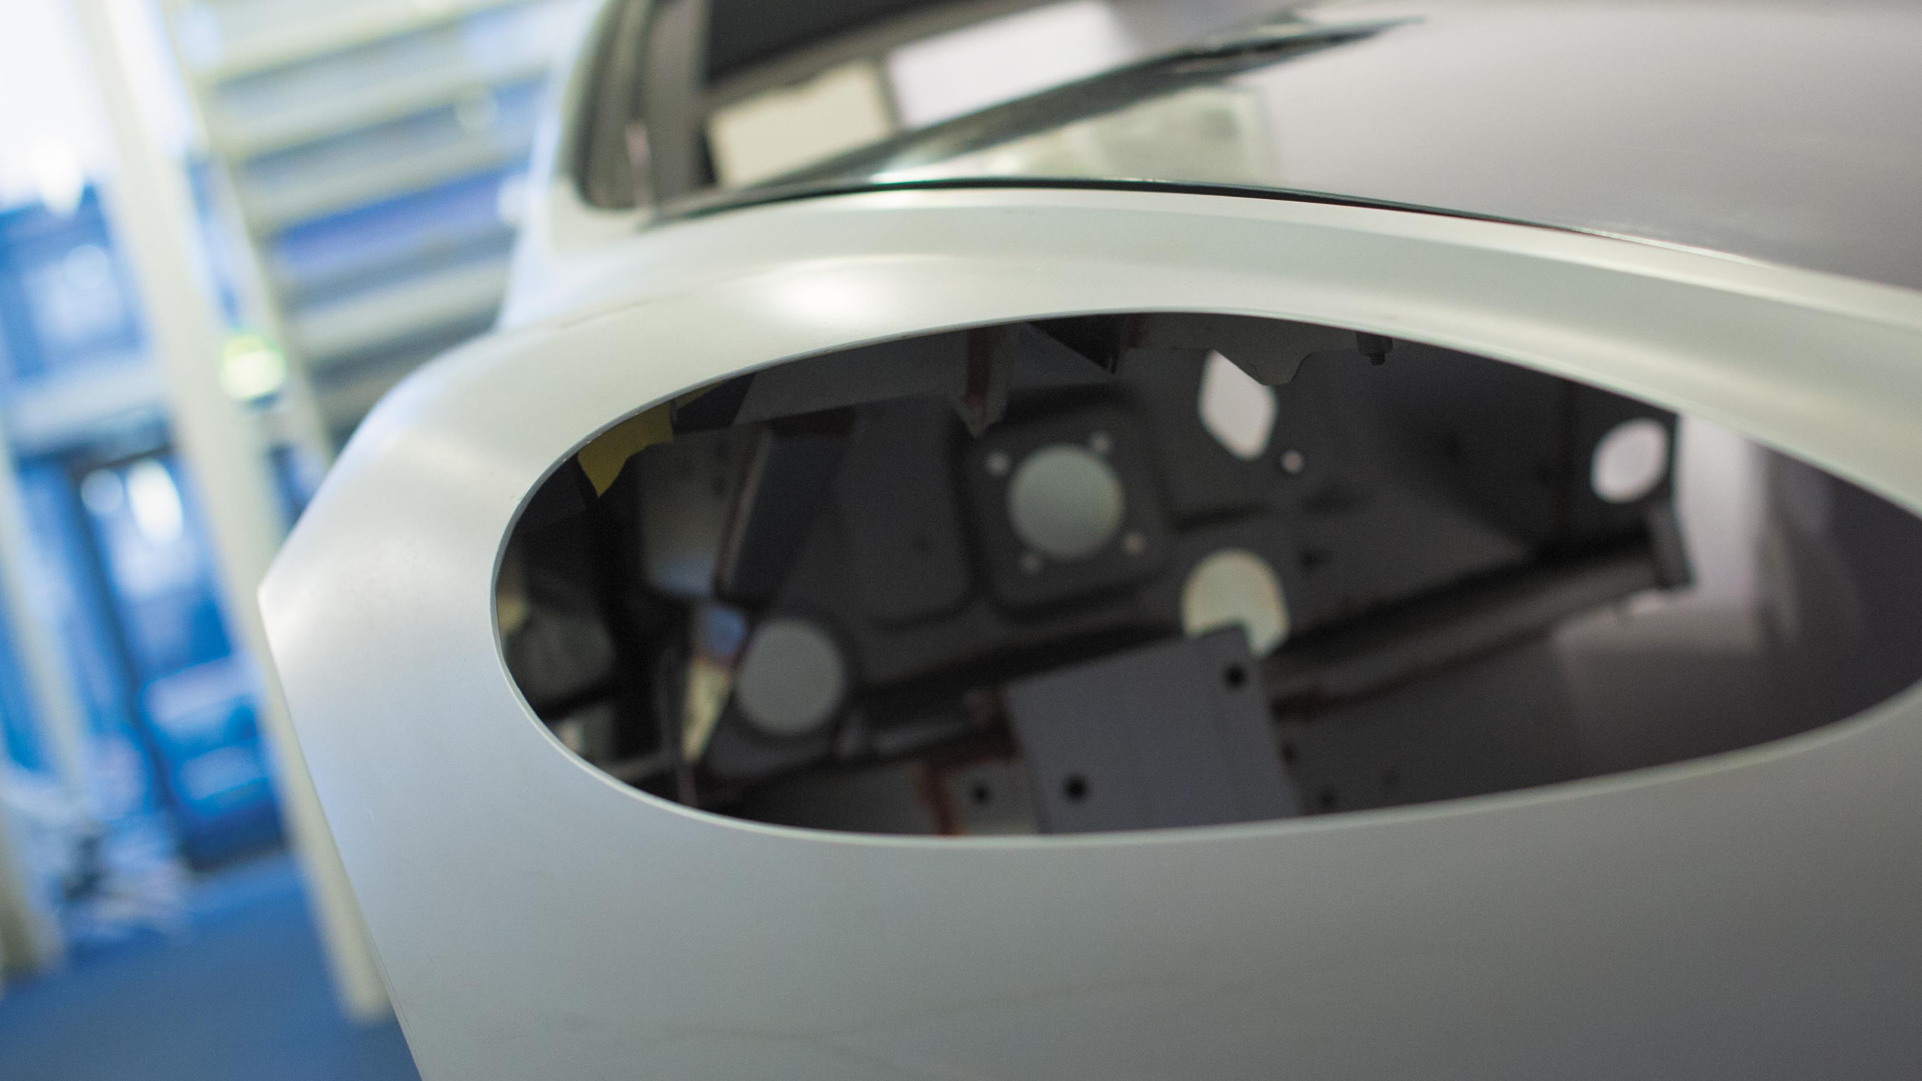
Automotive
There are nine volume car manufacturers, seven commercial vehicle manufacturers, three off-highway manufacturers, five motorcycle manufacturers and 16 of the world’s top 20 automotive suppliers in the Midlands.
There are more than 10,000 students studying automotive related courses in the Midlands,
with courses accredited by professional bodies such as the Institution of Mechanical Engineers (IMechE) and the Society of Automotive Engineers (SAE).
More than one third of British cars
are developed in the Midlands.
16 of world’s 20 biggest automotive suppliers
are in the Midlands.
30% of UK automotive employment is in the Midlands.
The region makes 40% of all cars exported from the UK.

Slide 9
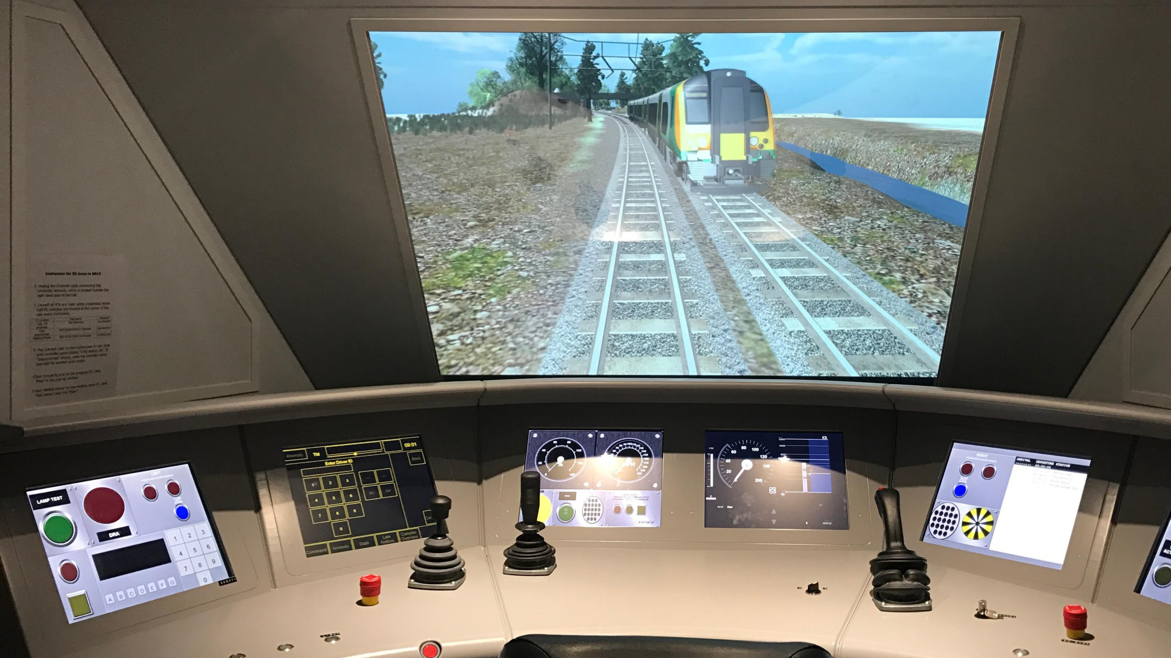
Rail
The UK Government calls the Midlands a ‘Rail Supercluster’. The region is home to several major railway companies, including Network Rail, East Midlands Railway, and West Midlands Trains. Great British Railways, the new public body that will oversee the vast majority of rail transport in Great Britain, has chosen Derby as the site of its new headquarters. The Midlands is also home to a significant number of railway engineering and manufacturing firms, including Bombardier in Derby, and Siemens.
The Birmingham Centre for Railway Research and Education (BCRRE) is Europe’s largest academic-based group for the rail industry, with over 180 academics and researchers and a lead partner in the £92m UK Rail Research and Innovation Network (UKRRIN).
Over 60,000 people are employed at 600 companies in the rail industry in the Midlands.
The rail industry supported £43bn in economic growth in the UK in 2021.
Over 80% of rail freight traffic travels through the Midlands.

Slide 10
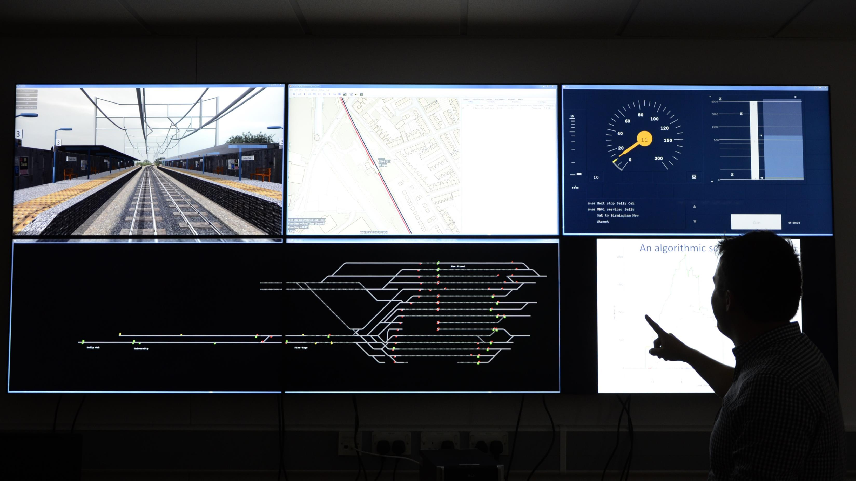
Enablers of research and development in transport technology

Slide 11
Advanced manufacturing
The Midlands is renowned for advanced manufacturing, building on more than a century of innovation and invention from world-beating companies across the automotive, aerospace and rail sectors. This foundation of technical knowledge brings expertise from across the globe to live and work in the Midlands, and is continuing to shape the future of travel, transport and mobility. The Midlands provides 15% of the UK’s total manufacturing output, while generating £36bn in GVA.
The Midlands is home to
21% of all UK manufacturing.
20% of the UK manufacturing workforce works in the Midlands.
There was £36bn in GVA generated from manufacturing in the region.
WMG generated over £110m of income in 2021, and the group played a pivotal role in supporting the NHS – producing 13,000 ventilators to help those seriously ill with COVID.

Slide 12
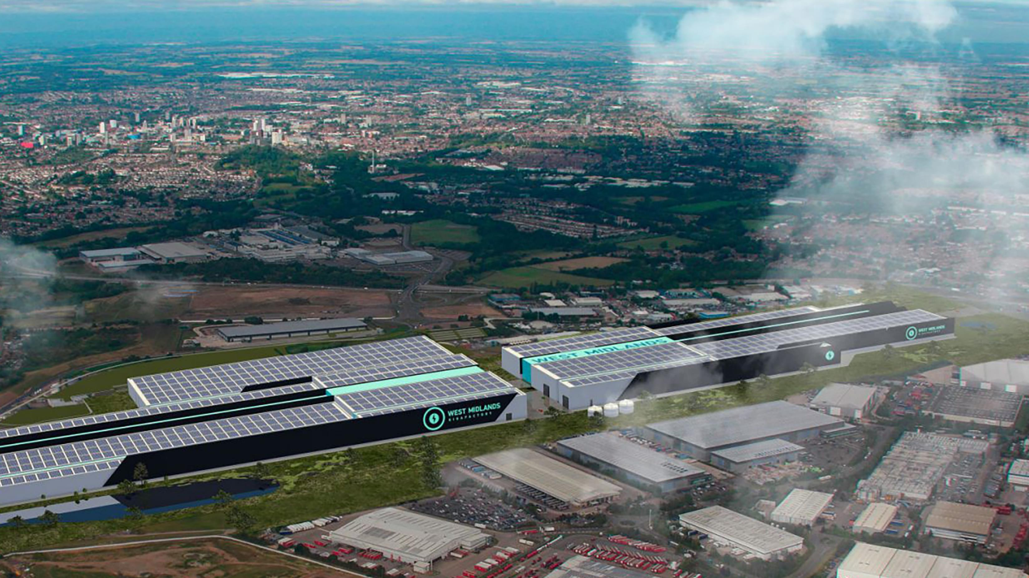
Electrification, energy generation and storage
The Midlands’ low carbon economy is worth £12 billion and growing. The Midlands hosts a number of research centres dedicated to driving the transition to a low carbon economy. The UK Battery Industrialisation Centre (UKBIC), located in Coventry, is the national battery manufacturing scale-up facility. UKBIC is a £130 million, 20,000m² pioneering facility, which provides the missing link between battery technology at laboratory or prototype scale, through to successful mass production. UKBIC is a key part of the Faraday Battery Challenge, a UK Government programme to fast-track the development of cost-effective, high-performance, durable, safe, low-weight and recyclable batteries.
The UK’s largest windfarm is in the East Midlands, providing 18% of UK renewables capacity.
30% of renewable electricity generated in the Midlands comes from wind, and 25% from solar.
The UK Battery Industrialisation Centre is a £130m, 20,000m² facility supporting battery manufacturing in the UK.
The Energy Research Accelerator has delivered over £110m in industrial co-investment, supporting product development and large-scale demonstrator projects.

Slide 13
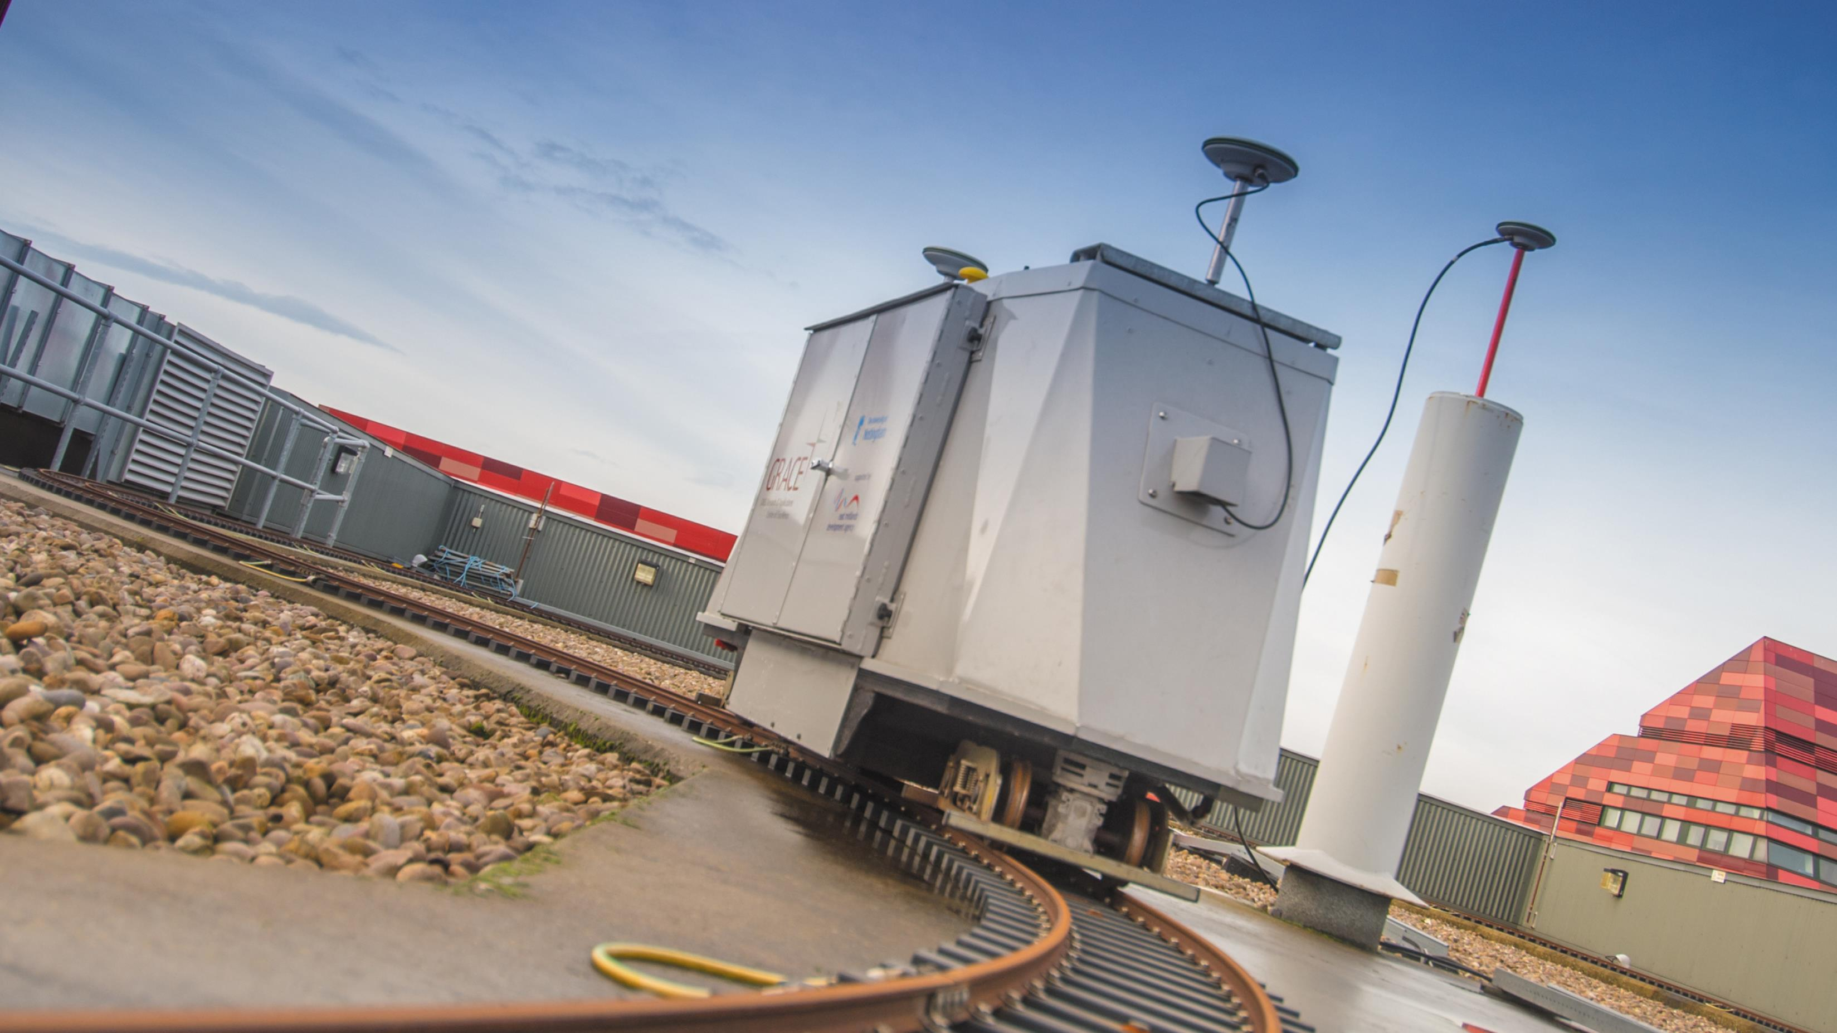
Digital and Artificial Intelligence
The Midlands is recognised as a centre of excellence in digital innovation, with the sector employing nearly 129,000 people, in 20,000 firms, and generating just over £9.5bn in GVA. Over 96% of premises in the Midlands have access to superfast broadband – facilitating the use of digital technology and Artificial Intelligence (AI) to support innovation clusters of transport technology expertise, invention and talent.
The connected and self-driving vehicle technologies industry is estimated to be worth £52bn nationally by 2035.
The West Midlands has more AI businesses than Cambridge.
The digital sector employs nearly 129,000 in the region.
Over 96% of businesses in the Midlands have access to superfast broadband.

Slide 14
Propulsion
The APC, since 2013 has:
Facilitated
£1.3bn
of investment.
Supported nearly 200 individual
projects.
Propulsion innovation in the transport sector focuses on developing advanced technologies to propel vehicles efficiently and sustainably. It encompasses a range of solutions aimed at reducing emissions, increasing energy efficiency, and improving overall performance.
450 organisations,
from SMEs to volume vehicle manufacturers.
Safeguarded 55,000 jobs.
Saved over 350 million
tonnes of CO₂.
Taken the equivalent of
14.1m cars off the road.
There are more
EV charge points in the Midlands, like for like, than Brussels, Boston and Barcelona.
Over 92,000 Ultra Low
Emission Vehicles are registered in the Midlands.
Coventry is on track to becoming the UK’s first all-electric bus city by 2025, with up to 300 zero-emission buses.
The University of Birmingham developed the UK’s first hydrogen-powered train in collaboration with Porterbrook.

Slide 15
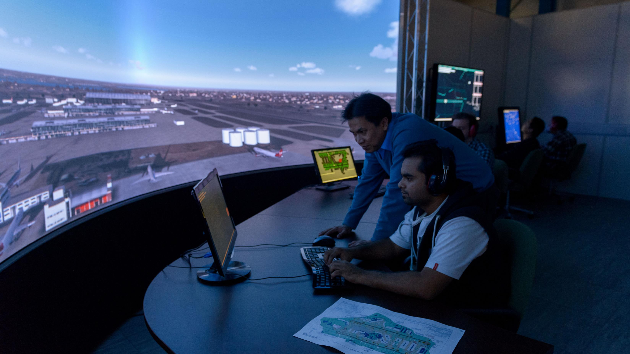
Invest in a partnership with Midlands universities

Slide 16
Research translation
Universities in the Midlands have an exceptional track-record of working with the world’s largest companies, helping translate fundamental research into industry-leading innovations.
The University of Warwick and the University of Nottingham are both in the Top 5 recipients of the £885m of Innovate UK Funding allocated across the UK in the last 10 years.

Slide 17
Innovation
Midlands universities have been supporting the innovation eco-system of their local and regional economies for decades. If your business is looking to access innovation support chains, our dedicated support programmes, funding and networks can help you do this. Through co-funded Government schemes like Knowledge Transfer Partnerships (KTPs), which is one of the most successful, long-running innovation schemes anywhere in the world, we help business of all sizes to innovate using the knowledge and expertise of UK universities.
Case study
Aerospace Unlocking Potential (Aerospace UP) is a £20 million three-year project supporting the aerospace SME supply chain in the Midlands. It provides free access to expert support, events and workshops covering a range of subjects across business and aerospace, as well as grants of up to £100,000 to support innovation and business growth. The Delivery Team at Aerospace UP can create fully tailored support packages to address specific business needs. The team of experts are drawn from the University of Nottingham and the Midlands Aerospace Alliance.

Slide 18
Innovation
Case study
Aston University entered into a three year knowledge transfer partnership with Aurrigo, a division of the Richmond Design and Marketing Group (RDM) through the College of Engineering and Physical Sciences. Led by Aston’s Computer Science department, the KTP’s purpose is to develop and implement a sophisticated machine vision solution for autonomous vehicles in the Low-Speed Autonomous Transport Systems (L-SATS) sector. The project puts forward the development of intelligent systems with perception and autonomous decision capabilities in order to navigate the presence of static and dynamic obstacles while following higher level directions. Further benefits of the KTP will include higher levels of safety in operating autonomous vehicles, delivery of L-SATS into mixed environments, and low cost alternatives to high-cost detection systems.

Slide 19
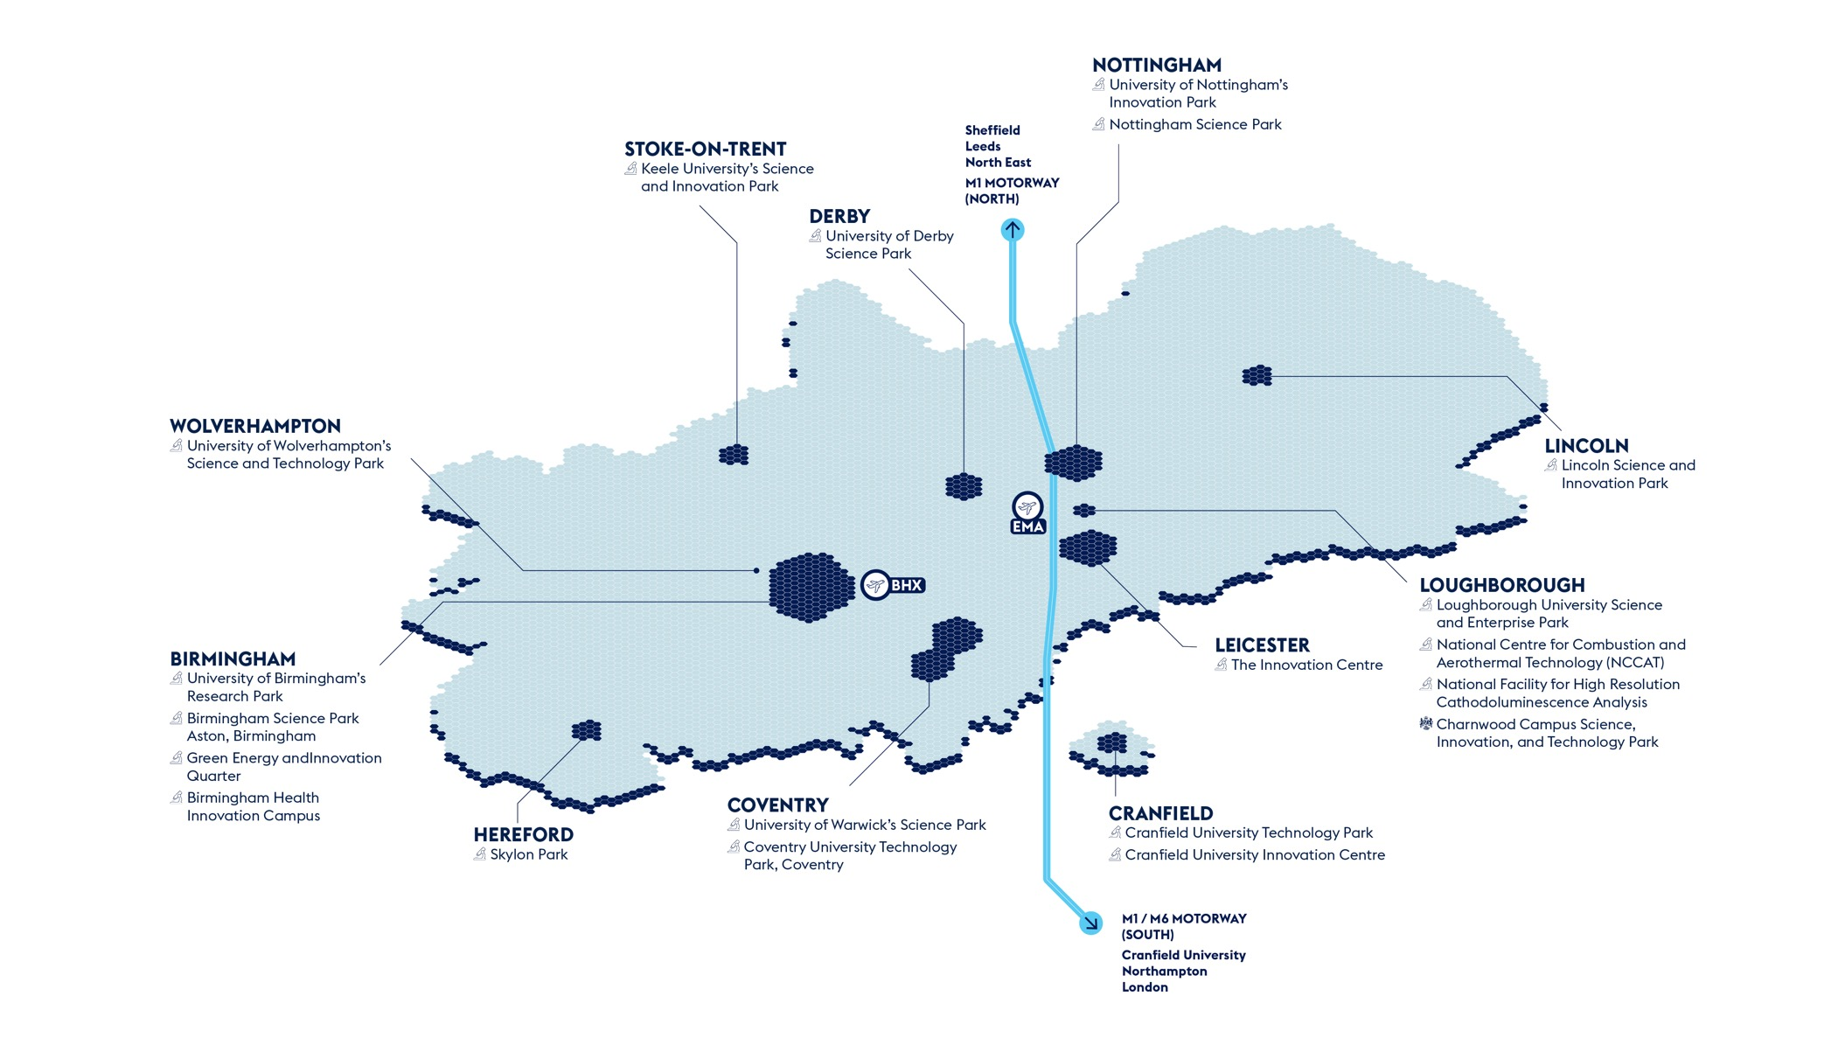
Co-location

Slide 20
Regeneration and integration
Case study
Universities across the Midlands work in partnership with the UK and Local Government to help drive economic growth through innovation and inward investment. Through a range of public-private partnerships, universities are involved in over 20 major economic development opportunities identified by the Midlands Investment Portfolio, worth over £10bn in Gross Development Value. In the West Midlands, universities work with the Combined Authority and Growth Company to work on a range of projects as a part of one of only three UK Innovation Accelerators.
The WMG Skills Centre has been created to deliver expert-led, flexible and cutting-edge short courses designed for groups and individuals who will shape the future of business and industry.
The University of Derby leads the Nuclear Skills Academy in partnership with Rolls Royce. It is the first of its kind and aims to sustain nuclear capability within the UK’s submarines programme by creating a dedicated pipeline of apprentice talent at the start of their careers.

Slide 21
Talent
Home to 20 universities, the Midlands hosts over 350,000 students and 100,000 graduates a year.
Case study
The University of Derby, Loughborough University, Derby College, and Loughborough College are working together on the £13 million East Midlands Institute of Technology to create a highly advanced workforce ready to lead Industry 4.0, with a focus on critical engineering, manufacturing, and digital skills. Specialist skills programmes will include engineering and manufacturing technologies; information and communication technology; science, mathematics, and construction; and planning and the built environment.
The Institute will work closely with global firms leading in the transport sector like Rolls Royce and Toyota, as well as others like Uniper, Fujitsu, Alstom, National Grid ESO, and Bloc Digital.

Slide 23
Midlands Mindforge - £250m patient capital fund combining the spinout portfoliosof eight leading UK universities
Midlands Mindforge is an ambitious, patient capital investment company aiming to transform ground-breaking science and technology into successful businesses with the potential to positively impact our world and accelerate the commercialisation of research from our partner universities - Aston, Birmingham, Cranfield, Keele, Leicester, Loughborough, Nottingham, and Warwick.
By providing capital and company-building skills to university spinouts and early-stage IP rich businesses in the Midlands, we will build the foundations of a new technology eco-system in the region and create companies that can drive economic growth whilst delivering real-world impact.
enquiries@midlandsmindforg

Slide 24
Midlands Mindforge - £250m patient capital fund combining the spinout portfoliosof eight leading UK universities
Midlands Mindforge is an independent company that aims to raise up to £250m from strategic corporate partners, institutional investors and qualifying individuals.
Mindforge will “invest with impact” to found and scale transformational science backed companies in sectors such as Clean Technologies, AI and Computational Science, Life Sciences and Health Tech, to create highly skilled jobs and support the UK’s ambition to become a science and technology superpower.
enquiries@midlandsmindforg

Slide 25
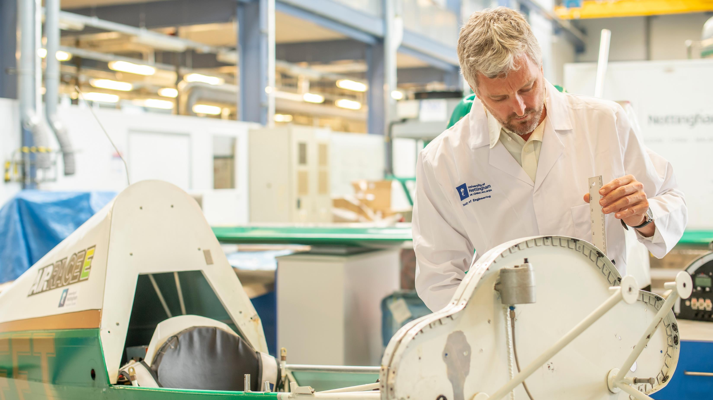
Directory of key transport technology R&D assets across the Midlands

Slide 26
Sectors
Aerospace
The Midlands has a number of world class research facilities that businesses can collaborate with - all dedicated to helping the aerospace sector in the Midlands remain at the forefront of technology.
An investment opportunity: Jet Zero at the University of Nottingham
The £40 million (US$50 million) Power Electronics and Machines Centre (PEMC) offers purpose-built laboratories for the Power Electronics, Machines and Control research group – the largest such group of researchers in the world. It hosts the UK Government-funded Driving the Electric Revolution Industrialisation Centre – Midlands (DER Midlands Industrial Centre) which is developing technology and manufacturing processes for advanced electrical machines and drives.
The building also houses the 20MW UK Electrification of Aerospace Propulsion Facility (UKEAPF) which will offer large-scale industry testing, the likes of which no other research institute in the world can offer.
By March 2024, the University of Nottingham will have aligned £470 million worth of industrial work with the PEMC facility, and with the support of partners its ambition is to make the East Midlands the world’s foremost location for low-carbon aerospace innovation.

Slide 27
Sectors
Aerospace
Investor support
Global Research Airport at Cranfield University
Cranfield University’s own airport offers a unique environment for transformational research in the aerospace sector.
As one of the few universities in the world with its own airport, Cranfield is at the forefront of aerospace technology, working to address the challenges of digital aviation and rethink the airports, airlines, airspace management and aircraft of the future.
Located in Bedfordshire, Cranfield works closely with business, industry, and governments across the world. From the development of Volante Vision Concept with Aston Martin and Rolls-Royce to the £67 million Digital Aviation Research and Technology Centre, Cranfield offers teams of experts from a range of skill sets, often in collaboration with other universities and consultants to meet any aerospace challenges that a business can face.
Research assets
University based
Catapults and other research collaboration opportunities
Cluster organisations

Slide 28
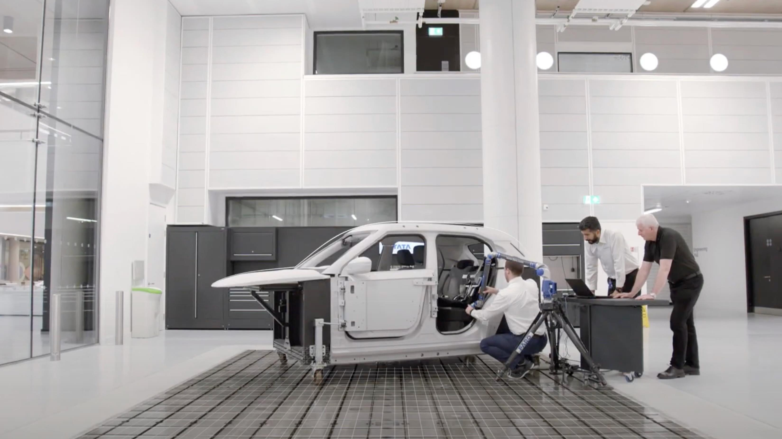
Sectors
Automotive
Businesses can work with a range of research and development facilities, which can help them translate their research, innovate their product, or co-locate to access research facilities, and a skilled community of experts. Companies could choose to invest in the Net Zero transport investment opportunity in Coventry and Warwickshire, test their vehicles at one of National Wind Tunnel test centres, or develop new manufacturing processes with experts at the National Automotive Innovation Centre.
The National Automotive Innovation Centre
The £180m National Automotive Innovation Centre, at Warwick University, in Coventry, is the single largest automotive research centre in Europe – a partnership between WMG, Jaguar Land Rover, and the Tata Motors European Technical Centre. There are over 1,000 designers, engineers and researchers at the Centre, working on a range of future vehicle and mobility solution projects, alongside SMEs, large manufacturers, and governments.
Elsewhere, on the Warwick University Wellesbourne Campus, is the Lotus Advanced Technology Centre. There are 130 highly qualified engineers co-located on site, focused on developing new technologies for the automotive industry, such as lightweight materials, new manufacturing processes, and new powertrains.

Slide 29
Sectors
Automotive
An Investment Opportunity - Net Zero transport in Coventry and Warwickshire
Green transport is driving the UK towards Net Zero, and Coventry and Warwickshire offer an ecosystem for developing and deploying Net Zero transport technologies.
Companies seeking to locate in Coventry and Warwickshire can tap into first-class research universities with strong links to industry, a leading cluster of public and private R&D assets, and opportunities to connect with a robust supply chain of transport technology businesses.
Coventry and Warwickshire is a global centre of future mobility R&D in many sectors, including aerospace, automotive, rail, marine propulsion and last mile delivery. This has given the region key capabilities and experience across:
light-weighting
battery technology
hydrogen
connected and automated mobility (CAM) technologies
Investor support
Research assets
University based
Catapults and other research collaboration opportunities

Slide 30
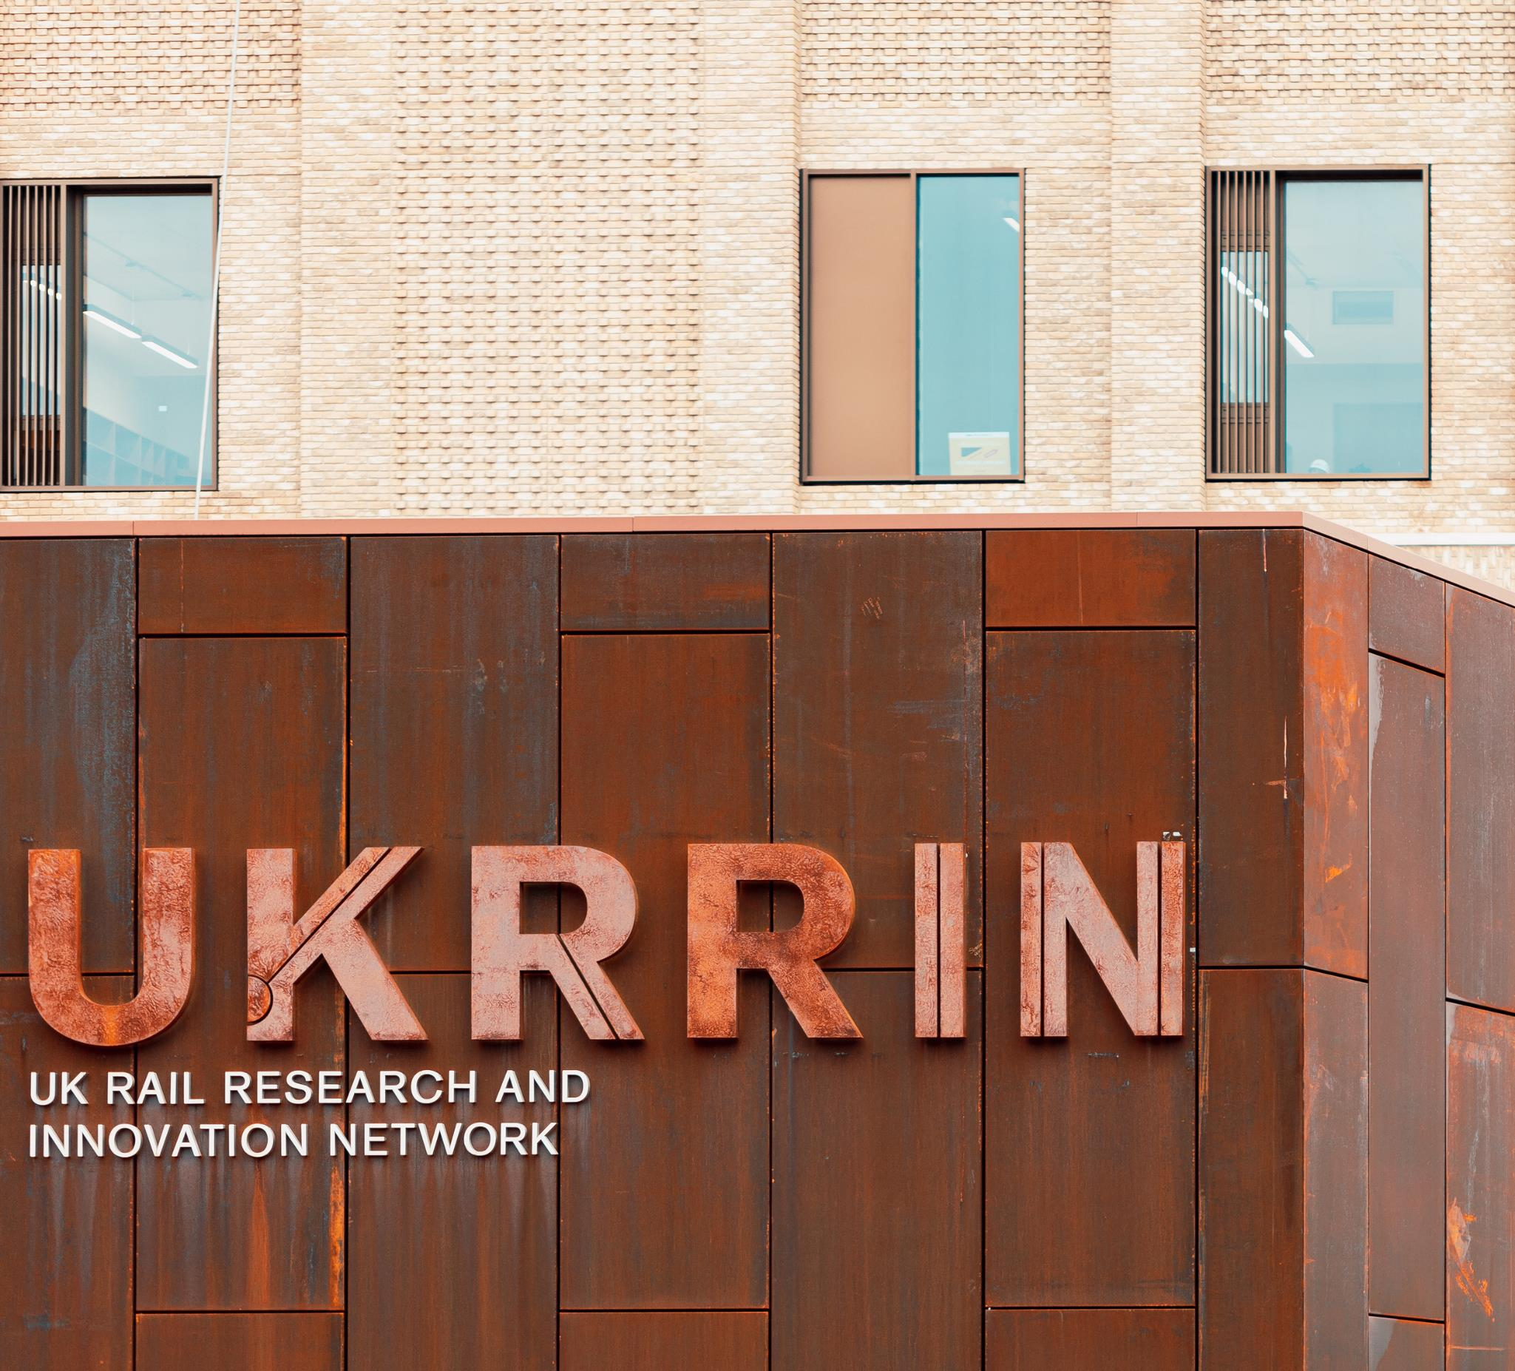
Sectors
Rail
Home to over 600 businesses, the rail sector in the Midlands offers a wide range of opportunities for investors to grow their business. Manufacturing hubs, such as those connected to Bombardier in the East Midlands, allow businesses to access extensive supply chains, while the Birmingham Centre for Railway Research is driving internationally recognised innovation in the sector.
Birmingham Centre for Railway Research and Education
The Birmingham Centre for Railway Research and Education (BCRRE) is Europe’s largest academic-based group that provides world-class research, education, and innovation to the global rail industry, with over 180 researchers and 57 live projects. The BCRRE demonstrated the UK’s first Hydrogen Train at COP26. The train is now ready to be commercialised.
BCRRE is also the lead academic partner in the £92m UK Rail Research and Innovation Network (UKRRIN), a collaboration between academic centres of excellence and the rail industry. UKRRIN is revolutionising innovation in the rail industry by bringing together academia with industrial partners from all over the supply chain. Industry members of UKRRIN can: access world-class research capabilities and facilities; understand where key rail relevant research capabilities and facilities are in the UK; and, develop opportunities to showcase new technology.

Slide 31
Sectors
Rail
Investor support
Research assets
University based
Catapults and other research collaboration opportunities
Cluster organisations

Slide 32
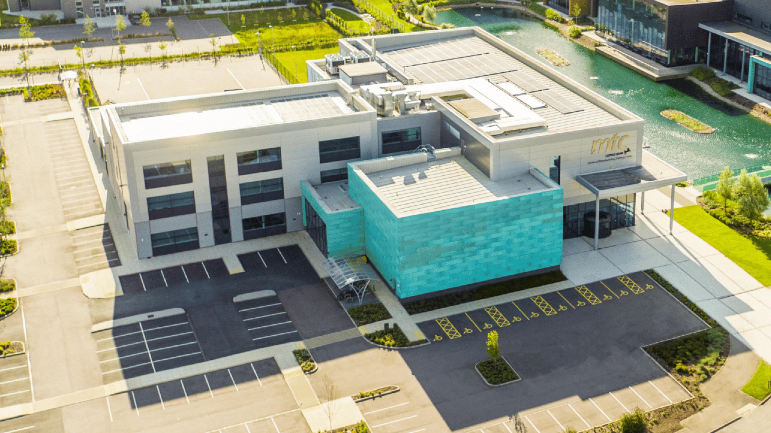
Enablers
Advanced manufacturing
Manufacturing Technology Centre (MTC)
Opened in 2010, in Coventry, the MTC was established with the objective of bridging the gap between academia and industry – a gap often referred to as ‘the valley of death’. The MTC develops innovative manufacturing processes and technologies. Since opening, the MTC’s rapid growth has seen the expansion of their campus with the construction of three more facilities, including the opening of the Advanced Manufacturing Training Centre and the National Centre for Additive Manufacturing. The MTC supports not only R&D but also training, advanced manufacturing management and factory design, with over 700 skilled engineers working across the MTC estate.
The MTC SME Support team was formed to work directly with SMEs – be they start-ups, going through scale-up pains, or looking to mature into larger established businesses. Manufacturing SMEs are able to draw on the extensive resources of the MTC to address practical, technical, and strategic manufacturing challenges. The MTC now helps 100s of SMEs every year to embed innovation and new ways of working, increase their competitiveness, and accelerate their growth.
Research assets
University based
Catapults and other research collaboration opportunities

Slide 33
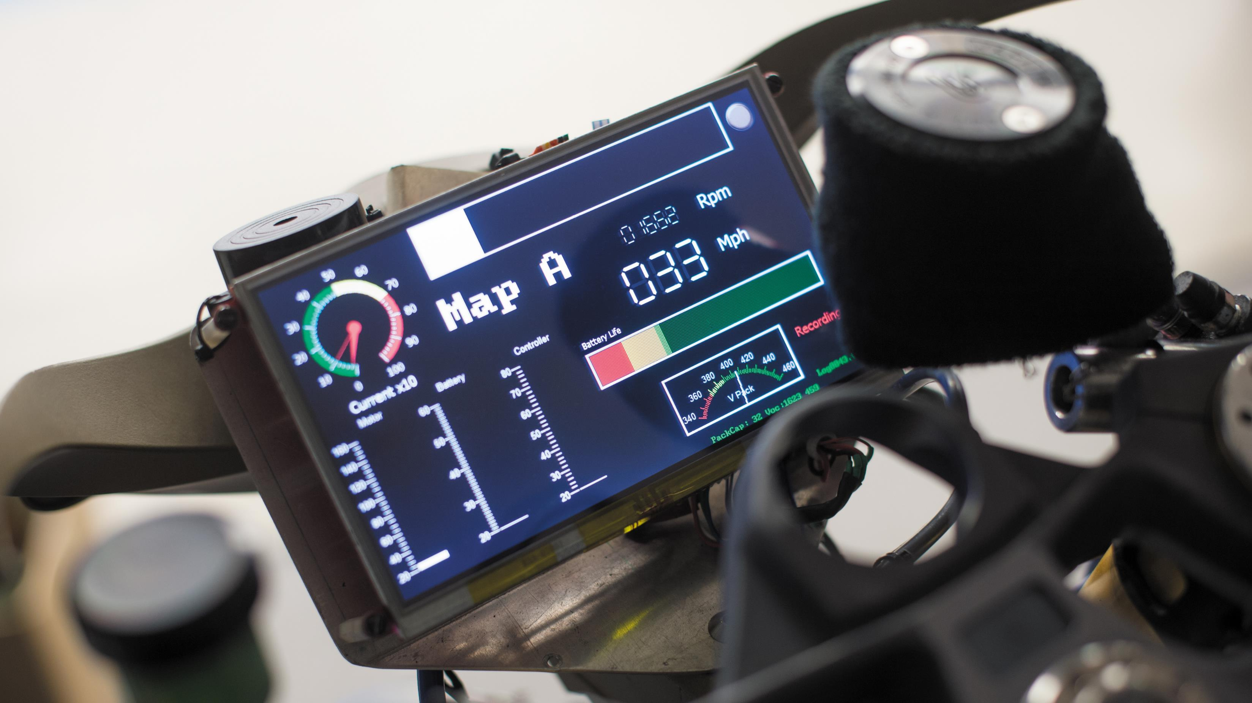
Enablers
Electrification, energy generation and storage
The UK Battery Industrialisation Centre (UKBIC)
The £130 million UKBIC is a pioneering concept in the race to develop battery technology for the transition to a greener future.
The unique facility provides the missing link between battery technology, which has proved promising at laboratory or prototype scale, and successful mass production. Based in Coventry, the publicly-funded battery product development facility welcomes manufacturers, entrepreneurs, researchers and educators, and can be accessed by any organisation with existing or new battery technology – as long as that technology will bring green jobs and prosperity to the UK.
UKBIC is a key part of the Faraday Battery Challenge (FBC), a Government programme to fast track the development of cost-effective, high-performance, durable, safe, low-weight and recyclable batteries.
Research assets
University based
Catapults and other research collaboration opportunities
Cluster organisations

Slide 34
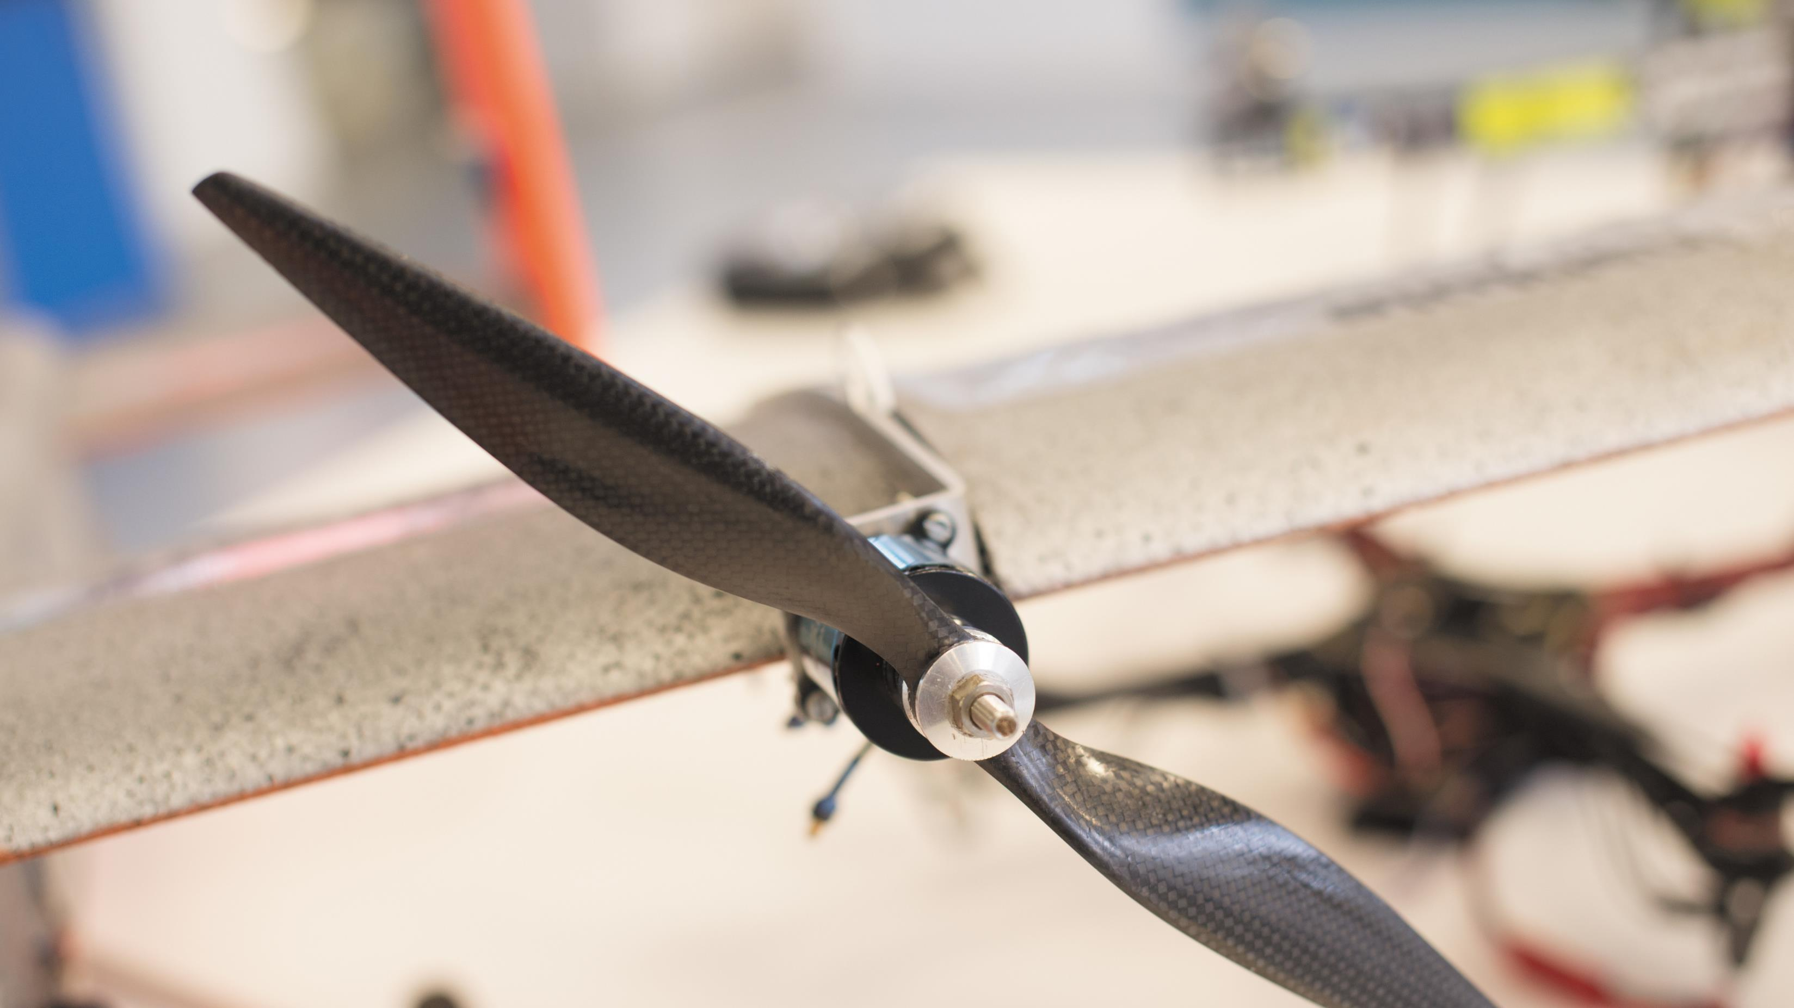
Enablers
Digital and AI
Midlands Future Mobility – Coventry
Midlands Future Mobility (MFM), based at Coventry University, offers a wide range of connected and automated mobility (CAM) development and trialling services, from initial virtual development through to real-world trials and market deployment. Through combined expertise and a comprehensive on-road trialling environment, covering over 200 miles (350 kilometres), MFM is ideally placed for businesses developing the future of mobility. Midlands Future Mobility brings together leading organisations from the automotive, transport, communications, infrastructure and research sectors by creating an extensive connected platform for the development of future CAM solutions.
Covering a diverse road network including urban, inter-urban, campus and highways, MFM’s real-world, connected trialling environment is the most comprehensive of its kind. Through extensive services in test and trial development, vehicle centre and testing platforms, 5G research, simulation, and human factors, MFM can support businesses in bringing new CAM technologies to market. The UK industry is set to be worth £52bn by 2035, with £200m currently committed by government and industry to support MFM.
Research assets
University based
Catapults and other research collaboration opportunities

Slide 35
Enablers
Digital and AI
Investment Opportunity – Connected and Automated Mobility modelling and simulation in Oxfordshire and the Midlands
Companies in the connected and automated mobility (CAM) Testbed UK region of Oxfordshire and the Midlands are leading the move to zero emission vehicles and green public transport. CAM Testbed UK offers investors the opportunity to develop connected and automated mobility technologies from concept to commercialisation. CAM Testbed UK is offering six world-leading facilities for the modelling, simulation, testing, development and deployment of connected and automated mobility solutions.
The Testbed runs from London through Oxfordshire and into the Midlands. It offers investors access to an advanced, comprehensive, and coordinated CAM testing ecosystem, a world-class academic research community, a growing industry cluster and an impressive talent base.
The global market for CAM technologies will be £100 billion by 2035 and £6.4 billion in the UK alone. CAM Testbed UK enables technologies to be developed, tested, and proven, so they are ready to deploy in global markets.
Research assets
University based
Catapults and other research collaboration opportunities

Slide 36
Enablers
Digital and AI
Research assets
University based
Catapults and other research collaboration opportunities
Local and national government support
The region has a well-funded R&D base with a joint UK government and industry commitment of £440 million into more than CAM 90 projects. These involve more than 200 organisations working on self-driving and connected technologies. Local government partners can also support investors with recruitment and training, access to finance, site selection, and engagement with testbed facilities, universities and supply chain partners.

Slide 37
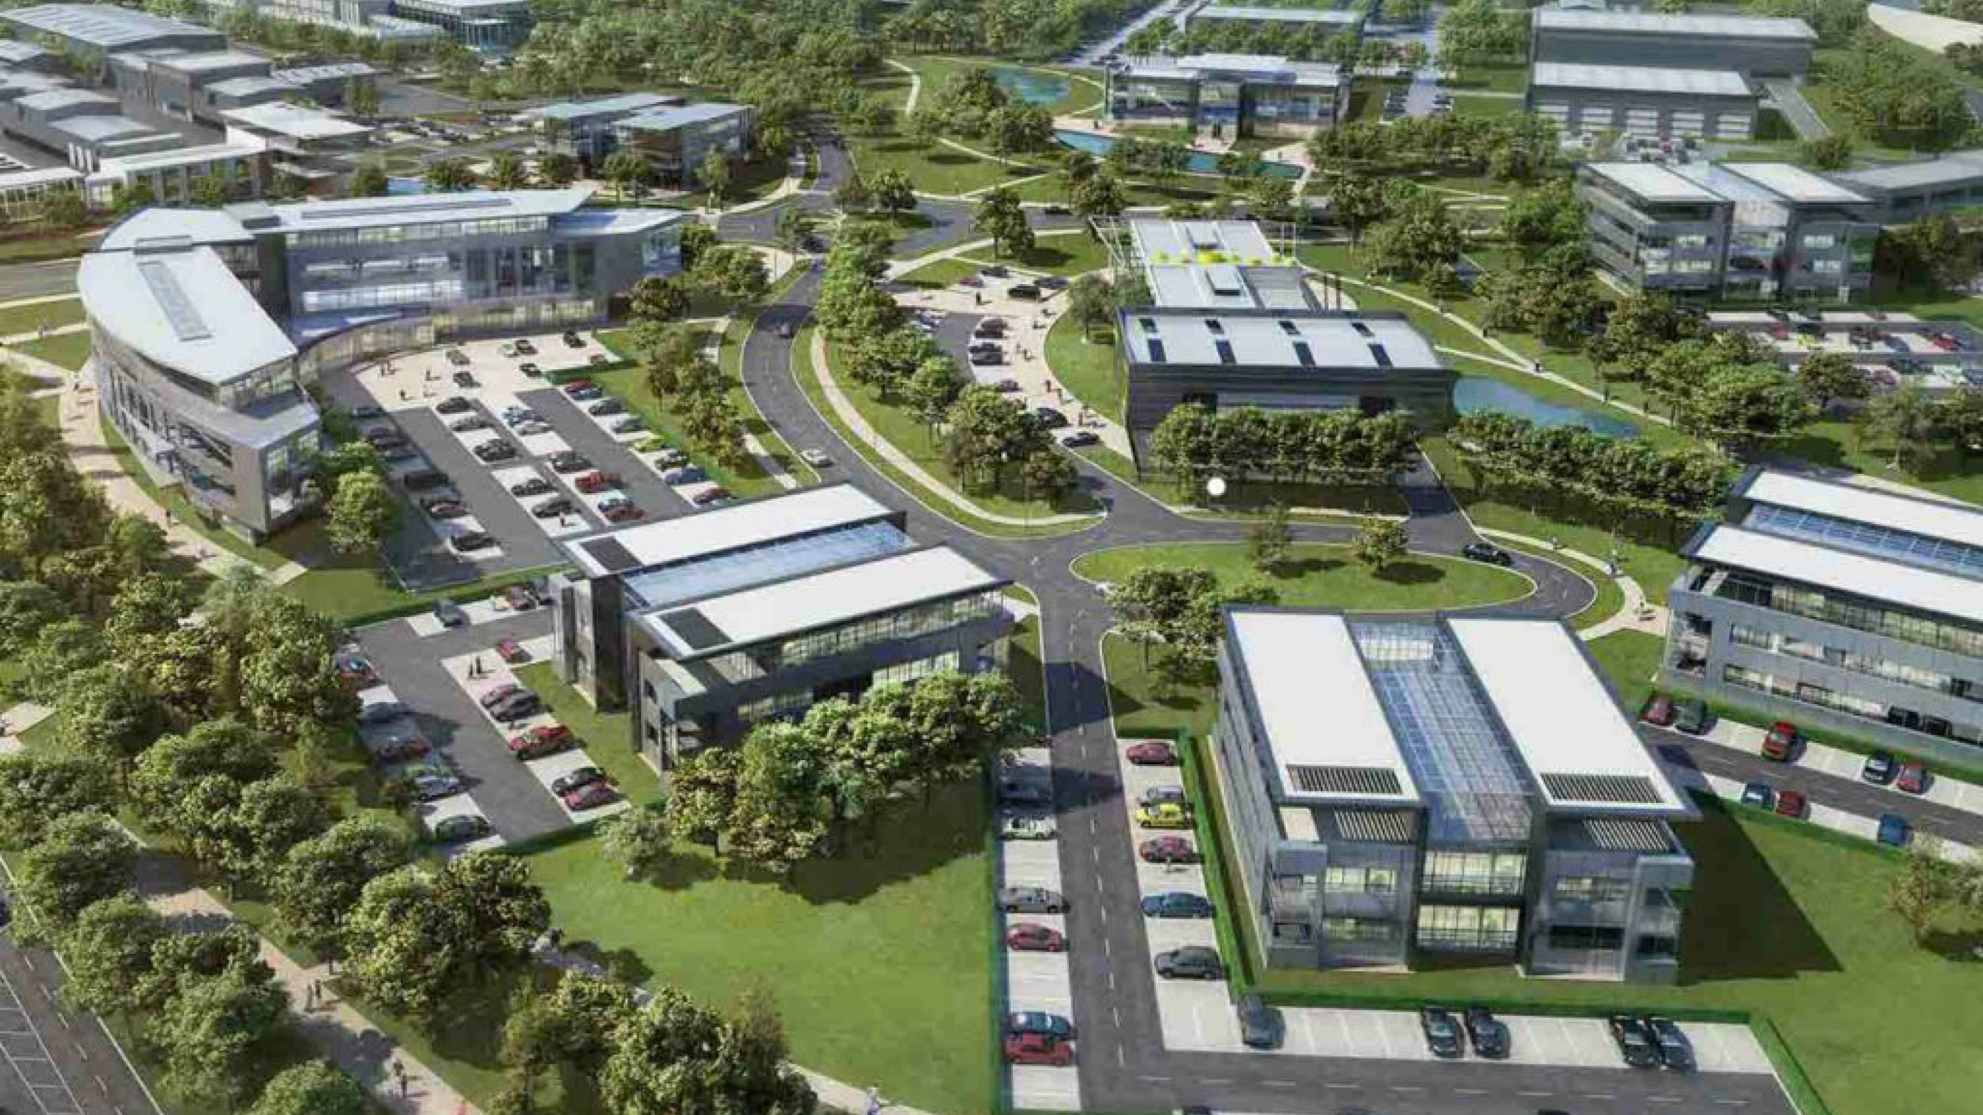
Enablers
Propulsion
Research assets
Catapults and other research collaboration opportunities

Slide 38
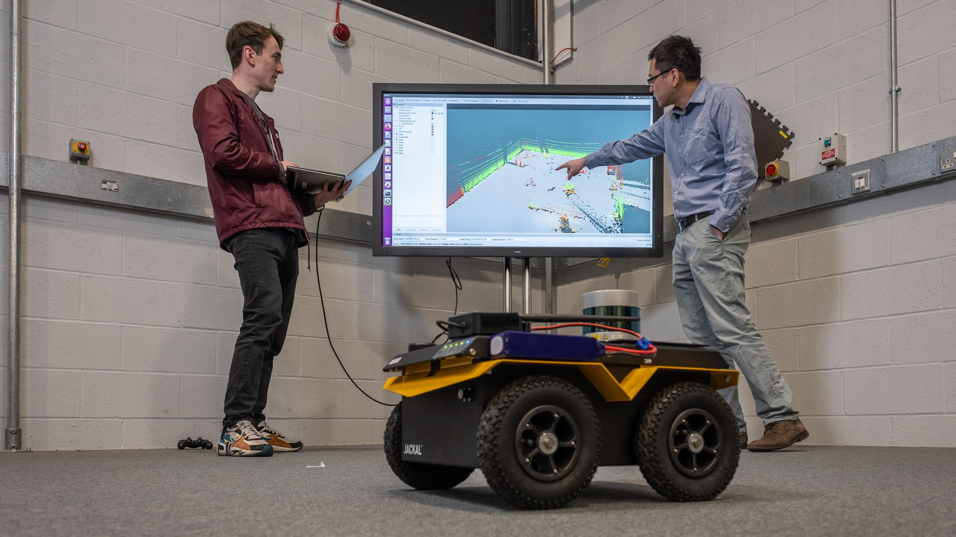
Work with us

Slide 39
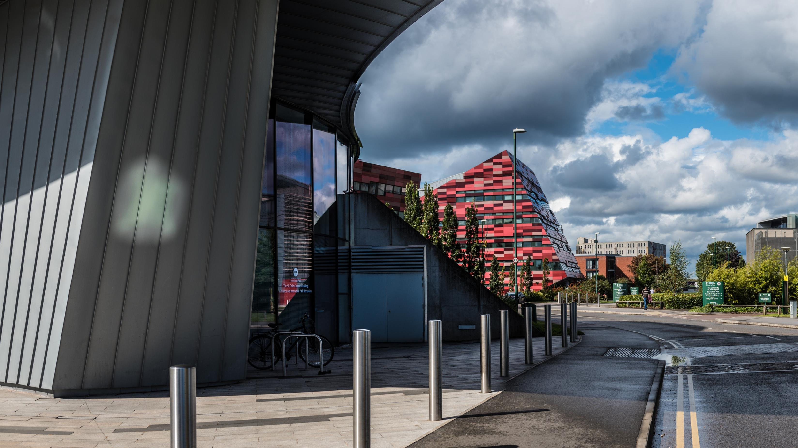
Our universities
From the Midlands, 90% of the UK’s population and businesses are less than a four-hour drive away; 45% of heavy rail freight and 33% of heavy road freight comes from, goes to, or passes through the Midlands and, with the advent of HS2, London will be less than an hour away. By air, the Midlands is home to two international airports – Paris is just a 90 minute flight away – with access to the seaports of the Humber. The Midlands are home to 11 million people, 15% of the UK’s GVA, and the only inland freeport. This is critical to dispersing the output of the Midlands and accessing the potential markets of not only the wider UK, but Europe and international buyers. The region is constantly growing with new development sites and spaces for bespoke builds, including labs, test spaces, and offices.

Slide 40
Directory of contacts across the Midlands
University | Business engagement and Technology Transfer | Careers service
Aston University | rke@aston.ac.uk | employerteam@aston.ac.uk
University of Birmingham | info@enterprise.bham.ac.uk | recruiters@contacts.bham.ac.uk
Coventry University | ei@coventry.ac.uk | talentteam@coventry.ac.uk
Cranfield University | business@cranfield.ac.uk | cranfieldcareers@cranfield.ac.uk
De Montfort University | businessservices@dmu.ac.uk | employerliaison@dmu.ac.uk
University of Derby | businessgateway@derby.ac.uk | employerteam@derby.ac.uk
Harper Adams University | reception@harper-adams.ac.uk | careers@harper-adams.ac.uk
Keele University | gateway@keele.ac.uk | gateway@keele.ac.uk
University of Leicester | redenterprise@le.ac.uk | employer.services@le.ac.uk
University of Lincoln | enterprise@lincoln.ac.uk | careers@lincoln.ac.uk
Loughborough University | innovation@mailbox.lboro.ac.uk | employer.services@lboro.ac.uk
University of Nottingham | workwithus@nottingham.ac.uk | recruiterservices@nottingham.ac.uk
Nottingham Trent University | workingwithyou@ntu.ac.uk | talent@ntu.ac.uk
University of Warwick | ventures@warwick.ac.uk | employerconnect@warwick.ac.uk
University of Wolverhampton | engage@wlv.ac.uk | theworkplace@wlv.ac.uk
University of Worcester | researchforbusiness@wor.ac.uk | careers@worc.ac.uk
Aston University | rke@aston.ac.uk | employerteam@aston.ac.uk

Slide 41
Science Park Contacts
University | Science or Technology Park
Birmingham Science Park Aston, Birmingham | info@astonsciencepark.co.uk
Birmingham Research Park, Birmingham | brpl@bham.ac.uk
Coventry University Technology Park, Coventry | +44 (0) 2476236000
Cranfield University Technology Park, Bedfordshire | joshua.parello@kirkbydiamond.co.uk
The Innovation Centre, Leicester | innovationcentre@dmu.ac.uk
University of Derby Science Park | +44 (0) 1332 742 800
INFINITY Park, Derby | ssalloway@salloway.com
Keele University Science and Innovation Park, Staffordshire | gateway@keele.ac.uk
Space Park, Leicester | enquiries@space-park.co.uk
Lincoln Science and Innovation Park | enquiry@lincolnsciencepark.co.uk
Loughborough University Science and Enterprise Park | lusep@lboro.ac.uk
University of Nottingham Innovation Park, Nottingham | reception@unip.nottingham.ac.uk
Nottingham Science Park | regeneration@nottinghamcity.gov.uk
University of Warwick Science Park, Coventry | more-info@uwsp.co.uk
University of Wolverhampton Science Park, Wolverhampton | joinus@wolverhamptonsp.co.uk
Birmingham Innovation Quarter, Birmingham | hello.scitech@bruntwood.co.uk
Skylon Park, Herefordshire | info@skylonpark.co.uk

Slide 42
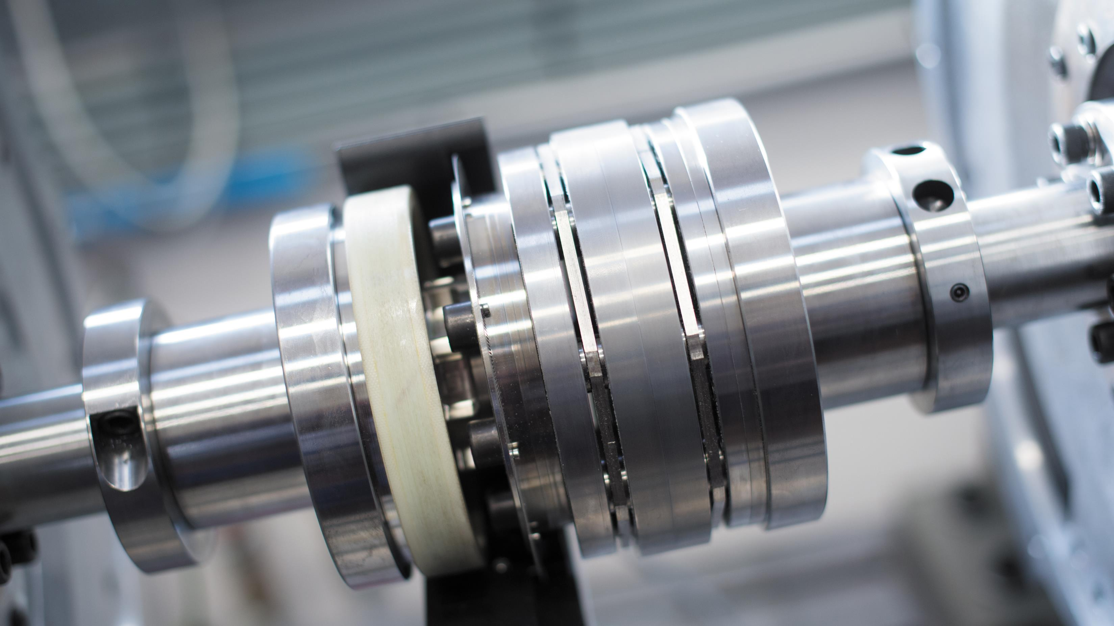
Investment support across the Midlands
Place focused inward investment support
Inward investment is supported by dedicated organisations in other parts of the Midlands, as detailed below.
Destination Chesterfield +44 (0) 1246 207207
Invest Coventry and Warwickshire contact@investcw.co.uk
Marketing Derby invest@marketingderby.co.uk
Invest in Leicester enquiries@investinleicester.com
Invest in Nottingham enquiries@investinnottingham.co.uk
Invest Telford Invest@telford.gov.uk
Invest Shropshire invest@shropshire.gov.uk
Invest Stoke-on-Trent enquiries@investstoke.co.uk
Invest Staffordshire hello@wearestaffordshire.co.uk
Invest in West Midlands invest@wmgrowth.com
Invest Wolverhampton invest@wolverhampton.gov.uk
Invest in Worcestershire +44 (0) 1905 677888
Team Lincolnshire investment@lincolnshire.gov.uk
The West Midlands Growth Company offers investors support to find the right networks, receive advice on locations, secure sector specific market research, identify funding support, and generate publicity.

Slide 43
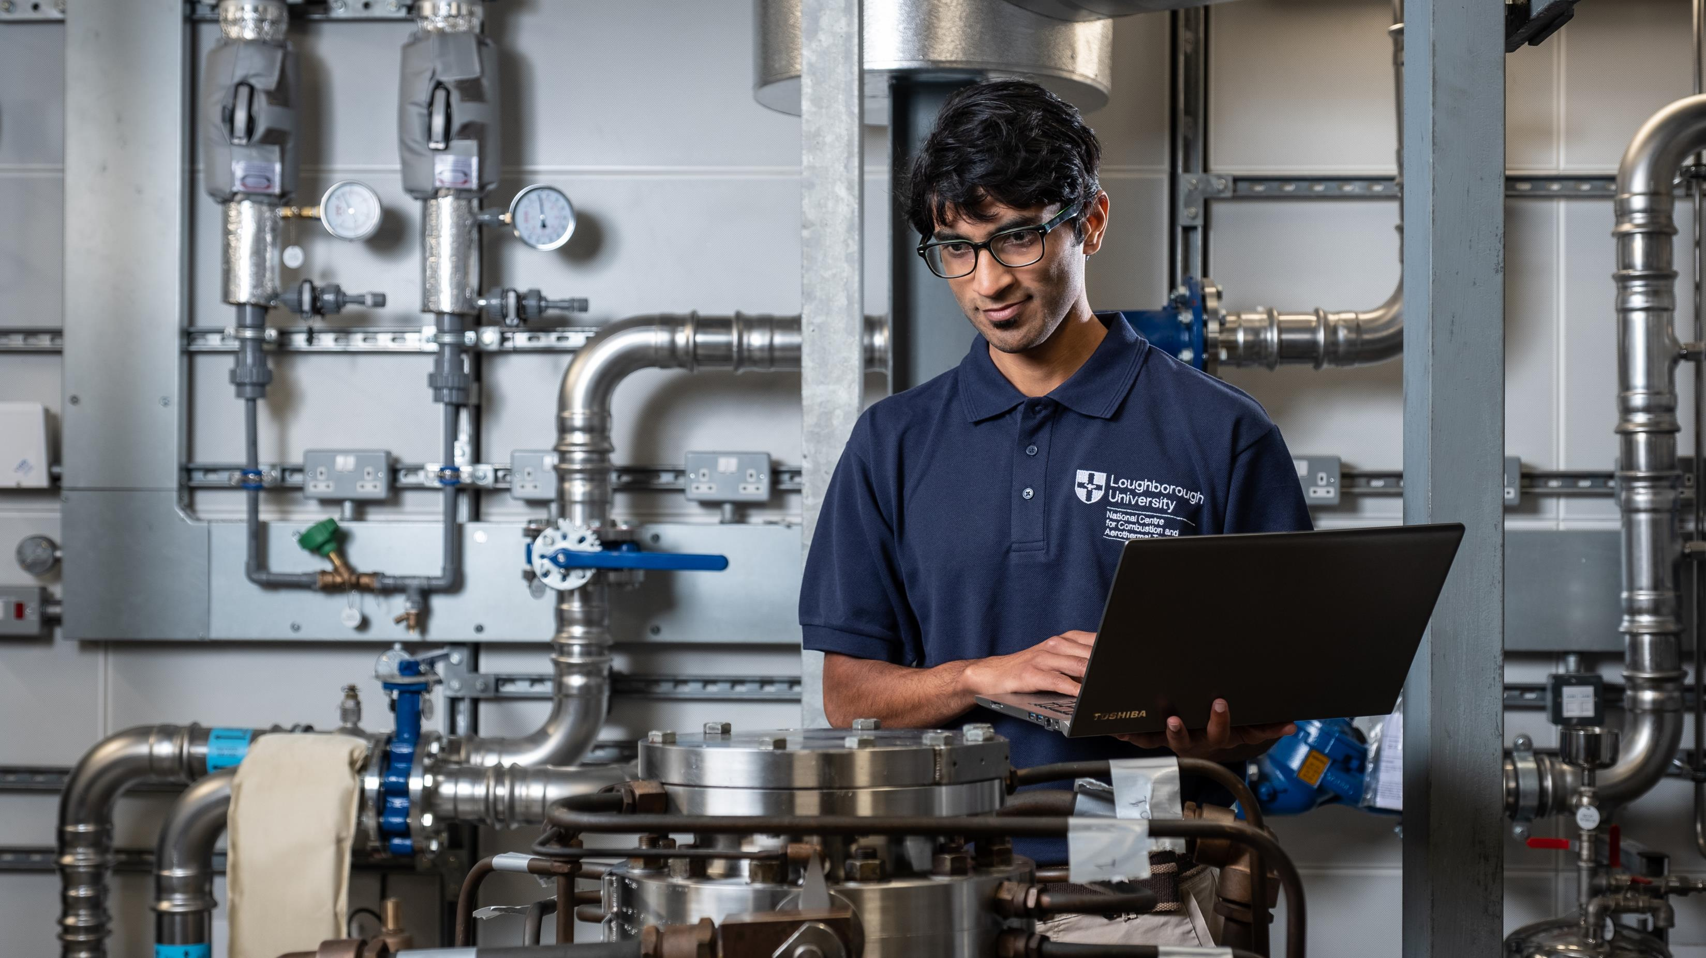
UK Investment Support
The UK’s ability to develop new ideas is one of our great strengths, from the jet engine and the bagless vacuum cleaner to MRI scanners and the world wide web. The UK’s talent pool, funding and incentives and business infrastructure all help create an environment of business innovation. Our commitment to world-leading research and development will help your business reach its full potential. We are one of the most innovative countries in the world - ranked in the top 5 countries in the Global Innovation Index 2019. For companies such as Ford, Pfizer, Eli Lilly, Nokia and Eisai, the UK’s business environment is the natural choice for investment in innovation.

Slide 44
Department for Business and Trade We support growth by backing businesses in the UK and globally, promoting investment and championing free trade.
Disclaimer Whereas every effort has been made to ensure that the information in this document is accurate, the Department for Business and Trade and the Contributors do not accept liability for any errors, omissions or misleading statements, and no warranty is given or responsibility accepted as to the standing of any individual, firm, company or other organisation mentioned.
© Crown copyright 2023 This publication is licensed under the terms of the Open Government Licence v3.0 except where otherwise stated. To view this licence, visit https://www.nationalarchives.gov.uk/doc/open-government-licence/version/3/
Where we have identified any third party copyright information you will need to obtain permission from the copyright holders concerned.
Published by Department for Business and Trade October 2023

